Slide 1

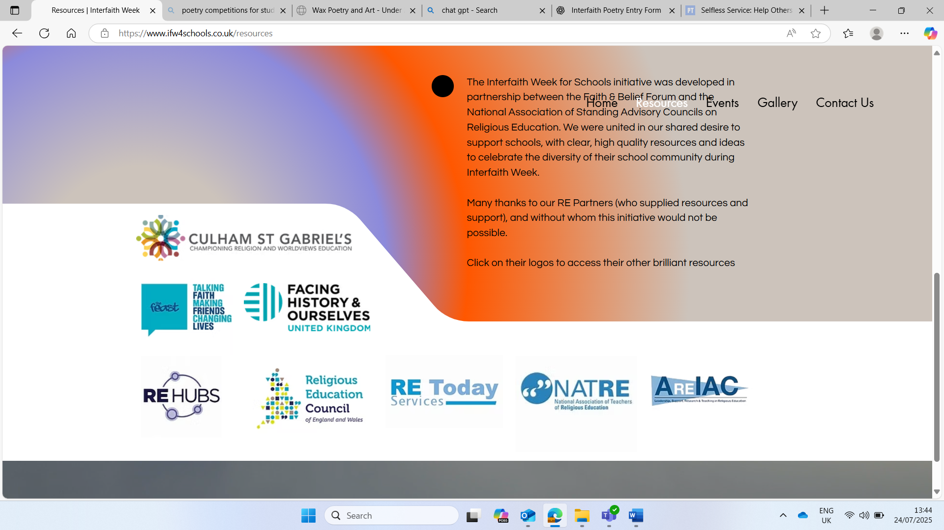

Interfaith Week 2025
Community: Together We Serve
KS3: Introduction
Notes:
This week is Interfaith week, a time when we learn about how people of different religions and beliefs can be friends, work together and help others. This year's theme is Community: Together we Serve, this means helping others and making our community a kinder place, together! We will be looking at people from different faiths, and those of no faith to see what they think about our theme. Throughout the week we will be engaging in Interfaith Dialogue. Interfaith means we will be looking at more than one faith and dialogue means sharing ideas. So we will be sharing ideas about community and service from different faith points of view.

Slide 2
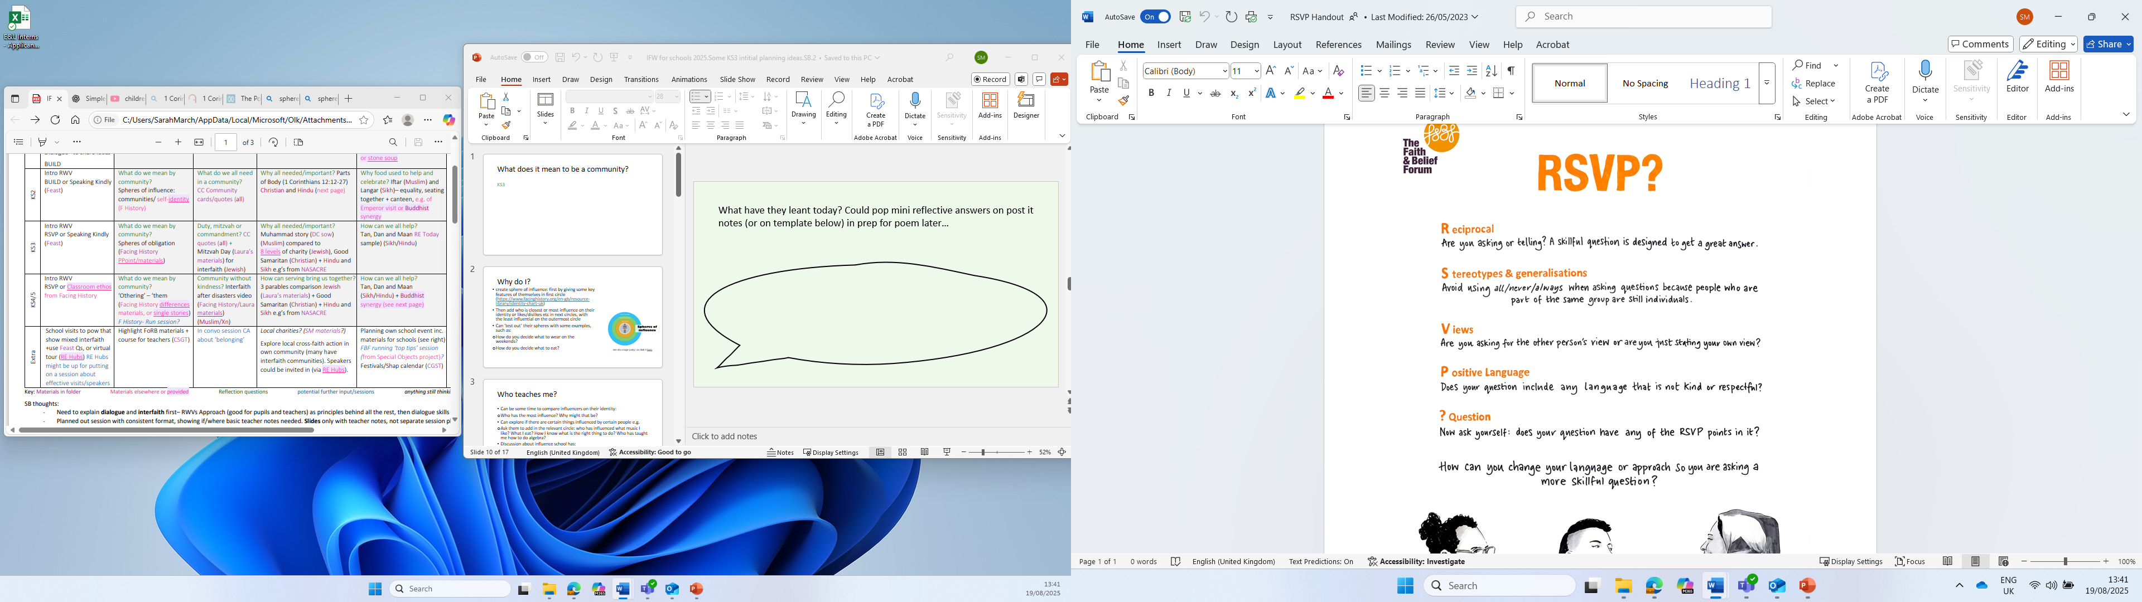
RSVP?
When sharing our own faith and beliefs, it’s important to agree on some ground rules. This helps to ensure that everyone feels comfortable, respected, and able to speak in a brave and safe space.
Look at the RSVP information.
It is important that we all understand and agree to follow these guidelines throughout the session.
Notes:
Ref: Faith and Belief Forum

Slide 3

1.What does it mean to be a community??
Notes:
Ask the pupils for some initial answers to this question, do they know the word? What does it mean to them?

Slide 4
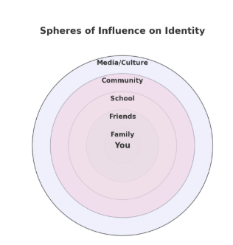
Your sphere of influence
Our identity is shaped by many people and the things around us. These are also known as spheres of influence.
They might include family, friends, school, community, culture, religion or media.
Use the blank diagram to fill in the different spheres of influence in your life with specific examples.
Notes:
Use the example on the slide to help them
REF: Facing history and ourselves

Slide 5
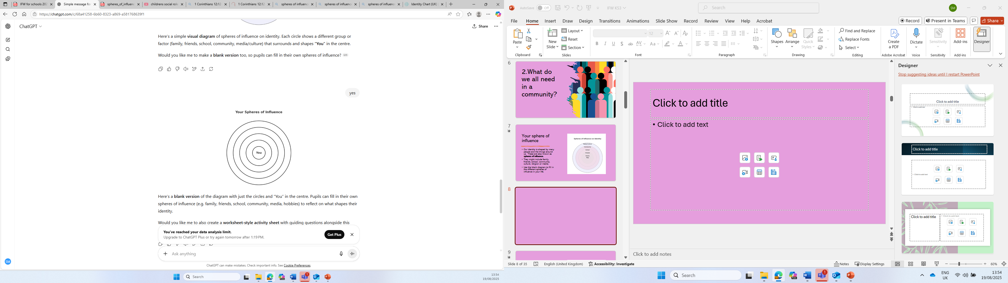
Your sphere of influence
In Circle 1, write your name.
In Circle 2, write the name of people/groups/beings to whom you feel the greatest obligation to or sense of care for – for example, people for whom you’d be willing to take a great risk or put yourself in peril for (you don’t have to write actual names.)
In Circle 3, who are the people/groups/beings on the next level? That is people to whom you have some obligation/responsibility, but not as great as in circle 2.
In Circle 4, who are the people/groups/beings on the next level? People to whom you have some obligation, but not as great as in circle 3.
Notes:
Ref: Facing history and ourselves

Slide 7
Your sphere of influence
Think about the following questions to help you with your spheres.
Who in your family influences the way you think or act?
How do your friends shape your identity?
What role does your school or teachers play in who your becoming?
Does your community, culture or religion influence your values?
How does the media affect the way you see yourself?
Notes:
Use the example on the slide to help them

Slide 8
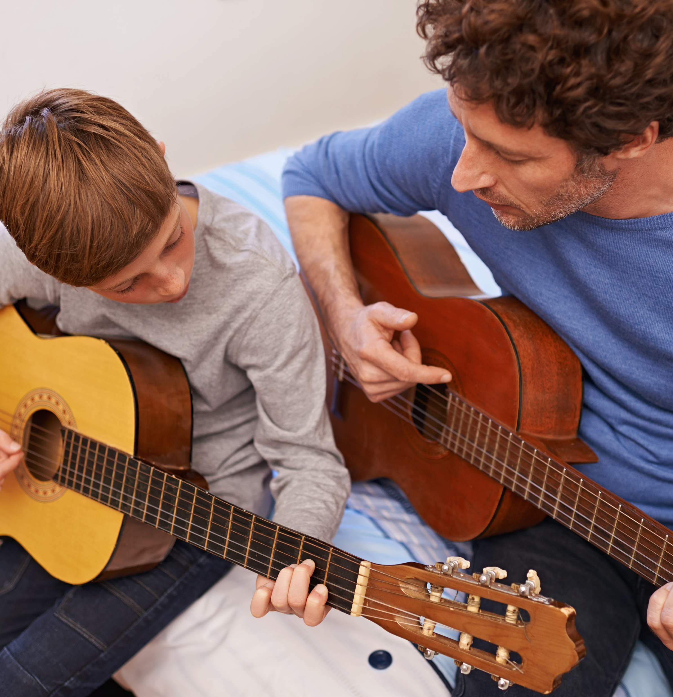

Who influences you?
Who has the most influence on you and why?
Who has influenced what music you like?
What food you like?
How you know right from wrong?
Who has taught you how to read?
Notes:
Allow students time to discuss their spheres with others and then bring them back together for a group discussion on the questions on the slide.

Slide 9

Who influences you?
School
Are there things you have learnt in school you would not have with any of the other influences in your circle? Why?
Why might it be a good thing to have more people to help and learn from?

Slide 10
What does being part of a community mean?
What does the term obligation mean?
Can you define it?
Write a one sentence definition, considering the words duty, responsibility, serve and care.
An act or course of action to which a person is morally or legally bound; a duty or commitment
If you were to complete a sphere of obligation would you have the same information. Why might that be?
Notes:
Check their own definition to the dictionary definition

Slide 11
What does community mean?
Unity: means ‘one’
COM: means ‘with’
COMMUNITY
Look back at your spheres of influence. How many communities can you see?
What are the positives about being part of a community?
Are there any negatives?
Notes:
Explain the etymology of the word community Com: with and Unity: One

Slide 12
Why might it be good to think together as a community?
Refer to RSVP?, are you sticking to the ground rules?
Next session we will be aiming to recognise the importance of looking and listening to others about how they serve and help the community, its important we follow RSVP?

Slide 13

2.What do we all need in a community?
Notes:
Initial thoughts from the pupils. Recap that we will be looking and listening to others about how they serve and help their community.

Slide 14

What do we all need in a community?
Look at the quotes on the following slide.
Complete the table you have been given.
Notes:
Discuss the quotes, check understanding and explain any parts that may be unclear.

Slide 15
Those who see all creatures in themselves and themselves in all creatures will find true unity
Caring for our fellow human beings is our highest calling
Whatever you say should be just, don’t be biased
We don’t believe in God, but we do believe in good
Be truthful and honest. Give people 2nd chances
As each Christian has a physical body through Jesus they form one spiritual body where everyone belongs to each other
In dealing with people, treat them with good and kind manners
Don’t show partiality to the poor or favouritism to the great, but judge all fairly
Always aim at purifying your thoughts and all will be well
Love God and love other people as you love yourself
A friend loves at all times, and a brother is born from a time of adversity
Always speak the truth. God and truth are two and one
Do not harbour evil intentions in your mind towards others
Generosity in everything
Notes:
Ref: REMatters

Slide 16
Quote | Example of this quote in action | Which is the most important for your class and why? | Which is the most important for the country and why? | What faith or belief?
Always speak the truth. God and truth are two and one
Whatever you say should be just, don’t be biased
Don’t show partiality to the poor or favouritism to the great, but judge all fairly
Do not harbour evil intentions in your mind towards others
We don’t believe in God, but we do believe in good
Always aim at purifying your thoughts and all will be well
Generosity in everything
Notes:
Print this slide and slide 15 for the students to fill in

Slide 17
Quote | Example of this quote in action | Which is the most important for your class and why? | Which is the most important for the country and why? | What faith or belief?
Be truthful and honest. Give people 2nd chances
Love God and love other people as you love yourself
Those who see all creatures in themselves and themselves in all creatures will find true unity
As each Christian has a physical body through Jesus they form one spiritual body where everyone belongs to each other
A friend loves at all times, and a brother is born from a time of adversity
Caring for our fellow human beings is our highest calling
In dealing with people, treat them with good and kind manners

Slide 18








Those who see all creatures in themselves and themselves in all creatures will find true unity
Caring for our fellow human beings is our highest calling
Whatever you say should be just, don’t be biased
We don’t believe in God, but we do believe in good
Be truthful and honest. Give people 2nd chances
As each Christian has a physical body through Jesus they form one spiritual body where everyone belongs to each other
In dealing with people, treat them with good and kind manners
Don’t show partiality to the poor or favouritism to the great, but judge all fairly
Always aim at purifying your thoughts and all will be well
Love God and love other people as you love yourself
A friend loves at all times, and a brother is born from a time of adversity
Always speak the truth. God and truth are two and one
Do not harbour evil intentions in your mind towards others
Generosity in everything
Notes:
Check the faith is matched to the quote

Slide 19
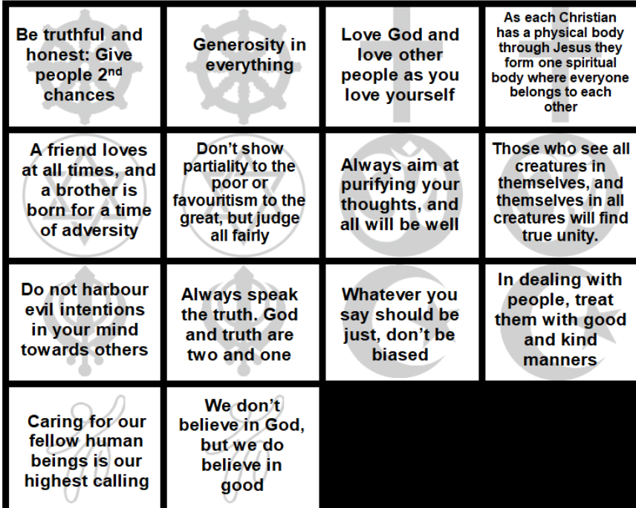
Would it be a community without kindness?
Pick out the key words from these quotes such as love, kindness, wisdom and add to the last column on your table.
Which are the top three words in your opinion and why?

Slide 20



Why a commandment for kindness?
Watch the video on the following slide.
Which words from the previous key words that you have written down did you hear?
Were there other quotes (not just Jewish) that might link to the idea of Mitzvah day?
How do you feel about duty and commandment being linked to kindness in the community?
What might this show about the importance of serving others in the community? Where else may you see this?
Why do you think serving community is a commandment?
Notes:
Read through the questions before showing the clip and come back to this slide after they have watched it
Links may be made to 5 pillars of Islam

Slide 21
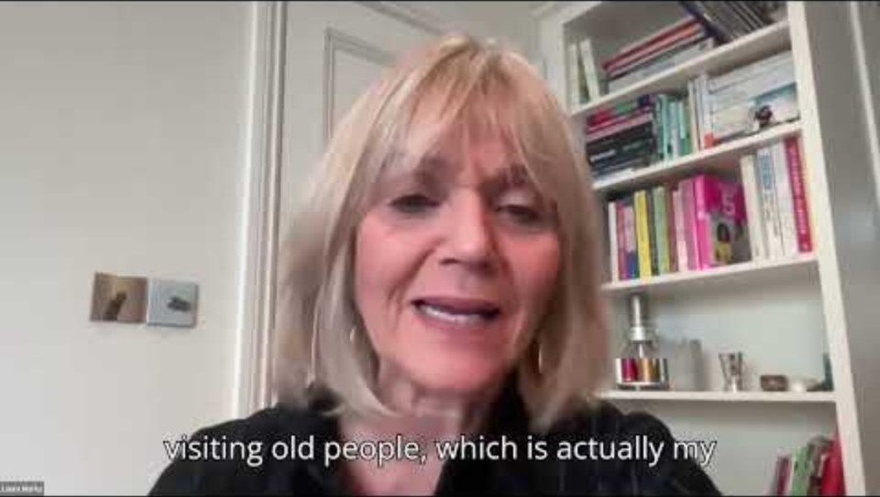
Notes:
What have they learnt today? Write answers on the template and keep for later.
REF: CIP

Slide 23
3. How can we serve our community?
Notes:
Ask the pupils for some initial answers to this question

Slide 24
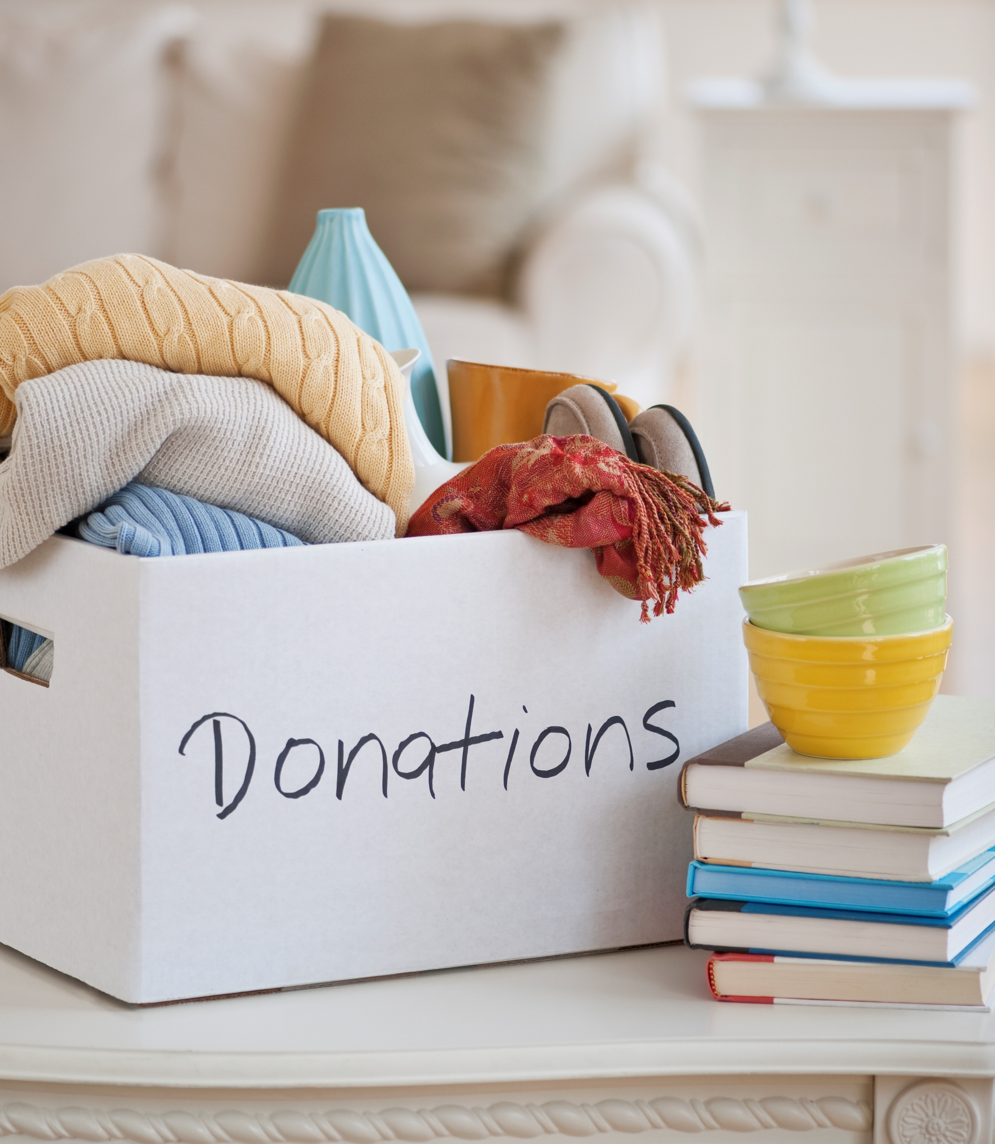
What do we mean by service?
You have been given a copy of the Jewish teaching of the 8 levels of charity.
Can you put them in order of the value or kindness being shown in your opinion?
Notes:
Recap: Looking at the importance of looking and listening to others and how they serve and help their community.
REF: SB

Slide 25
When one gives unwillingly
When one gives to the poor person after being asked
When one knows to whom one gives, but the recipient does not know his benefactor
To give to the poor without knowing to whom one gives, and without the recipient knowing from who he received
When one gives to the poor person directly into his hand, but gives before being asked
When one gives inadequately, but gives gladly with a smile
To support a fellow so that he will not need to be dependent upon others
When one does not know to whom one gives, but the poor person does know his benefactor.

Slide 26
To support a fellow so that he will not need to be dependent upon others
To give to the poor without knowing to whom one gives, and without the recipient knowing from who he received
When one knows to whom one gives, but the recipient does not know his benefactor
When one does not know to whom one gives, but the poor person does know his benefactor.
When one gives to the poor person directly into his hand, but gives before being asked
When one gives to the poor person after being asked
When one gives inadequately, but gives gladly with a smile
When one gives unwillingly
Notes:
Reveal the answers. Do they agree with the order? Ask the questions: Why might some kindness/service mean more than others(donating)? When might giving to others be harder?

Slide 27

Does some service mean more?
Read through the story of Prohet Muhammad (PBUH) and the Old Woman from the next slide.
What acts of service or kindness did he show?
Did it mean more that it was to someone who didn’t show kindness to him at first?
Does this make a difference to the value of service/kindness that Muhammad showed?
Which of the 8 levels charity we have just looked at can you apply to this teaching?

Slide 28
Story of Prophet Muhammad (PBUH) and the Old Woman
In Makkah, the people loved and respected Muhammad (pbuh) and treated him kindly. When Allah gave him revelation and made him a prophet, the people turned against him and would try to harm him. This was because Muhammad told them to worship only Allah and they wanted to worship their stone idols. There was an old woman who would collect thorns and twigs. She would wait until Muhammad (pbuh) was coming and she then threw them in the way hoping that Muhammad (pbuh) would step on them and get hurt. She would collect these thorns everyday and wait for Muhammad (pbuh) to arrive. One day, the prophet (pbuh) was passing by and saw that the old woman had not thrown down the thorns on the road. He was worried for the old lady and asked some people where she was. They told him that the old woman was very ill and too sick to leave her bed. The Prophet (pbuh) was very concerned for the old lady and went to visit her. When he went to her house, he spoke to her in a respectful and kind manner. He spoke to her politely and said some kind words before he left her house. The woman was very surprised to meet such a respectful man. She felt ashamed that she had been so cruel to him over all this time. She decided that Muhammad (pbuh) was not a bad person like people had told her but was a kind and honest gentleman. From that day on she never tried to hurt the prophet (pbuh) in any way.
Notes:
REF: DC

Slide 29
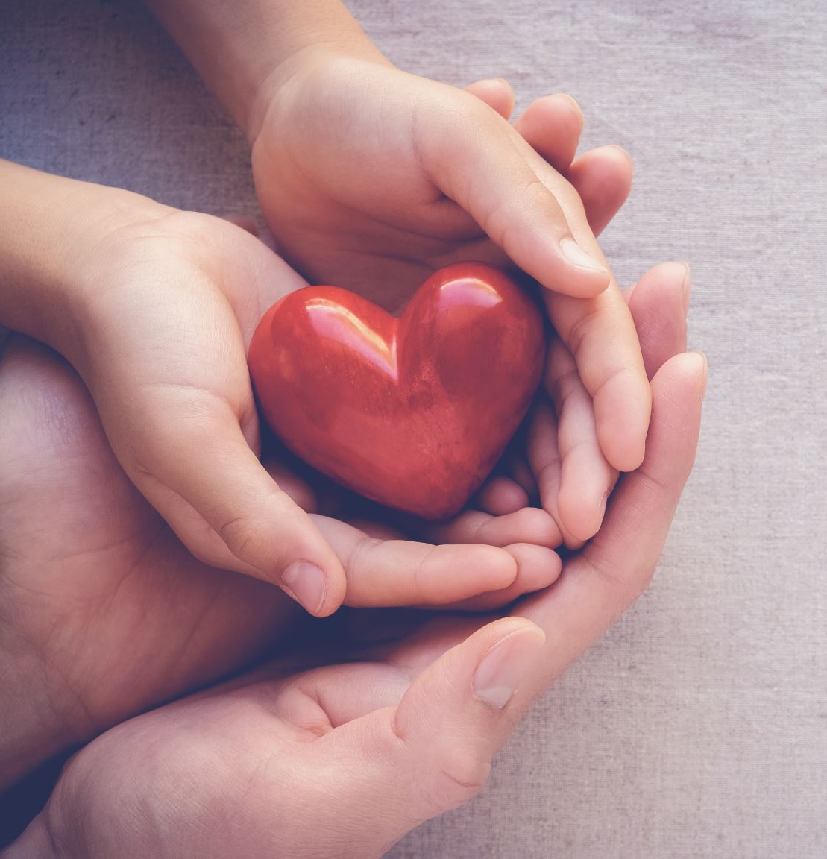
Does some service mean more?
We are now going to look at some examples of kindness and service from Christianity, Sikhi and the Hindu Dharma.
For each example answer the following questions:
How do each of these faiths demonstrate service to others?
Does it mean more to show kindness and service to someone who doesn’t have the same beliefs as you? Why?

Slide 30
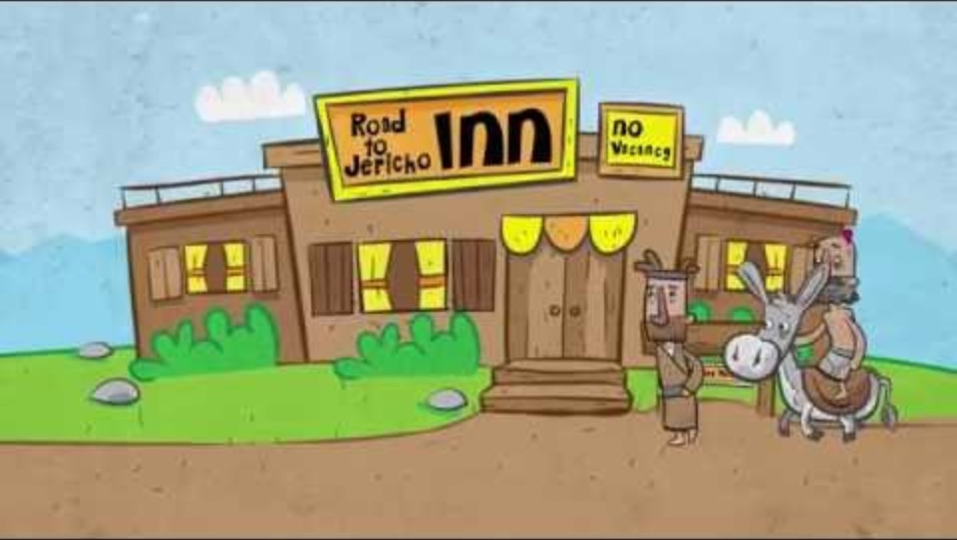
Christianity
Notes:
REF: https://www.youtube.com/watch?v=osfQg4yKtq8&embeds_referring_euri=https%3A%2F%2Fhubblecontent.osi.office.net%2F&source_ve_path=Mjg2NjYParable of the Good Samaritan
How do each of these faiths demonstrate service to others?
Does it mean more to show kindness and service to someone who doesn’t have the same beliefs as you? Why?

Slide 31
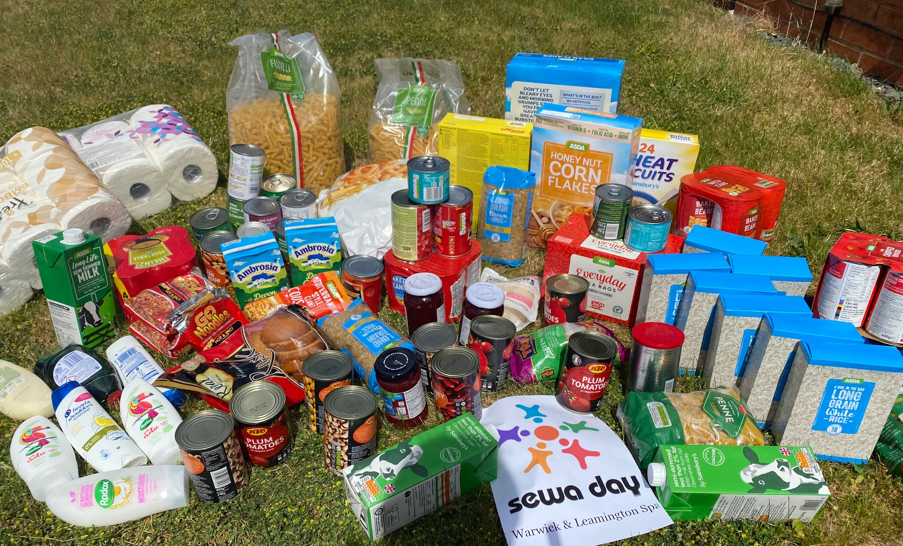
Hindu Faith
Hindus During Covid
Hindus helped restore a balance in the society and country they were living in by doing Sewa/service.
They replenished food banks, supplied PPE and cooked and delivered hot meals to elderly and disabled.
Hindus recognise the whole world as a one big family. VASUDHAIVA KUTUMBAKAM
Like in a family they accept all the members irrespective of their opinions and differences. The same way Hindus accept whole of Human race as one family irrespective of their beliefs.
Hindus apply this not only to human race but extend it to all living things too.
Notes:
How do each of these faiths demonstrate service to others?
Does it mean more to show kindness and service to someone who doesn’t have the same beliefs as you? Why?
REF: NASACRE

Slide 32
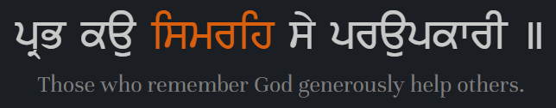
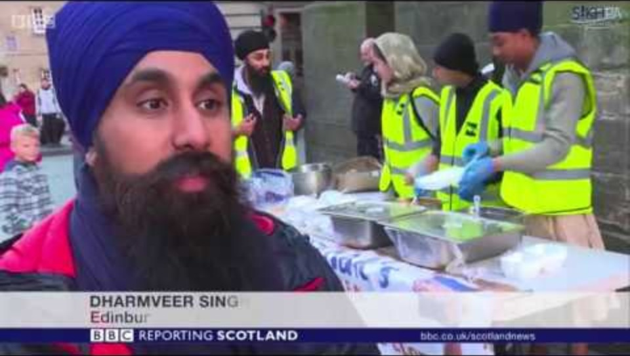
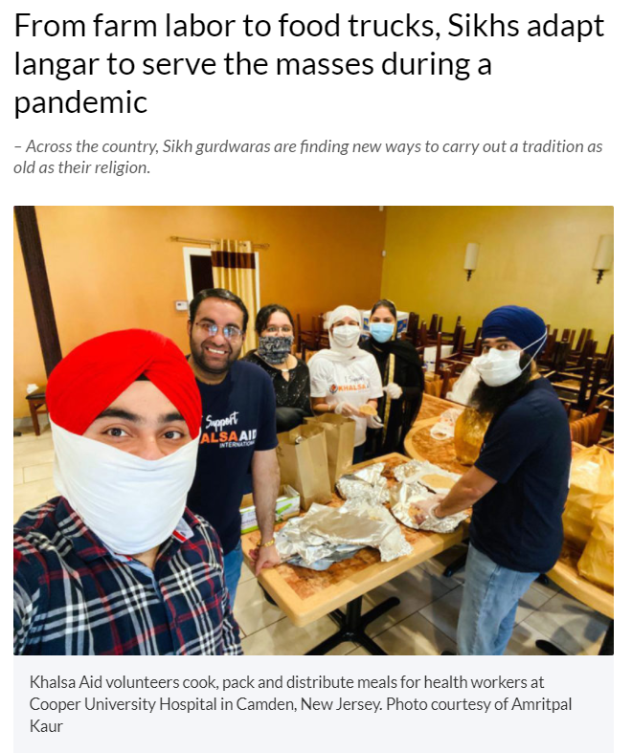
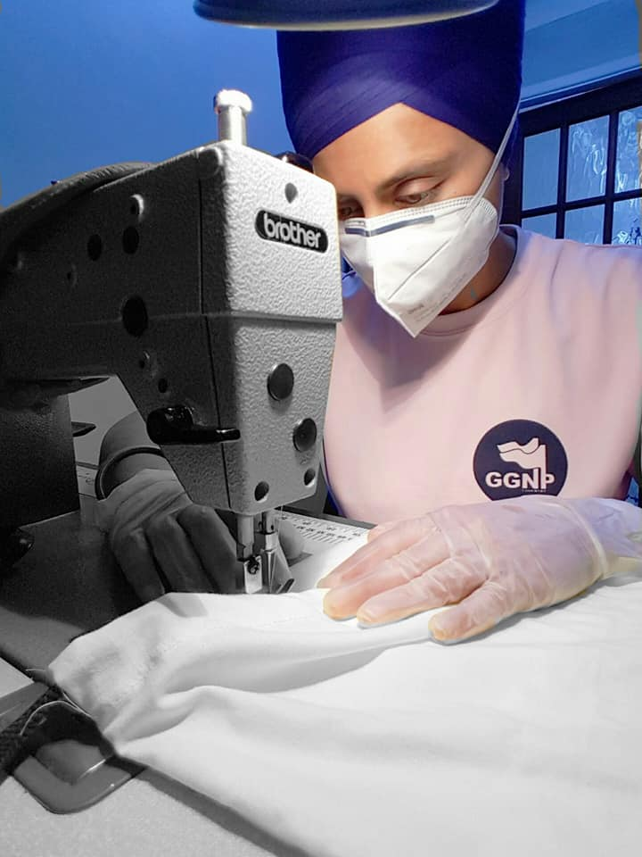
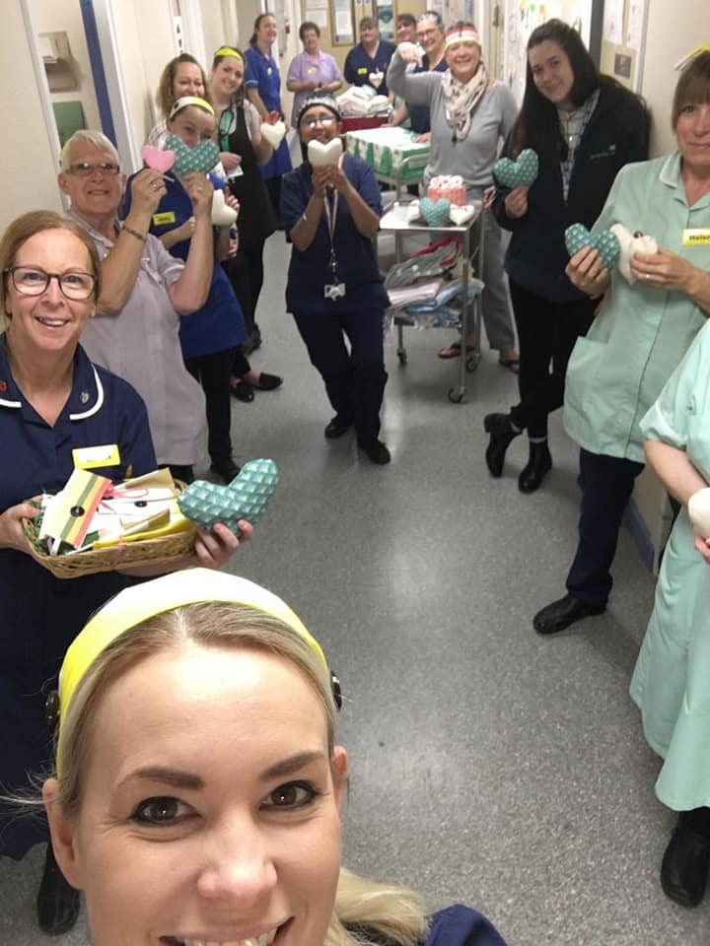
Sikh Faith
Notes:
How do each of these faiths demonstrate service to others?
Does it mean more to show kindness and service to someone who doesn’t have the same beliefs as you? Why?
REF: NASACRA BBC

Slide 33
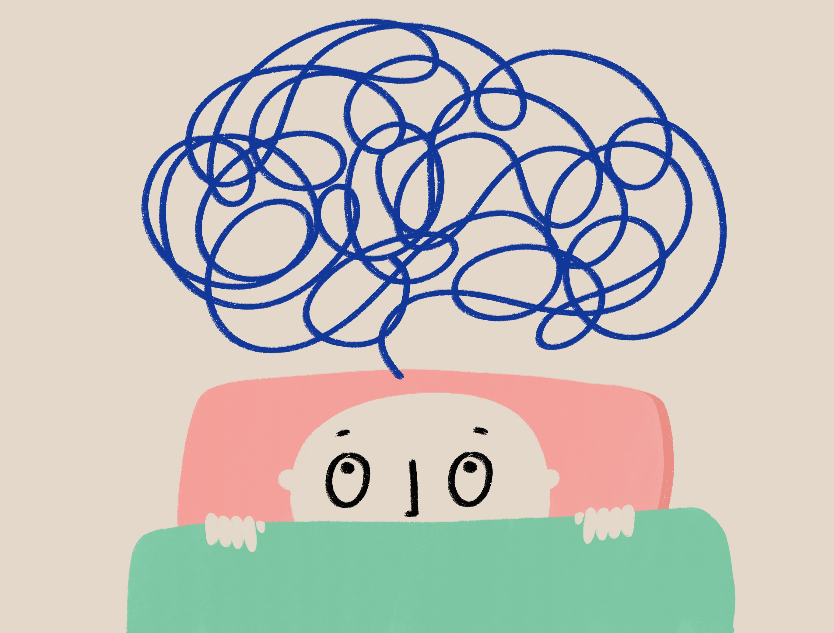
How can serving others bring us together?
Who can remember what community means?
If we just live together but don’t help each other are we still a community?
Who or what were your strongest influences on your sphere of influence?
What have you learnt today?

Slide 34

How can serving others bring us together?
Reflect on the 3 key words we have looked at – service, kindness and equality. How do they fit with the idea of community? Can you have a community without service?
Can you now write a sentence using these words?

Slide 35
4. What is so good about sharing?
Notes:
Ask the pupils for some initial answers to this question

Slide 36

Recap
Think back to the 8 levels of charity. What are the different ways people can give? (not just money)
Can you remember what the Langar is and how Sikhs offer service?

Slide 37
Sikh: Sewa
Within the Sikh faith they believe in 3 types of service/sewa.
We are now going to explore Sewa in more depth.
Questions to consider:
How did the Gurus/Sikhs support the community in the examples we have seen?
Can you match these examples to the 3 types of service on the following slide?

Slide 38
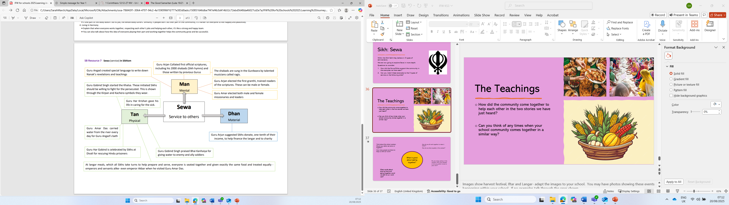
Notes:
REF: REToday

Slide 39
Think about the school canteen. Would you rather eat alone or together?
How many people are there to help us with our lunch?
How do we all work together to make it better?
How do we show equality in the canteen?
What is good about eating together?
Do you enjoy eating in the canteen with more people or do you prefer to eat on your own?
What words about sharing food and eating together could we add to our word wall?

Slide 40
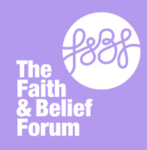
Interfaith Week Poetry Competition 2025
This year we are inviting you to take part in our Interfaith week poetry competition.
We are asking you to write a poem, no more than 30 lines in any style on the theme Community: Together we Serve
We want to see you using the key concepts and perspectives from the IFW session reflected in your work.
Your teacher will judge a Key Stage 3 and Key Stage 4 winner in school; the winner will then be sent to the Interfaith Week team to judge nationally.
There will be lots of exciting prizes and certificates for individuals and the school.
Further information available from your teachers.
Closing date 28th November
www.ifw4schools.co.uk

