Slide 1

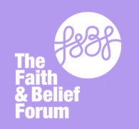
Inter Faith Week 2026
Secondary Assembly
Notes:
Take That - Shine (Official Video)

Slide 2

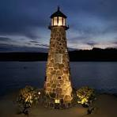
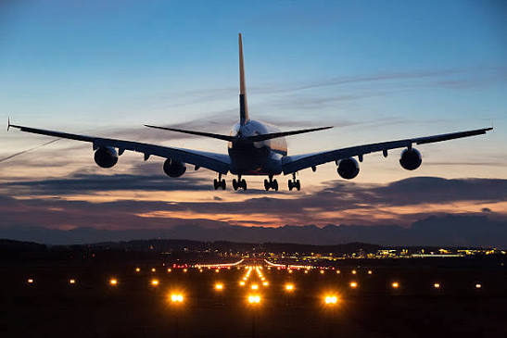






Ways we use light…
Magnific
iStock
Shutterstock
Shuttersctock
https://encrypted-tbn0.gstatic.com/images?q=tbn:ANd9GcQrRqSF09dTYqX6yG_pBwXlnMaqALxmlBhF0aDUeFrqQQ6STh8vTsfrw6o&s
Magnific
Magnific
Magnific
iStock

Slide 3

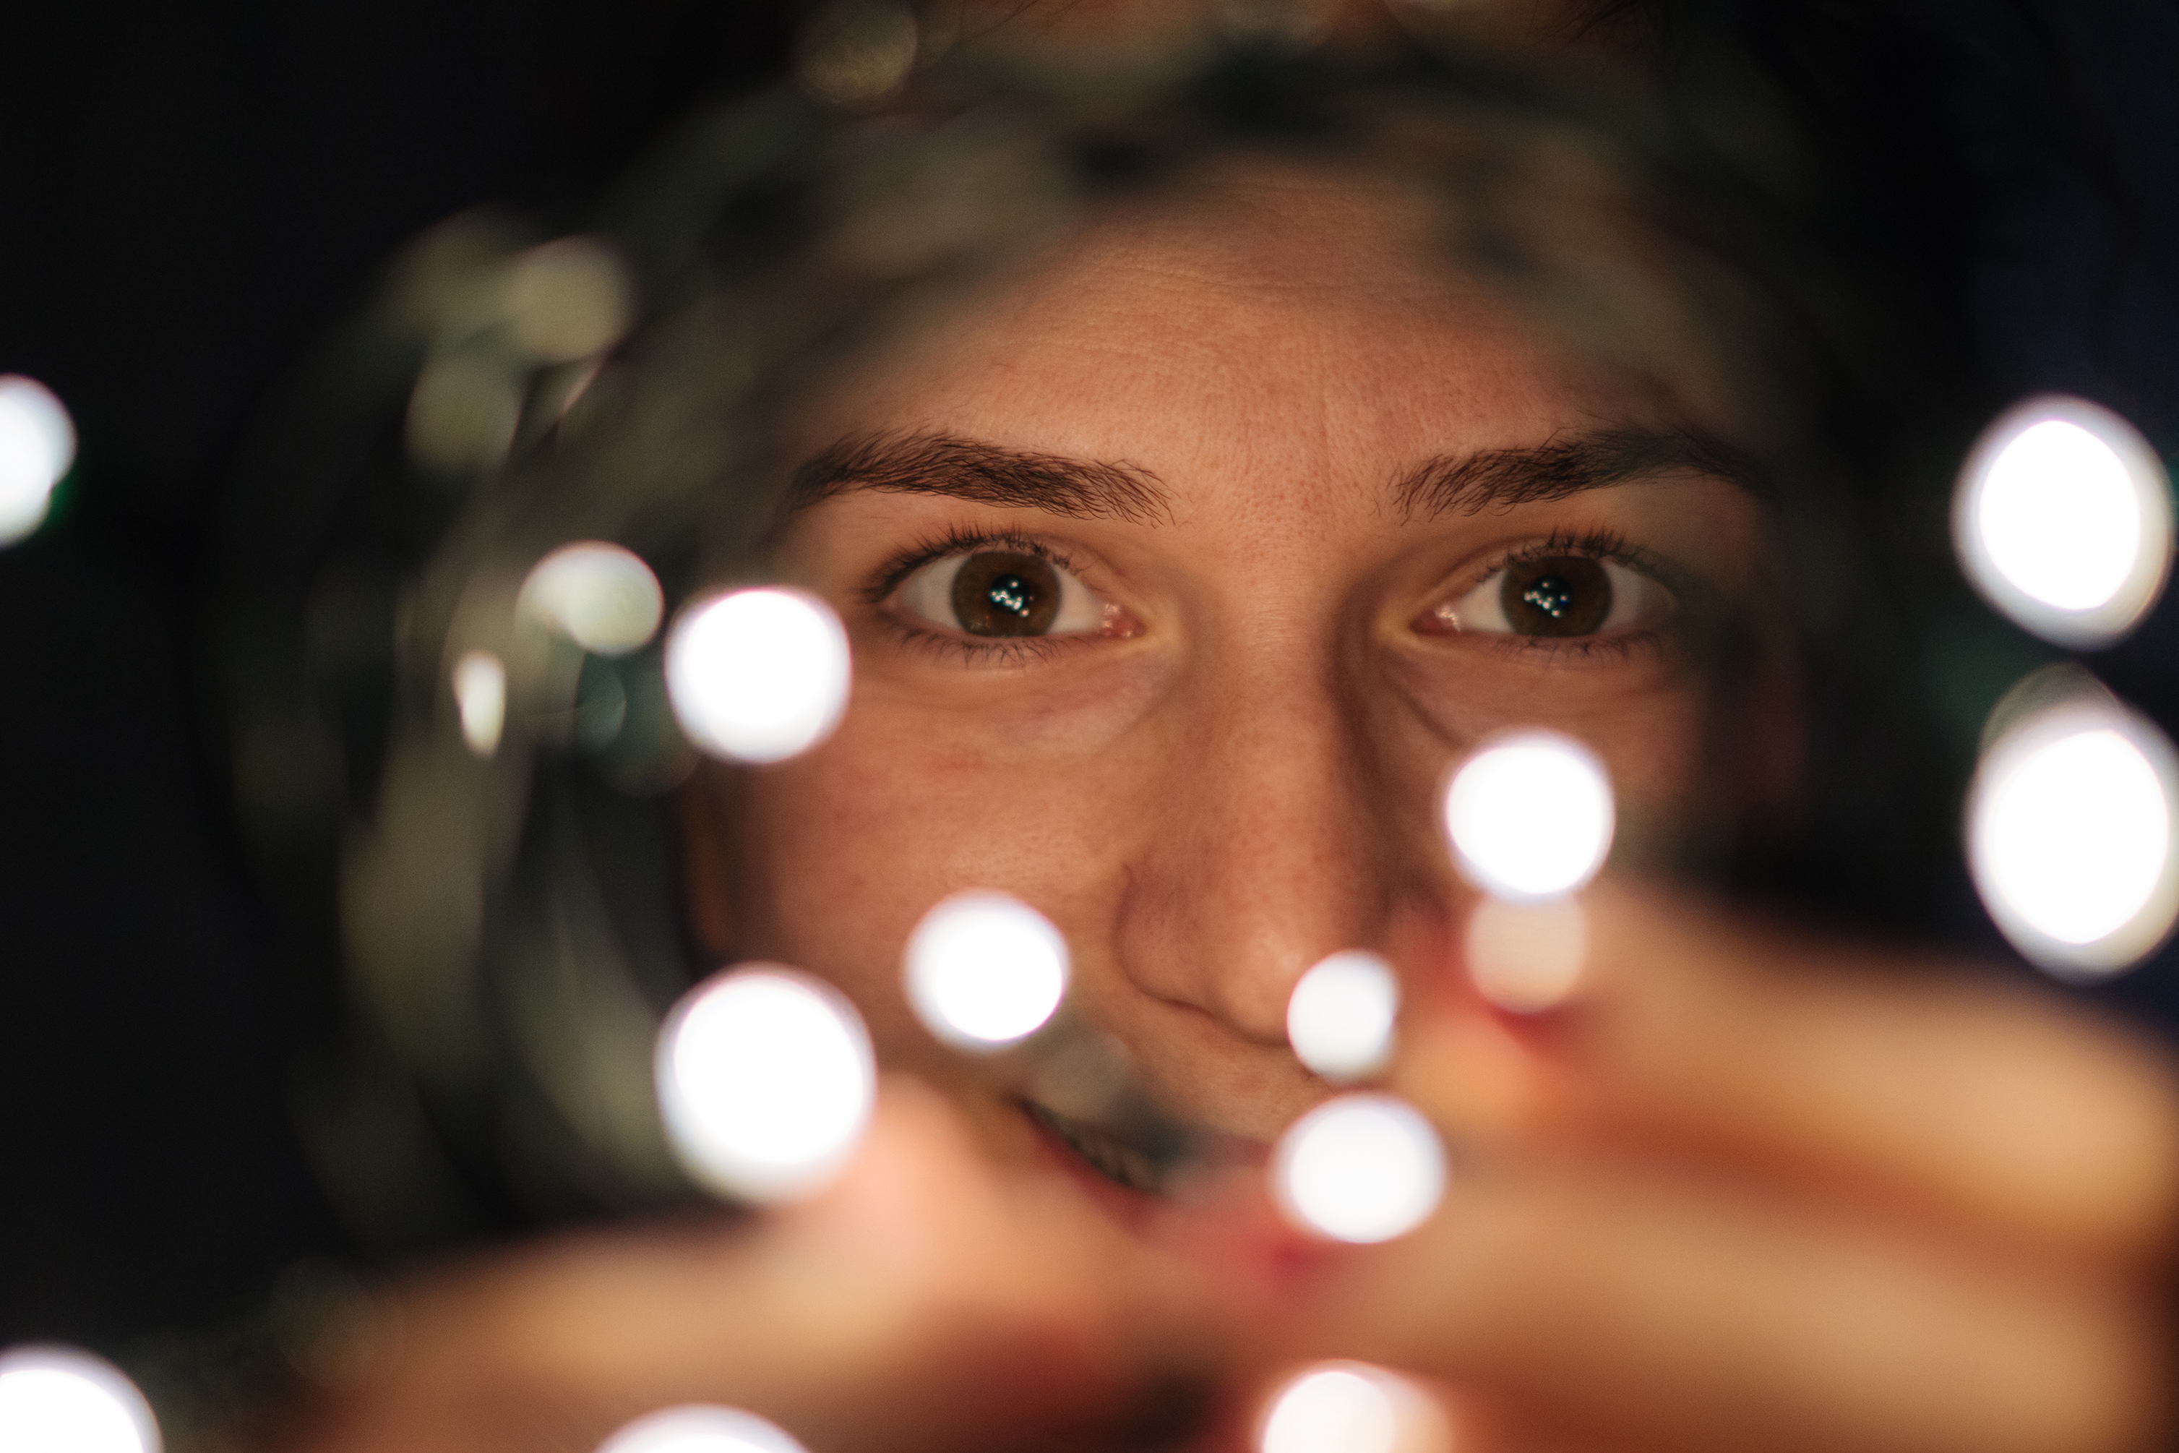

How we use light in our language…
“Light at the end of the Tunnel”
“See the light”
iStock
“Bright Future”

Slide 4

How we use light in our language…
“Bright Ideas”
“Bright” = Clever
PNGTree
“Bright Spark”
“Shed light on it”

Slide 5

How we use light in our language…
“Light of my life”
“Love and light”
“My guiding light”

Slide 6
Hope
Knowledge
Joy
“Light at the end of the Tunnel”
“Bright Ideas”
“Love and light”
“Bright Spark”
“My guiding light”
“See the light”
“Bright” = Clever
“Light of my life”
“Bright Future”
“Shed light on it”

Slide 7

Shine: Take That
You, you're such a big star to me
You're everything I wanna be
But you're stuck in a hole
And I want you to get out
I don't know what there is to see
But I know it's time for you to leave
We're all just pushing along
Trying to figure it out, out, out
All your anticipation pulls you down
When you can have it all
You can have it all
So come on
So come on, get it on
I don't know what you're waiting for
Your time is coming, don't be late, hey, hey
So come on
See the light on your face
Let it shine, just let it shine
Let it shine
Stop (stop) being so hard on yourself
It's not good for your health
I know that you can change
So clear your head and come 'round
You only have to open your eyes
You might just get a big surprise
And it may feel good
And you might want to smile, smile, smile
Oh, don't you let your demons pull you down
'Cause you can have it all
You can have it all
So come on
Oh, come on, get it on
I don't know what you're waiting for
Your time is coming, don't be late, hey, hey
So come on
See the light on your face
Let it shine, just let it shine
Let it shine

Slide 8
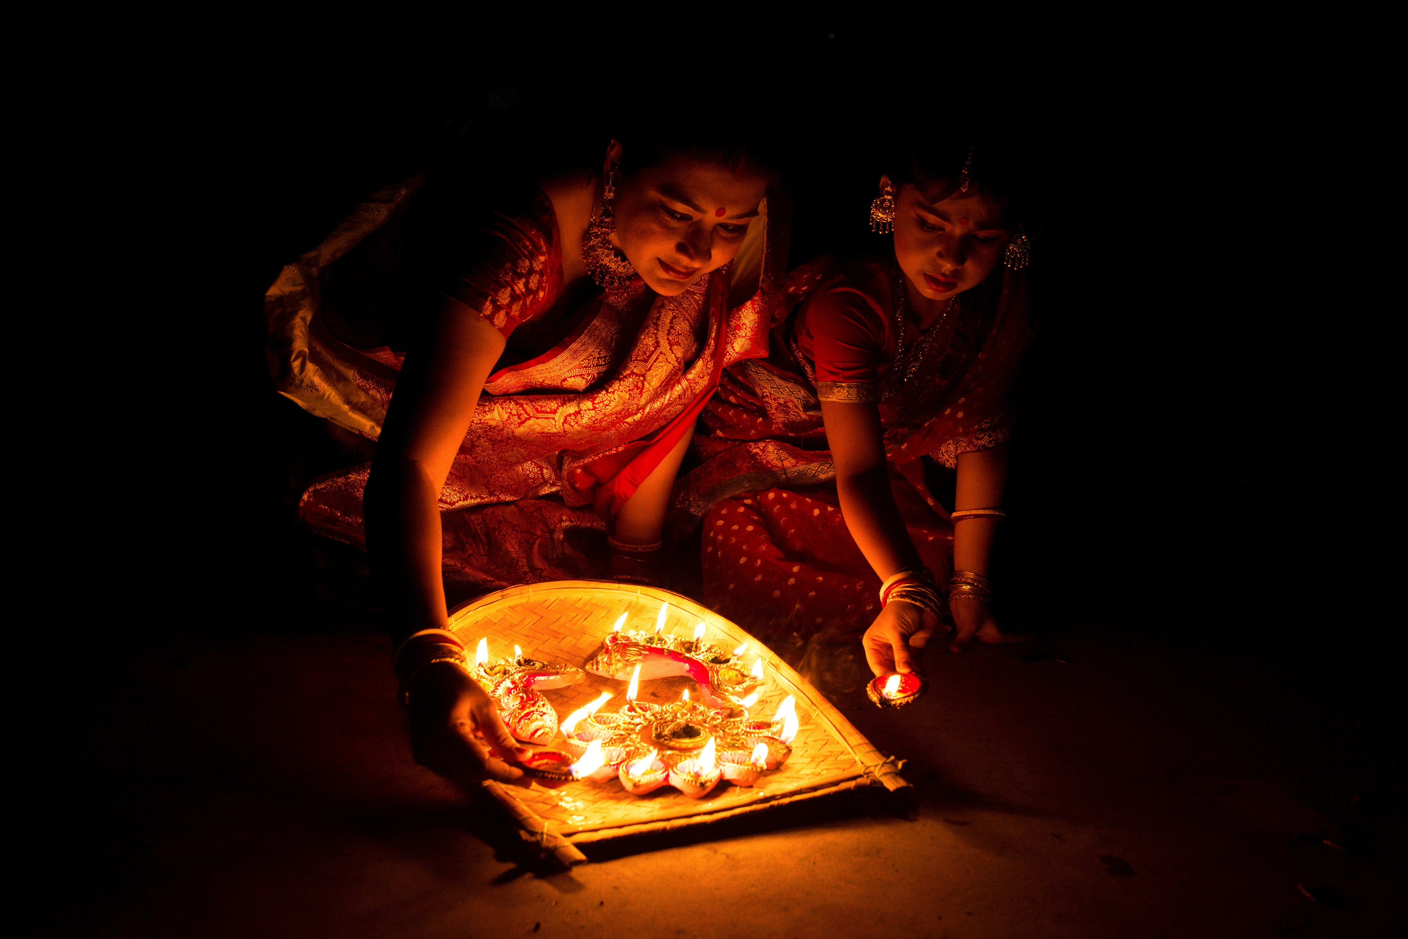

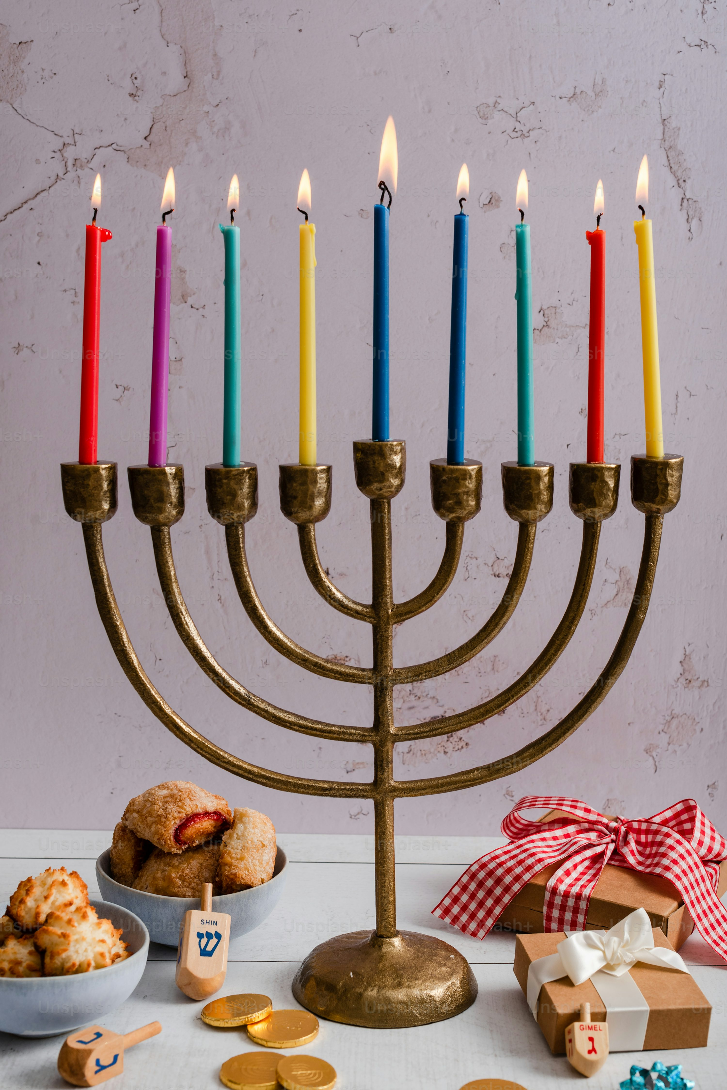
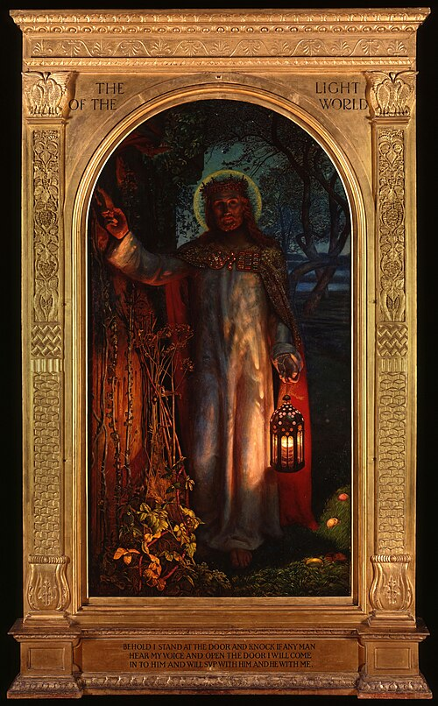
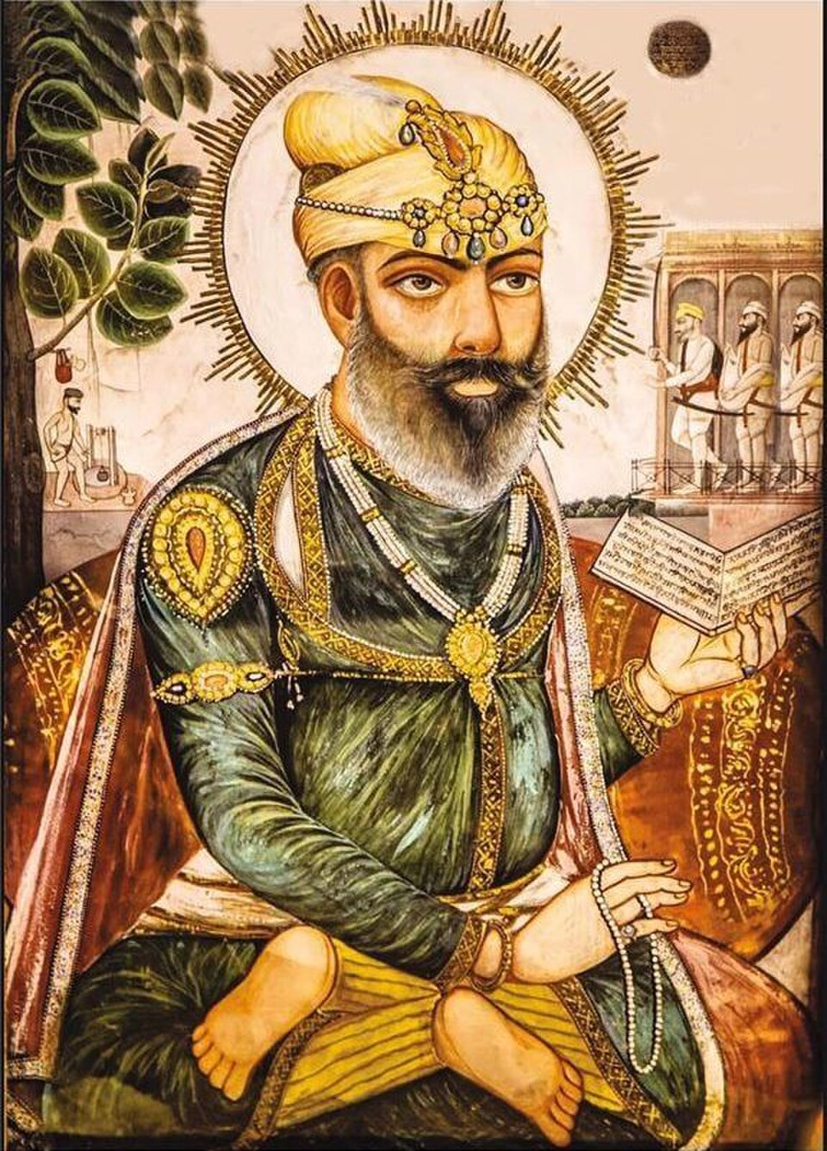

Notes:
William Holman Hunt, The Light of the World, c.1853–54/ Star and Crecent/ Guru/Zoroastrian fire pot Public domain, via Wikimedia Commons.

Slide 9
‘Lighting the Way for a Shared Future’
This years Inter Faith Week is during the week of 8^{th -}15th November
It’s a time when we learn about how people of different religions and beliefs can be friends, work together and help others.
This year we will be focusing on hope and how we can work together as a society to ‘Light the Way for a Shared Future’

Slide 10

Challenge for the Week
This week, can you be a light for someone else?
Think of one small thing you could do to help someone feel welcome, happy or supported.
Notice when you can bring a little more light to someone else’s day and do it!

Slide 11

Reflection
‘Darkness cannot drive out darkness; only light can do that.’
Martin Luther King Jr

Slide 12
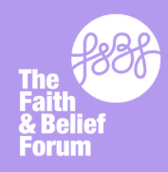
Inter Faith Week Poetry Competition 2026
Following the success of last year, the Inter Faith Week Poetry Competition will be running again.
We are asking you to write a poem, no more than 30 lines in any style on the theme Lighting the Way for a Shared Future.
You can draw on your own experiences, to make it a personal poem, or it can be more general about what various faiths and cultures believe.
Your teacher will judge a Key Stage 3 and Key Stage 4 winner in school; the winner will then be sent to the Inter Faith Week team to judge nationally.
This year we are excited to announce that Key Stage 4 judging will be done in partnership with Cambridge University.
There will be lots of exciting prizes and certificates for individuals and the school.
Further information and resources to help you with your work can be found on our website www.ifw4schools.co.uk
Closing date Friday 27th November

