Slide 1

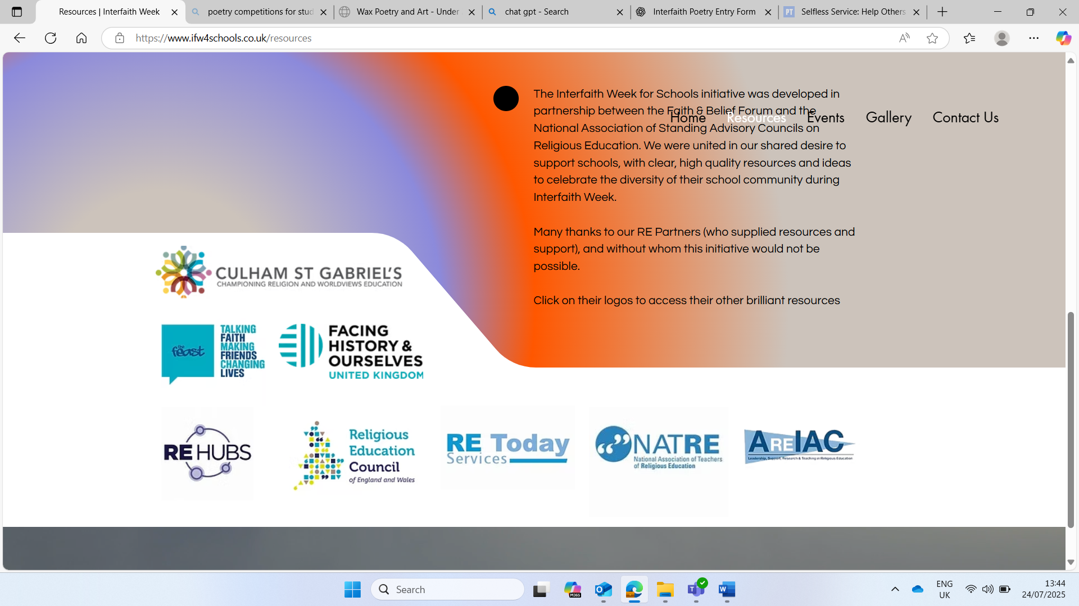

Interfaith Week 2025
Community: Together We Serve
KS2: Introduction
Notes:
This week is Interfaith week, a time when we learn about how people of different religions and beliefs can be friends, work together and help others. This year's theme is Community: Together we Serve, this means helping others and making our community a kinder place, together! We will be looking at people from different faiths, and those of no faith to see what they think about our theme. Throughout the week we will be engaging in Interfaith Dialogue. Interfaith means we will be looking at more than one faith and dialogue means sharing ideas. So we will be sharing ideas about community and service from different faith points of view.

Slide 2
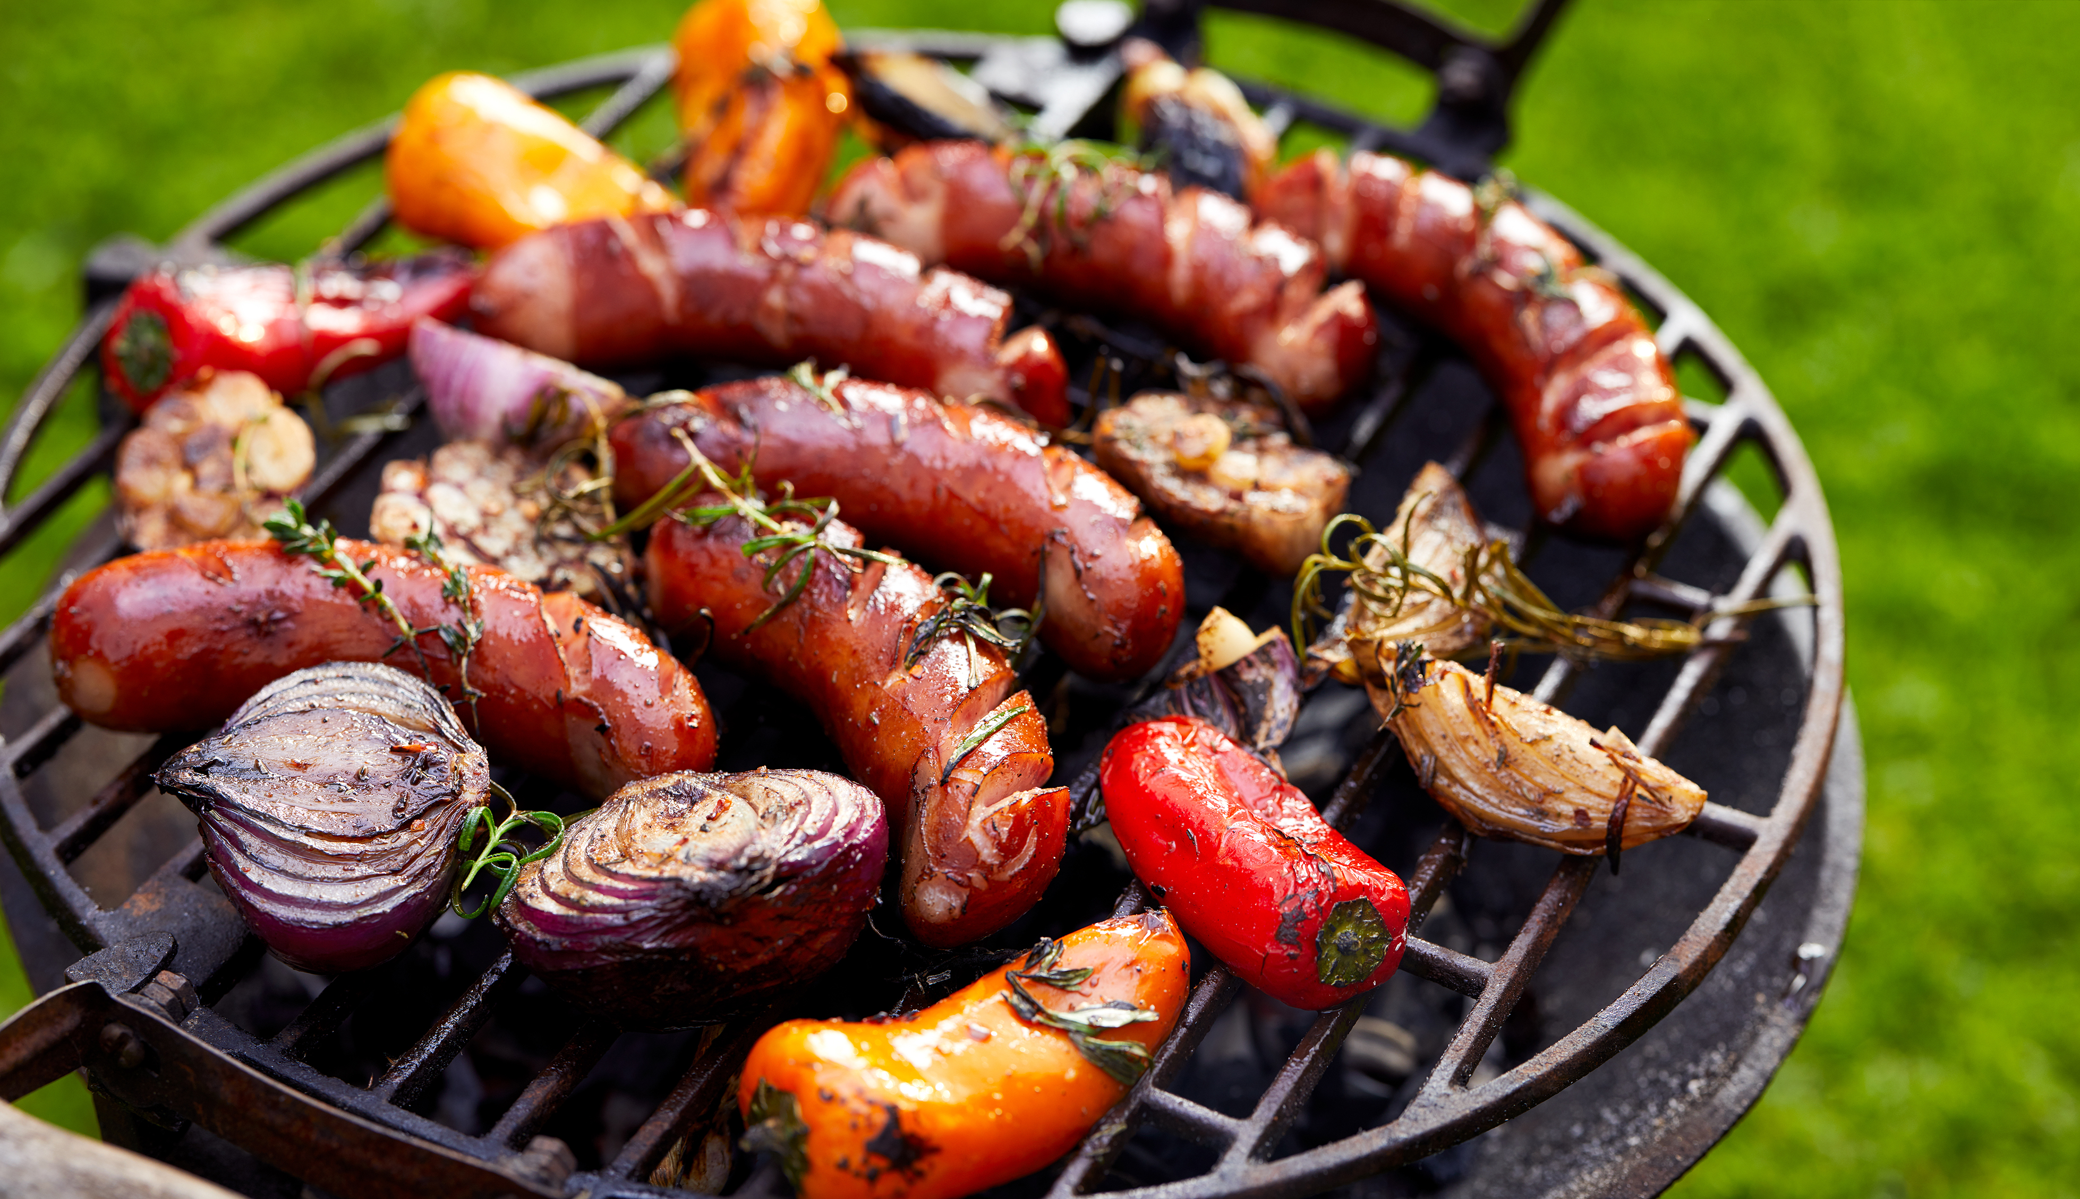

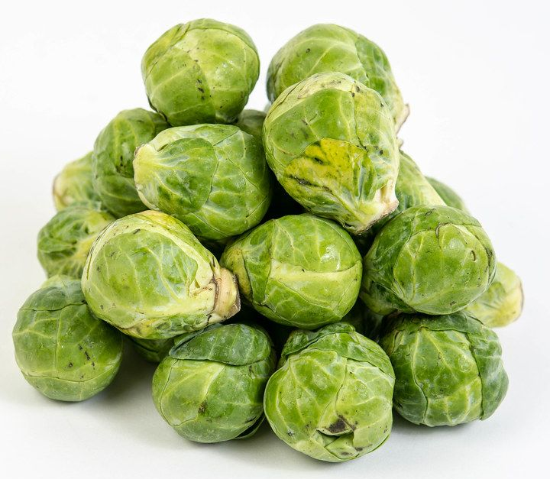
Look at the image. Do you:
Know of it?
Know it?
Know it well?
How do you know what it is?
Have you ever tried it?
Who told you about it? Family? Friends?
Do you like it?
Notes:
Print off the table or ask them to write it in their books. Images show sprouts, pork and ice cream.

Slide 3
What does the image show? | Know of it Know it Know it well | Have you ever tried it? | Who told you about it? | Do you like it?
Why might there be some things we haven’t all tried?
Notes:
Consider the religious reasons as to why some pupils may not have tried pork, or dietary reasons for ice cream

Slide 4
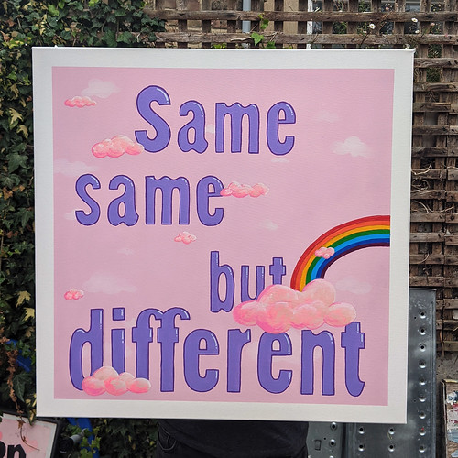
Does it matter?
Does it matter if we didn’t all have the same answers?
Was there anything we all agreed on?
What do we all have in common?
Would other people in our school have these in common?
Would people in X area have all these in common?
This Photo by Unknown Author is licensed under CC BY-NC
Notes:
Adapt the X to make relevant to your school.
Give the class one post it note each and ask them to write down what do they all have in common. Add the information to a class word wall someone in the room. Discuss the words they added. Emphasise the point that although we are all in the same school and live in the same area we have many differences. We don’t have to all be the same to get along. Ask them to consider what the biggest difference they have with their best friend is, does it affect or change your friendship with them?

Slide 5
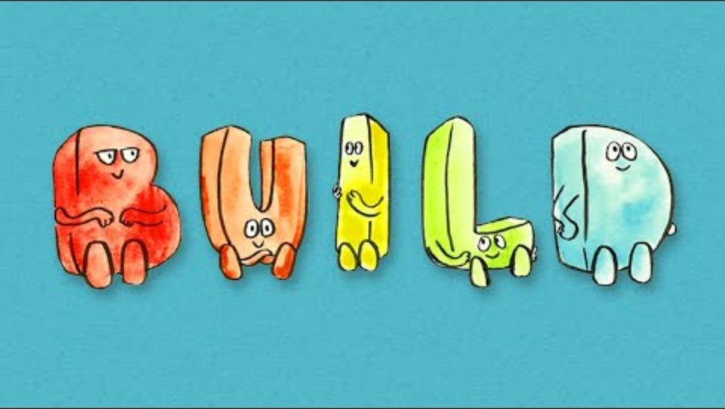
BUILD
When sharing our own faiths and beliefs, it’s important to agree on some ground rules. This helps make sure that everyone feels comfortable, respected, and able to speak in a brave and safe space. Watch the following clip to see how we can create this kind of space in our school.
Notes:
Ref: Faith and Belief Forum

Slide 6

1.What does community mean?
Notes:
Ask the pupils for some initial answers to this question, do they know the word? What does it mean to them?

Slide 7
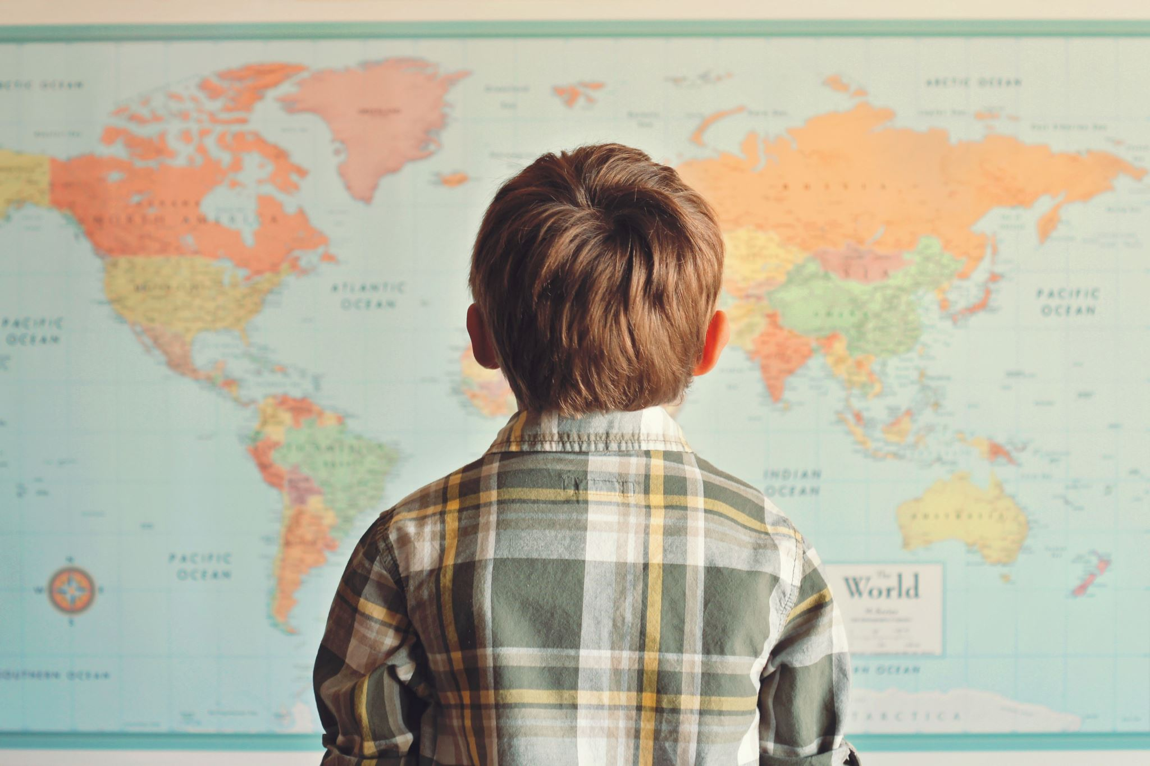
What does community mean?
Unity: means ‘one’
COM: means ‘with’
COMMUNITY
What do you think this means?
How are we all one community?
How does it feel to be a part in our community?
What might be good about being part of a community?
Notes:
Explain the etymology of the word community Com: with and Unity: One
Ask the pupils to write down on a post it note what is good about being part of a community and add it to the word wall you have started to create.
You can also include google maps and zoom in on your school, then zoom out to see the wider community you are physically part of.

Slide 8
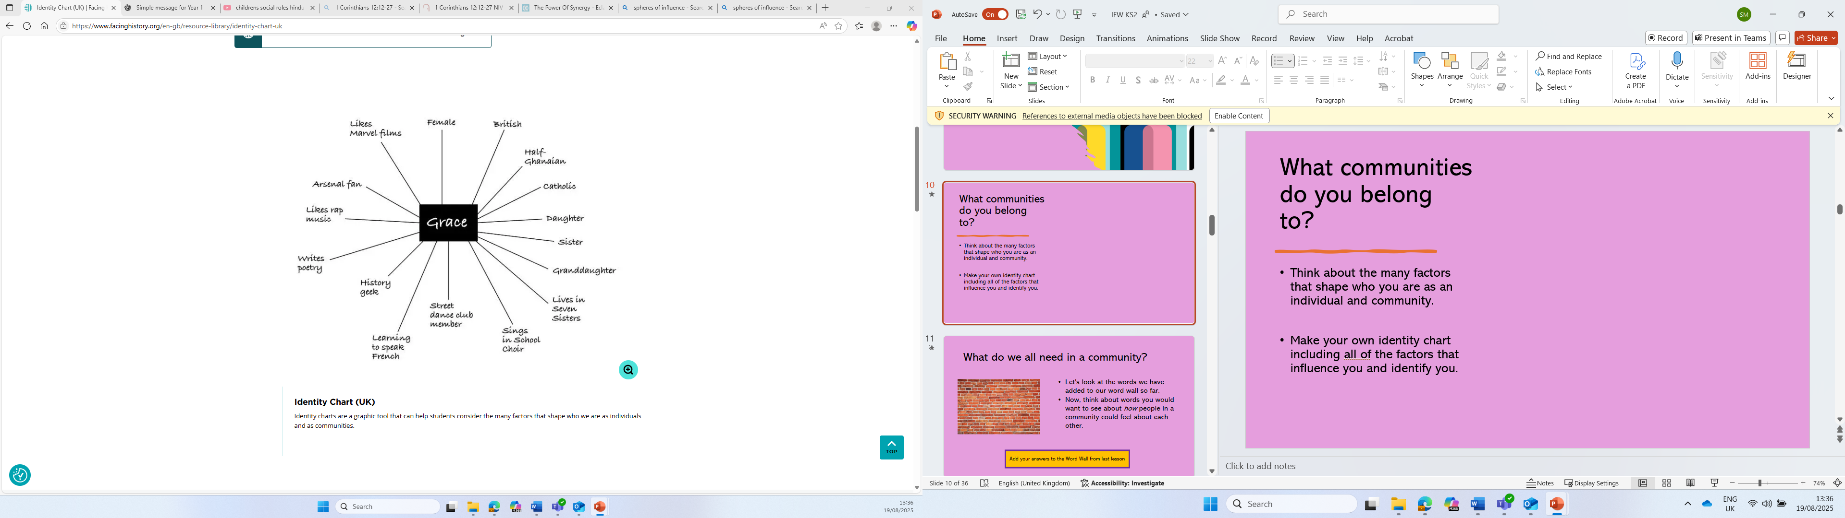
What communities do you belong to?
Think about the many factors that shape who you are as an individual and community.
Make your own identity chart including all of the factors that influence you and identify you.
Notes:
Ref: Facing History and Ourselves

Slide 9
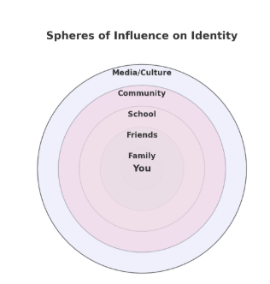
Your sphere of influence
Our identity is shaped by many people and the things around us. These are also known as spheres of influence.
They might include family, friends, school, community, culture, religion or media.
Use the blank diagram to fill in the different spheres of influence in your life with specific examples.
Notes:
Use the example on the slide to help them
REF: Facing history and ourselves

Slide 10
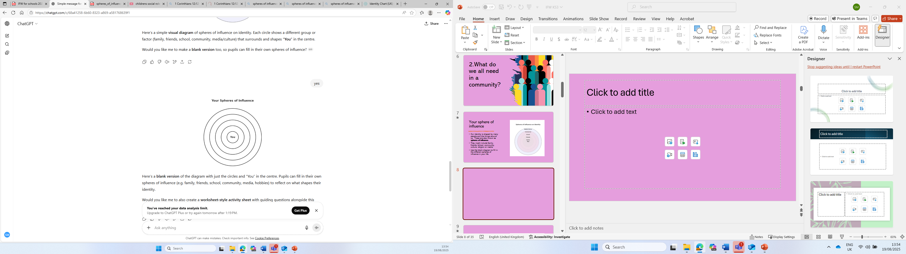
Your sphere of influence
In Circle 1, write your name.
In Circle 2, write the name of people/groups/beings to whom you feel the greatest obligation to or sense of care for – for example, people for whom you’d be willing to take a great risk or put yourself in peril for (you don’t have to write actual names.)
In Circle 3, who are the people/groups/beings on the next level? That is people to whom you have some obligation/responsibility, but not as great as in circle 2.
In Circle 4, who are the people/groups/beings on the next level? People to whom you have some obligation, but not as great as in circle 3.
Notes:
Ref: Facing history and ourselves

Slide 12
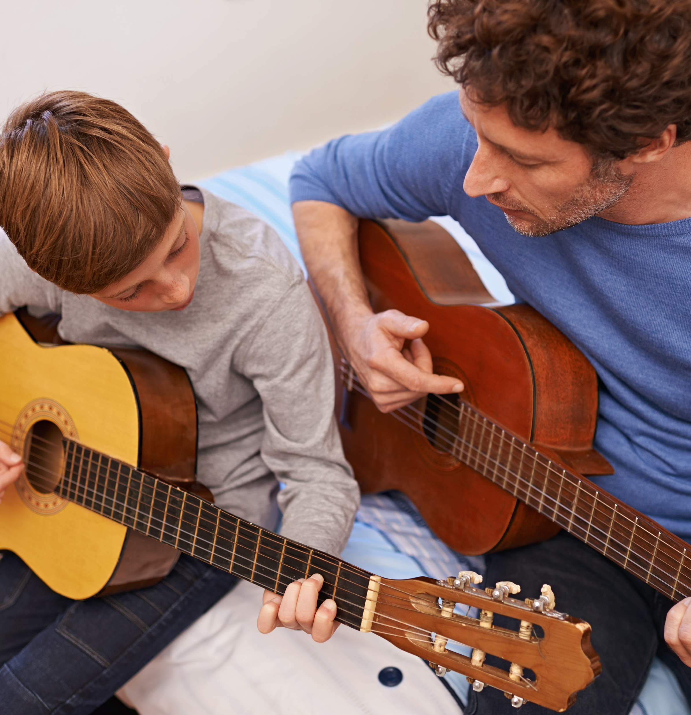

Who influences you?
Who has the most influence on you and why?
Who has influenced what music you like?
What food you like?
How you know right from wrong?
Who has taught you how to read?
Notes:
Allow students time to discuss their spheres with others and then bring them back together for a group discussion on the questions on the slide.

Slide 13

Who influences you?
School
Are there things you have learnt in school you would not have with any of the other influences in your circle? Why?
Why might it be a good thing to have more people to help and learn from?

Slide 14

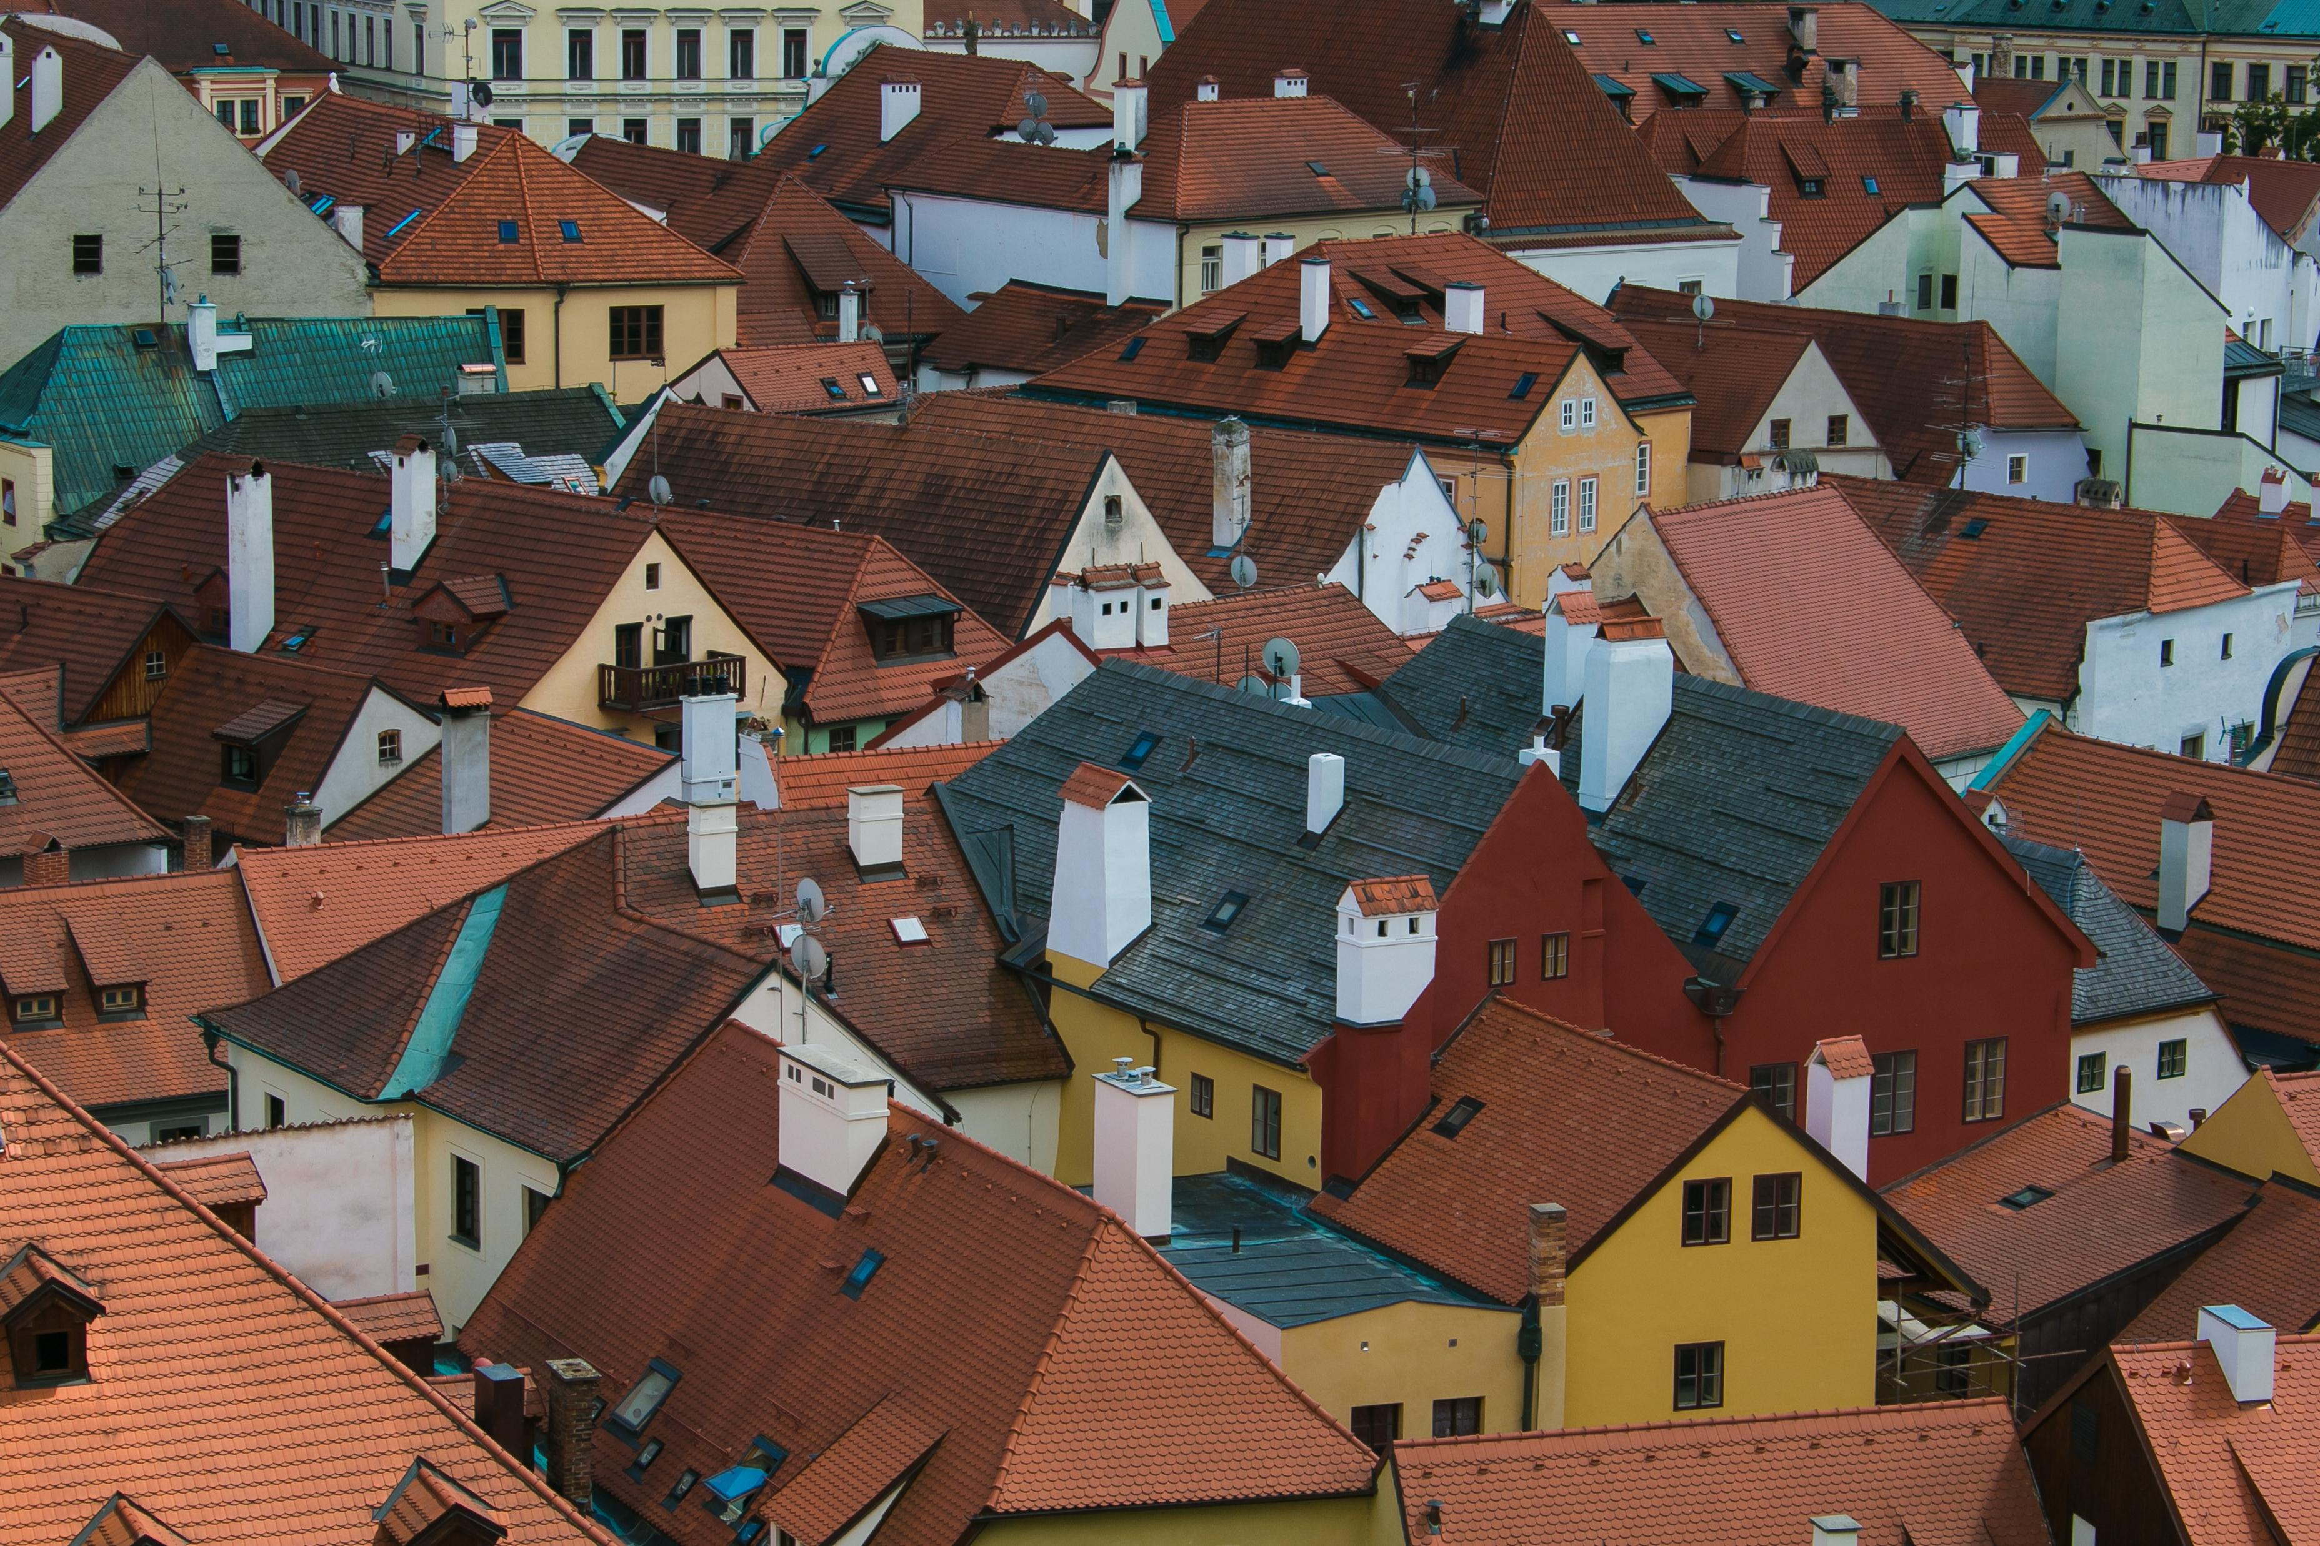

Why might it be good to think together as a community?
Notes:
Ask the pupils the question and get some answers using the images to help generate some thoughts.
Some suggestions for answers: Sharing different Points of view: Everyone brings unique experiences, knowledge, and ideas. When people think together, the community can see problems and solutions from many angles.
Stronger Solutions: Working as a group often leads to more creative and practical answers than what one person might come up with alone.
Builds Trust: When people are listened to and included, they feel valued and connected, which strengthens the community.
Learning from Each Other: Helps people understand new viewpoints, challenge assumptions, and grow their knowledge.
Fairness and Inclusion: Decisions made together are more likely to reflect the needs of everyone, not just a few.
Responsibility: Thinking as a community gives people a sense of responsibility, which encourages action and cooperation.
Explain that in the next session we will be looking and listening to others about how they serve their communities, so its important to remember the BUILD principles.

Slide 15

2.What do we all need in a community?
Notes:
Initial thoughts from the pupils. Recap that we will be looking and listening to others about how they serve and help their community.

Slide 16

What do we all need in a community?
Let's look at the words we have added to our word wall so far.
Now, think about words you would want to see about how people in a community could feel about each other.
Add your answers to the Word Wall from last lesson
Notes:
Think of some examples you can add from your own school

Slide 17
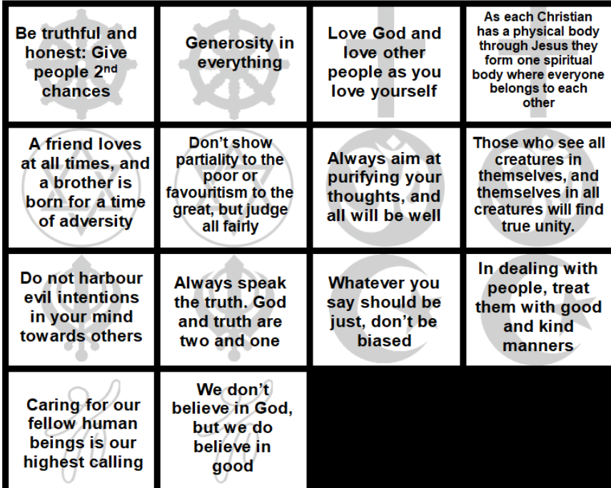
What does helping the community look like?
Which is the most important teaching for:
Our school
Our local area
The country
Have you chosen the same teachings for the different scenarios?
Does the size of the community make a difference?
Did other groups have different answers?
Can you give some examples of these quote being shown in the world?
What would it look like?
In groups decide which is the most important teaching for your class.
Which quote did you like best and why?
What faith do you think it was from?
Notes:
Have copies printed for the pupils. Go through all/some of the quotes to check understanding and meaning.
Buddha Buddha
Luke - Bible Romans 12 - Bible
Proverbs – Jewish
Bible Leviticus – Jewish Bible Mahatma Gandhi Isla Upanishads – Hindu scriptures
Guru Arjan Dev Guru Nanak Qur’an 49:9 Hadith 18, 40 Haith an-Nawawi
Sean Faircloth https://humanistsmn.org/new/what-is-humanism/
REF: REmatters

Slide 18
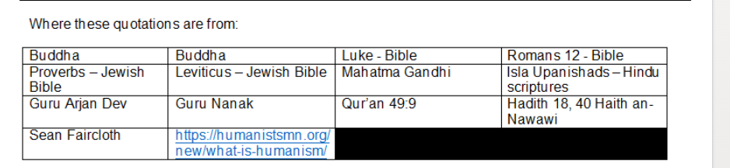
What faith are the teachings from?
What do you notice about the teachings?
Notes:
Get pupils to think about although the faiths are different they appear to share very similar values.
Ask why they think this is important for interfaith?

Slide 19
What have you learnt this session?
Write your answers on the template from the next slide and add to the world wall.

Slide 21
3. How can we serve our community?
Notes:
Ask the pupils for some initial answers to this question

Slide 22
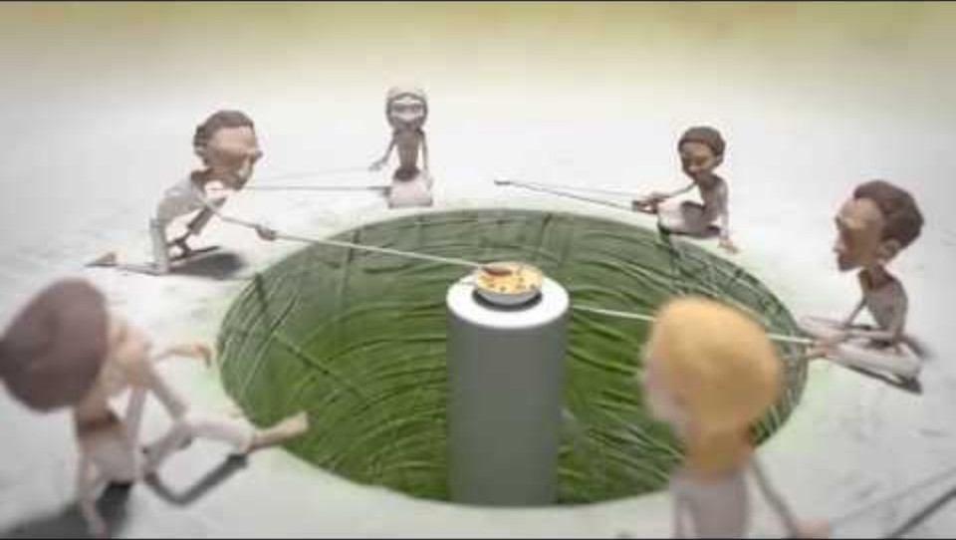
The Long Spoons
Notes:
Recap that you will be looking and listening to others about how they serve and help their community
Watch the story of the Long Spoons
REF: https://www.youtube.com/watch?time_continue=61&v=qhU5JEd-XRo&embeds_referring_euri=https%3A%2F%2Fhubblecontent.osi.office.net%2F&source_ve_path=Mjg2NjY

Slide 23
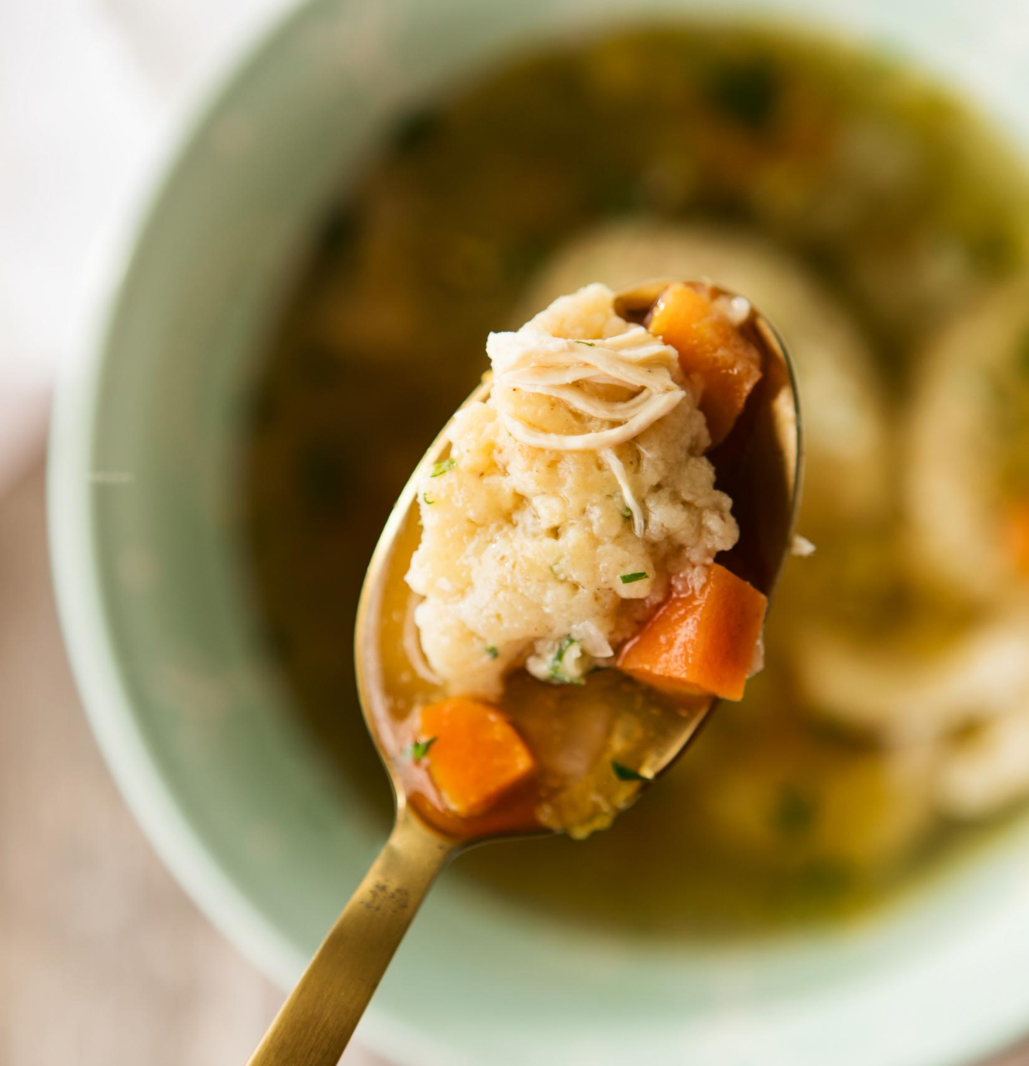
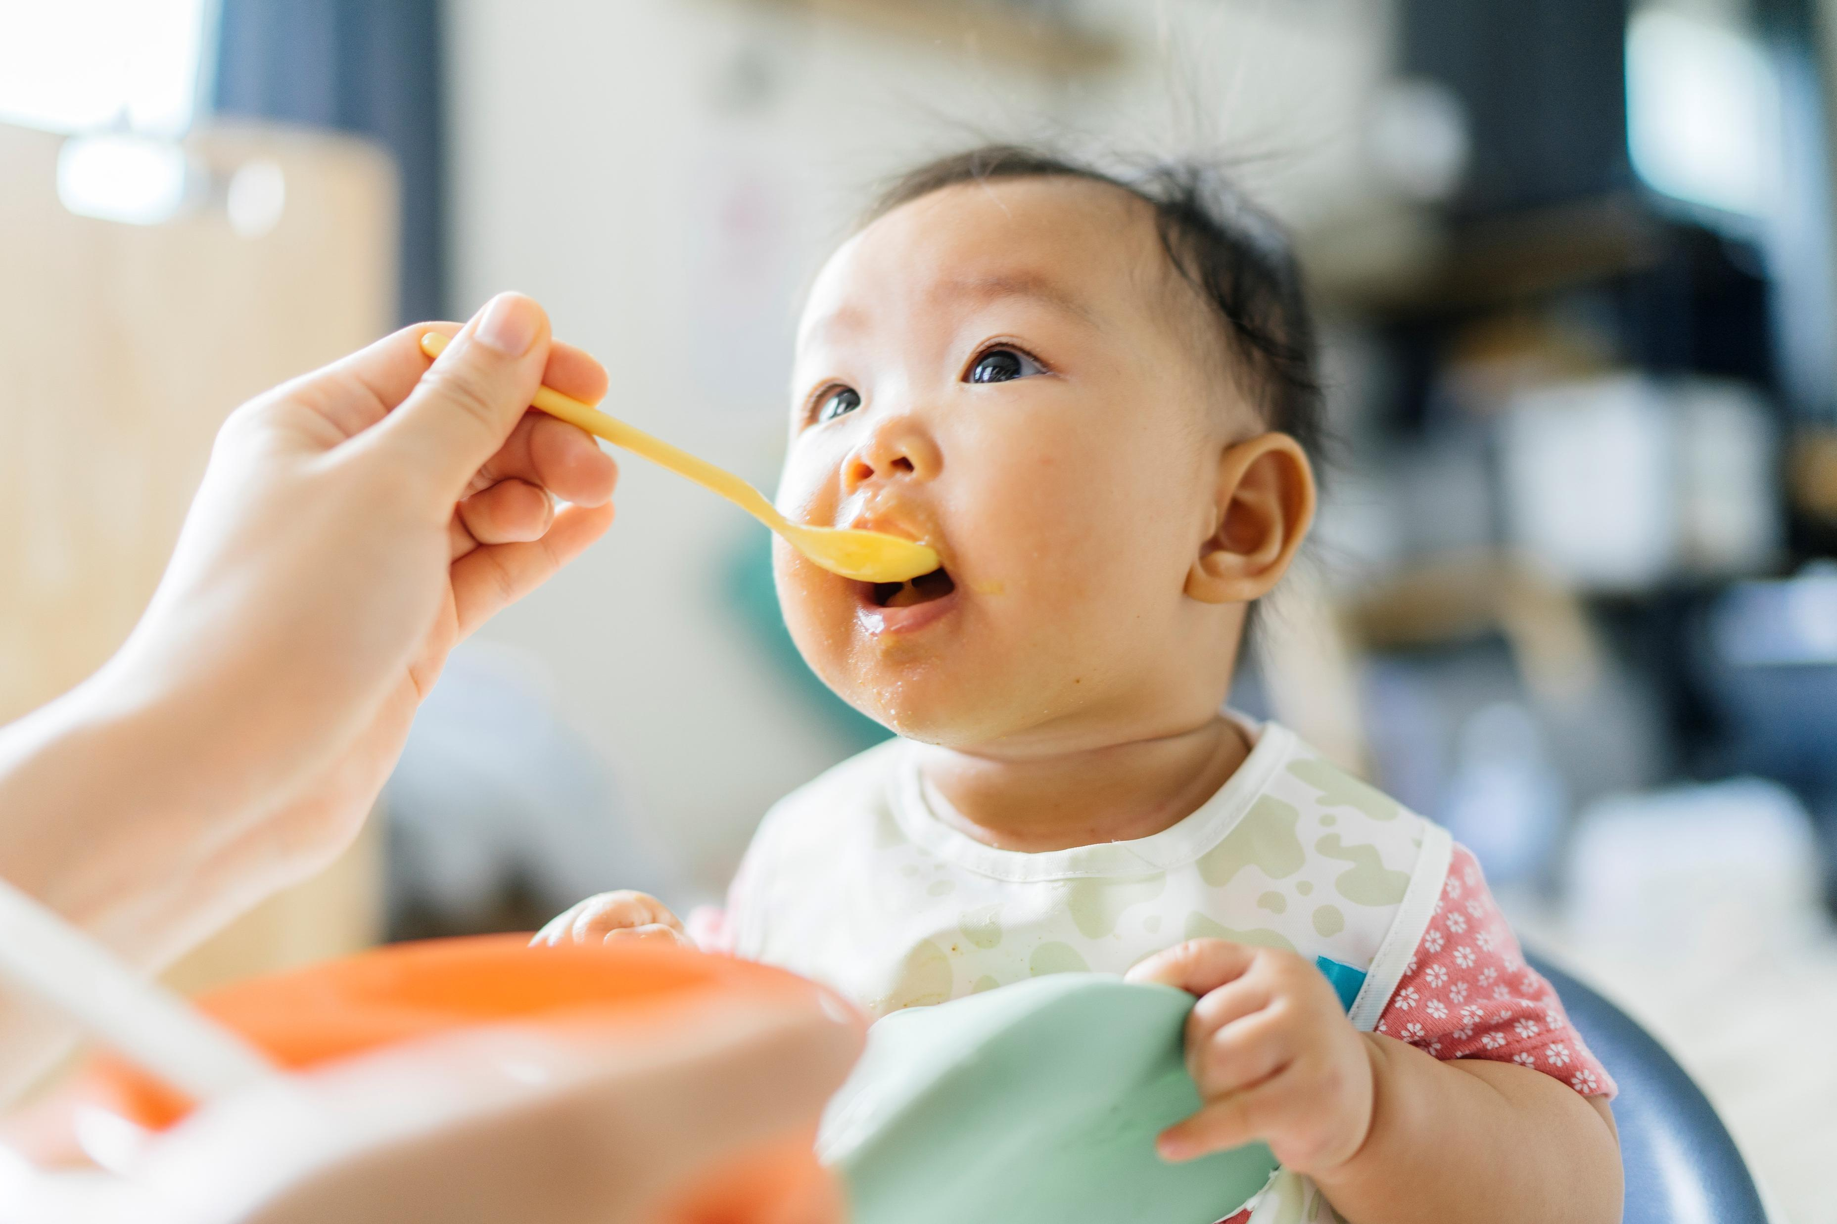
Who should we help?
At the start of the clip the community doesn’t help or serve each other. What happens because of this?
What happens at the end of the clip? How does it reflect your word wall/ideas about kindness?
Think about the word service. The people in the story served each other food, but which of the other words (from your word-wall) did this show?
Did you notice that everyone served each other – how did this show equality?
Notes:
Meaning behind the long spoons: moral of sharing, encourages the nurturing of others as a means of nurturing ourselves. It's the ethic of reciprocity — aka the Golden Rule. In the exact same setting, one group perishes and one group thrives… all based on how they treat each other.

Slide 24
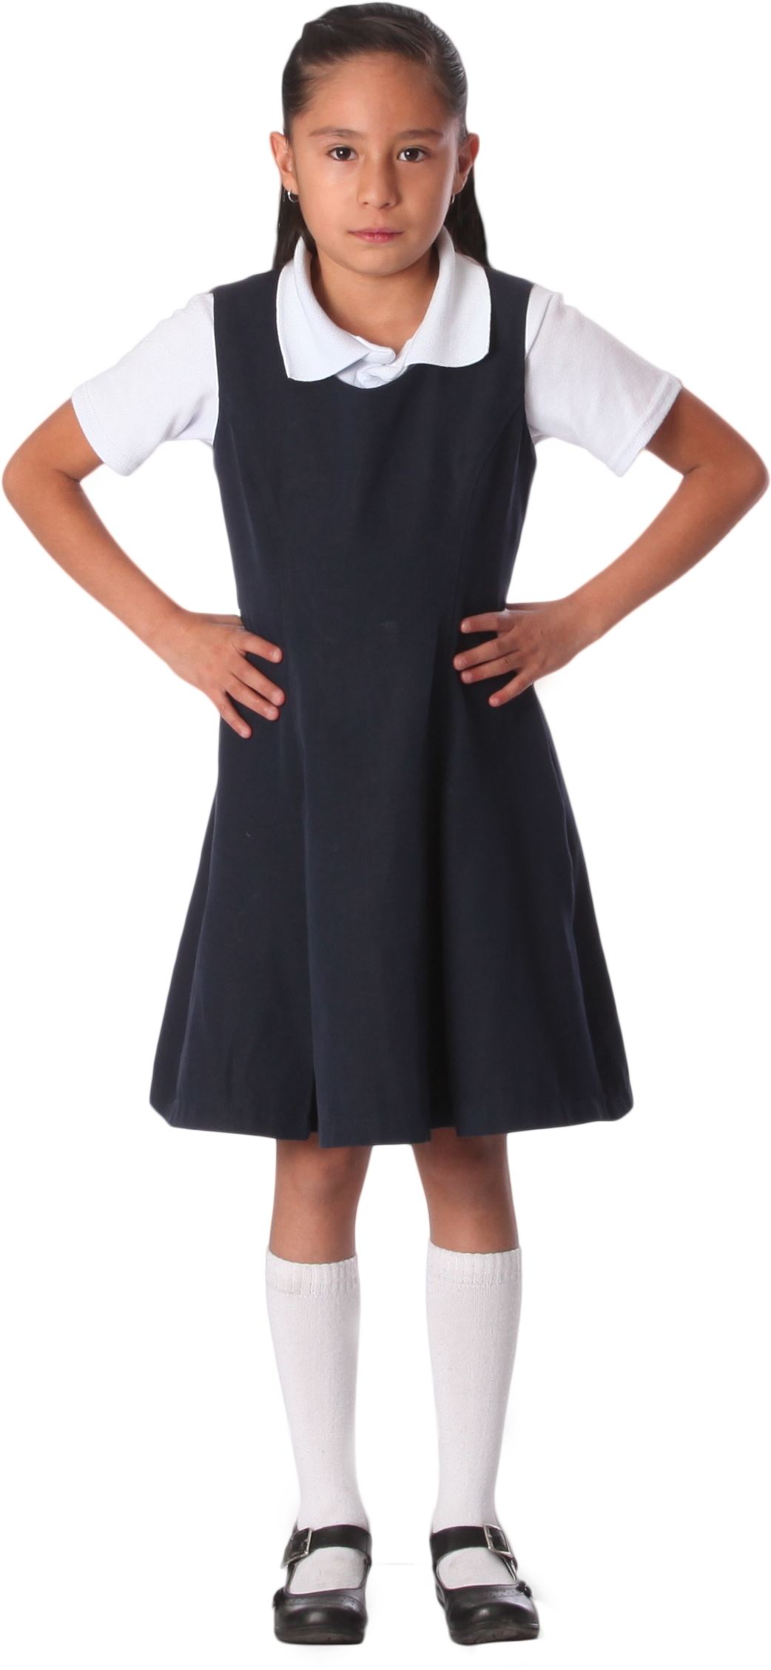
Why is equality important in community?
Within Hinduism there is a teaching called the Purusha Sukta which explains social roles to children.
It says that your body is like a team, and each part has a special job to do.
Notes:
REF: SB

Slide 25
BRAIN: think & decide
ARMS: build & protect
HANDS: create & care for things
LEGS: move & explore
Just like how your body needs all its parts to work together, a community needs everyone to do their part too.

Slide 26
BRAIN: Some people are the brain of the community, they think about important ideas, learn and teach each other. Eg: teachers or scientists.
ARMS: Some people are like the arms, brave and strong, they protect people and make sure they are safe. Eg: police or firefighters
THIGHS: Some are like the thighs, they help everyone get what they need, like food and clothes. Eg: farmers & shopkeepers
FEET: Some are like the feet, they help everyone get around and make sure everything is working well. Eg: builders & delivery drivers

Slide 27
Community
How is the body like a community?
How does each part helping the rest, show equality?
What would happen if one body part stopped serving the rest?

Slide 28
Community
Every single job is important and valuable.
No one job is better than another, just like your feet are not more important than your brain.
If one part of the body doesn't do its job, the whole body suffers.
Similarly, if people don't do their part in the community, it's harder for everyone to live happily and peacefully.
When everyone works together, respecting each other's jobs and helping each other, it's like a strong and happy team.
Everyone playing their part and working together helps the community grow and be successful.

Slide 29
Community
Read through the Bible passage on the next slide.
What are the similarities you can see with the Hindu teaching on the body?

Slide 30
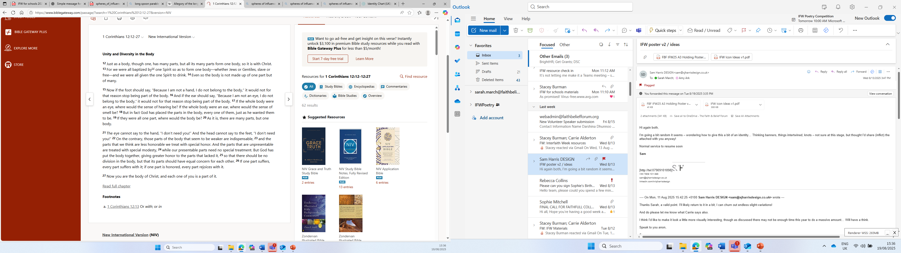

Slide 31
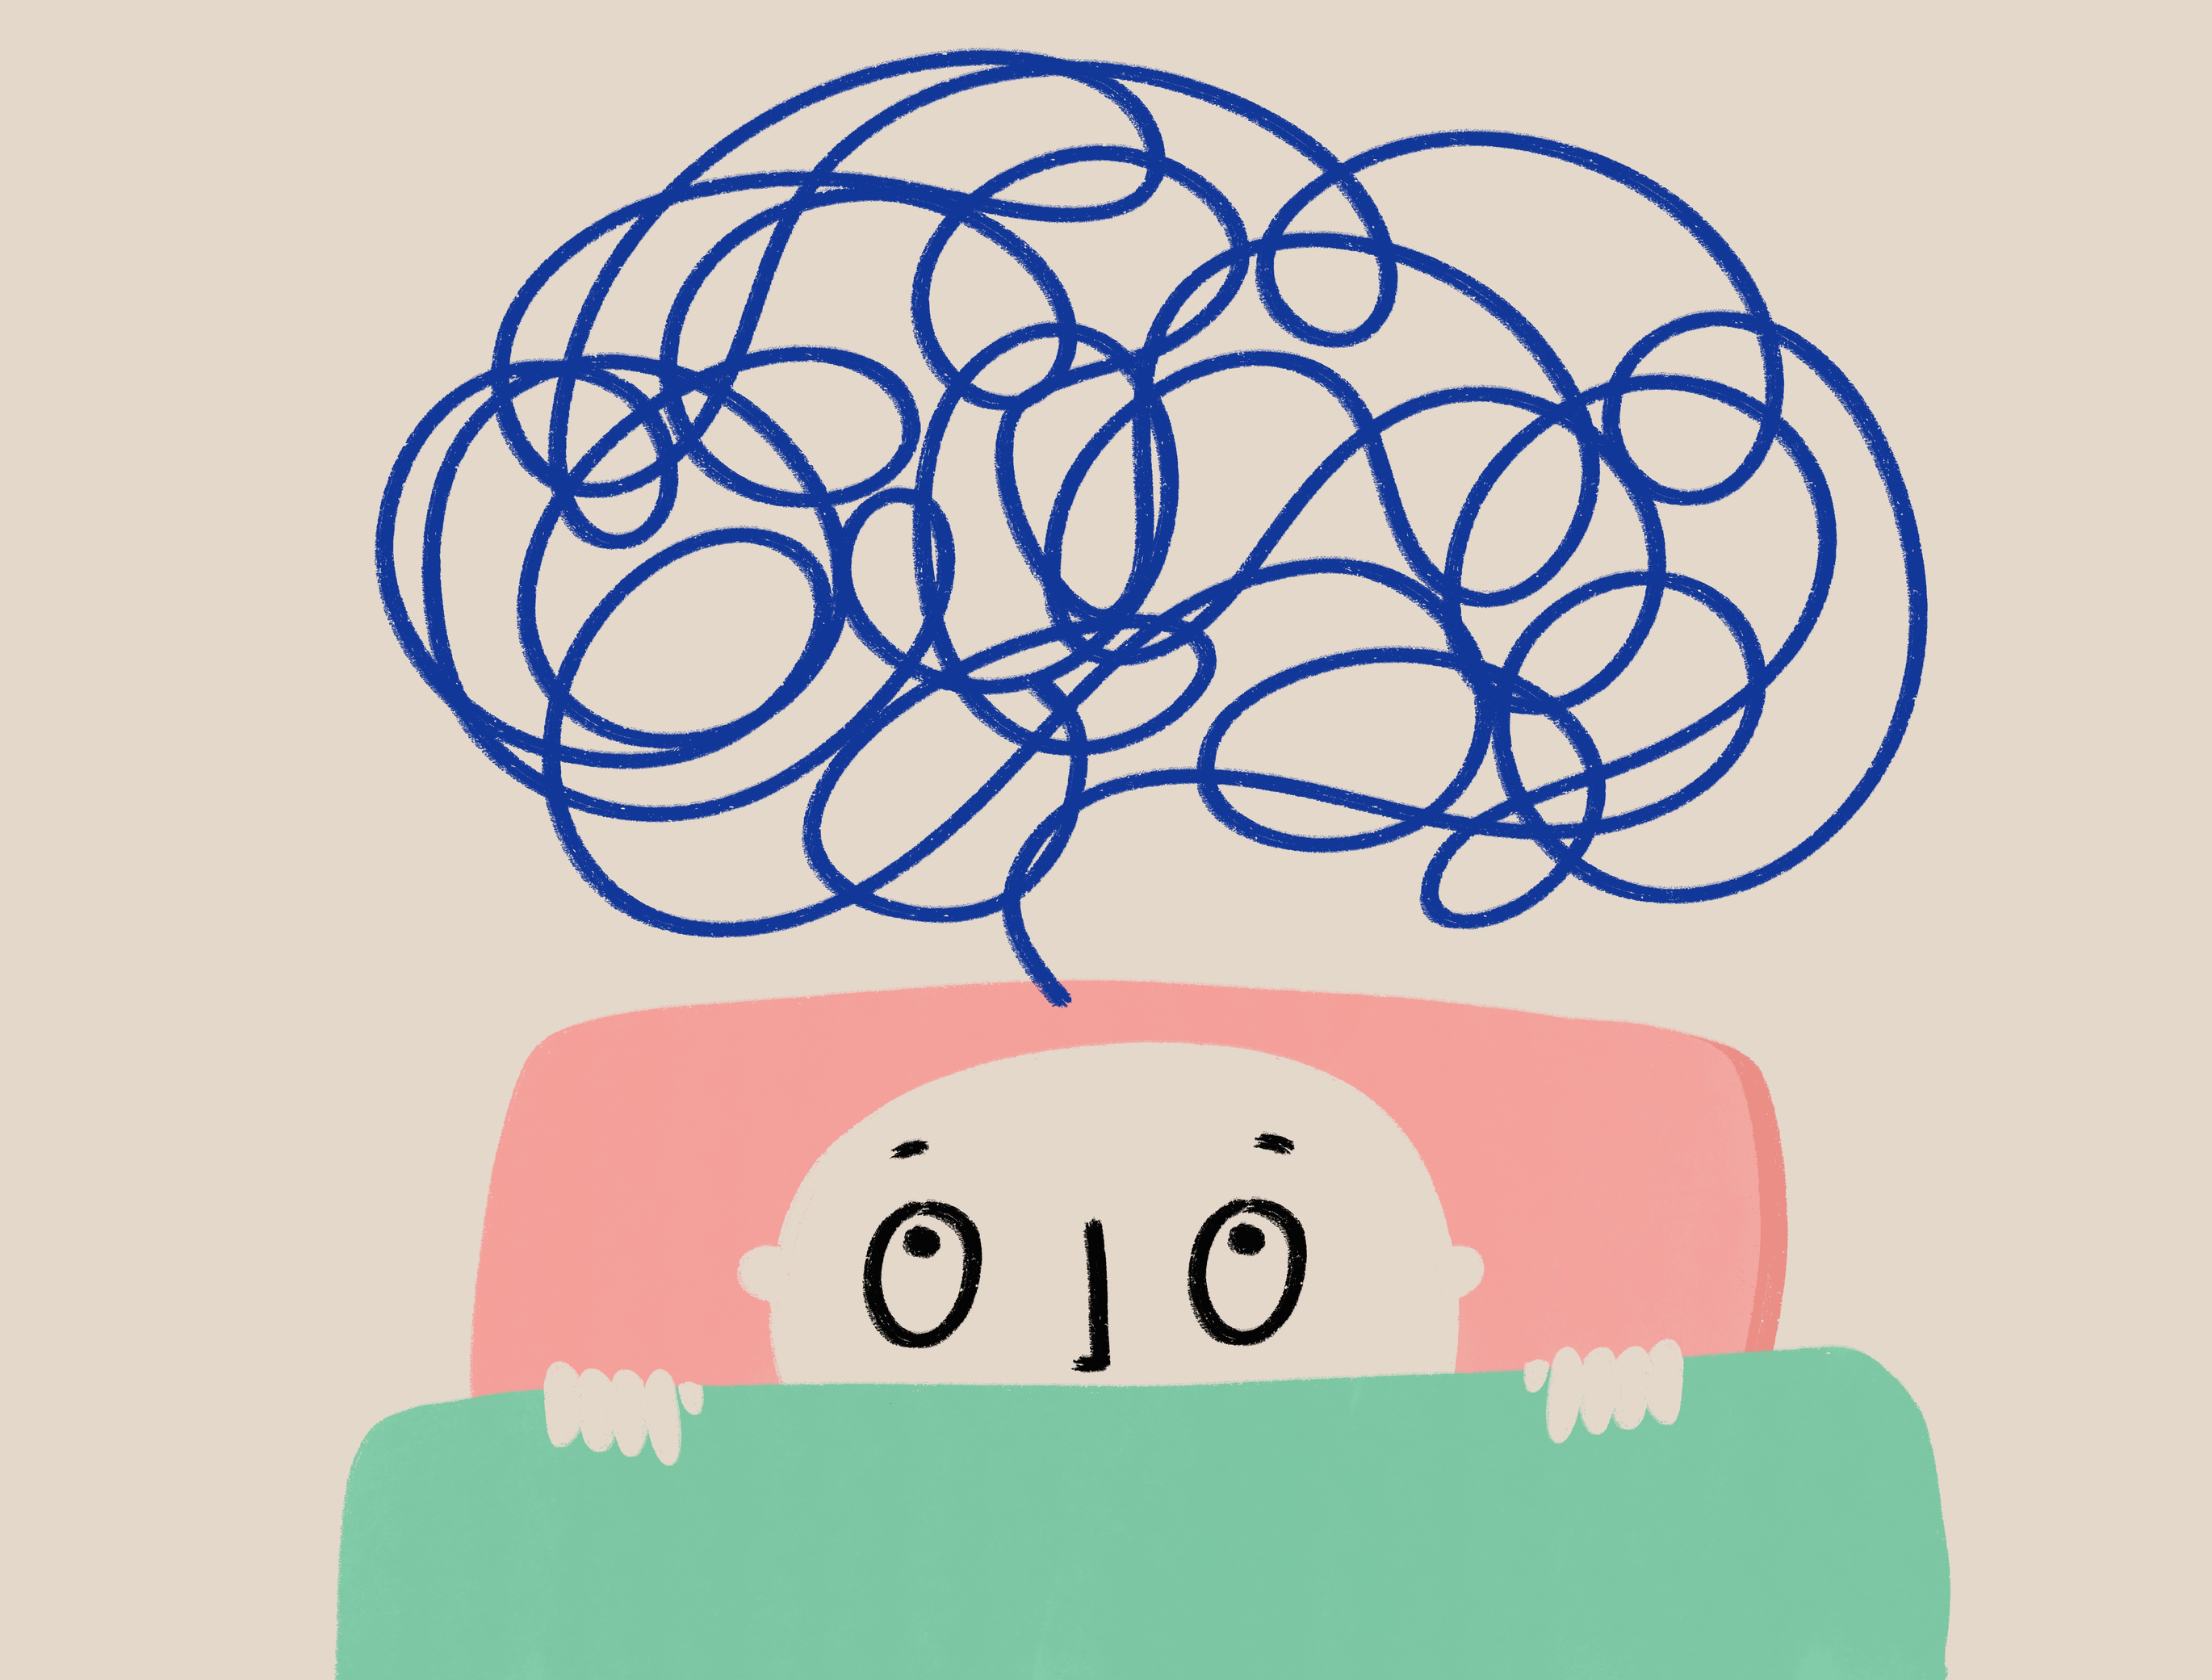
How can serving others bring us together?
Who can remember what community means?
If we just live together but don’t help each other are we still a community?
What have you learnt today?

Slide 32

How can serving others bring us together?
Reflect on the 3 key words we have looked at – service, kindness and equality. How do they fit with the idea of community? Can you have a community without service?
Can you now write a sentence using one of these words?
Notes:
You can just ask the pupils to put their hands up to make the word into a sentence that you then write on the word wall

Slide 33
4. What is so good about sharing?
Notes:
Ask the pupils for some initial answers to this question

Slide 34
Sharing recap
Think back to the story of the long spoons.
What happens if not everyone within our community has food?

Slide 35
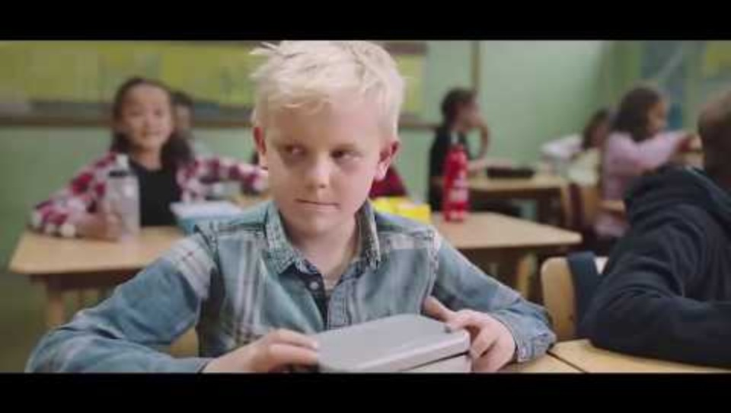
Notes:
REF: https://www.youtube.com/watch?time_continue=1&v=ruW9GzcuFG4&embeds_referring_euri=https%3A%2F%2Fhubblecontent.osi.office.net%2F&source_ve_path=Mjg2NjY

Slide 36
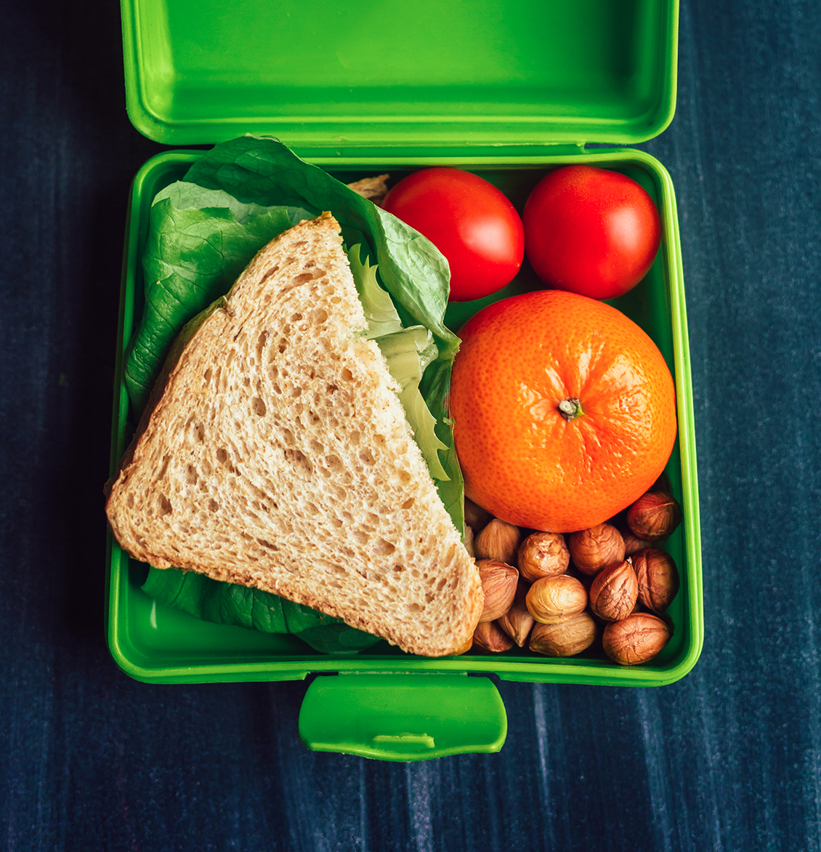

Clip
Which words from your word wall could be seen in the clips?
How did the community help the boy with no lunch?
Up to now, we have looked at how we can help the community.
How did the clip show us what was good about being part of a community?

Slide 37
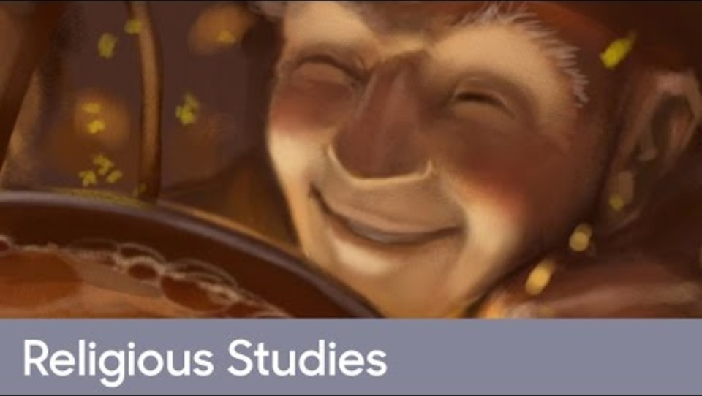
Stone Soup
Notes:
If you would rather read the story here is the link: REF: Stone soup - BBC Teach

Slide 38
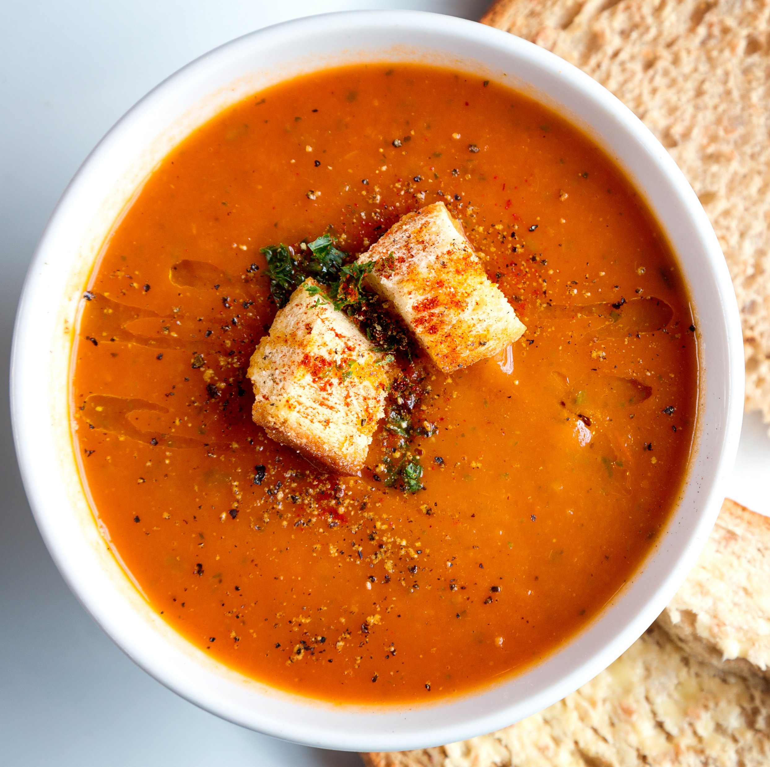
Stone Soup
Why did the old man describe the stone as the ‘vital ingredient’?
What did the community learn from the old man?
Notes:
Read through the story with the pupils

Slide 39

Buddhist Teaching
A long time ago in China, there was a Buddhist monastery with 99 monks and their Head Monk.
The monks lived very simply. They prayed, stayed away from worldly things, and worked hard every day.
They needed food and water to live. For food, they went to nearby villages and kindly asked for alms. For water, they had to walk to a pond some distance away. Since there were no taps, pipes, or wells at that time, the monks carried the water in clay pots back to the monastery.
Inside the monastery, there was a water tank where they poured the water so that all 100 monks could drink from it during the day.
💧 The monks shared the jobs fairly and helped one another. By working together as a community, everyone’s needs were met.
Notes:
Read through the story with the pupils

Slide 40
Buddhist Teaching
Why do you think the monks shared the job of carrying water?
What might happen if some monks refused to help with the water?

Slide 41
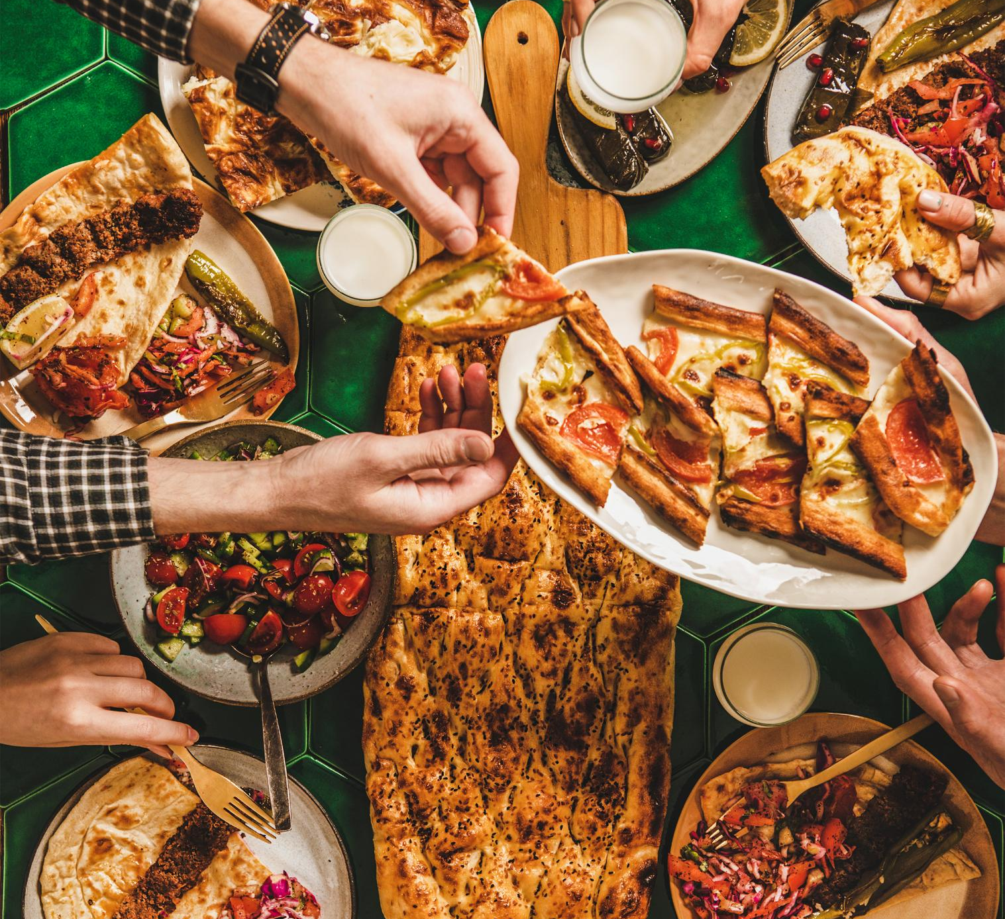
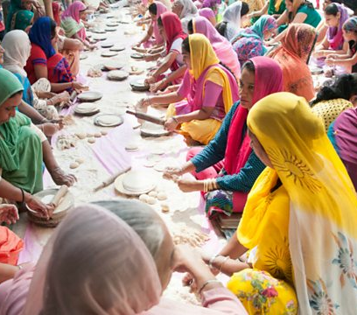
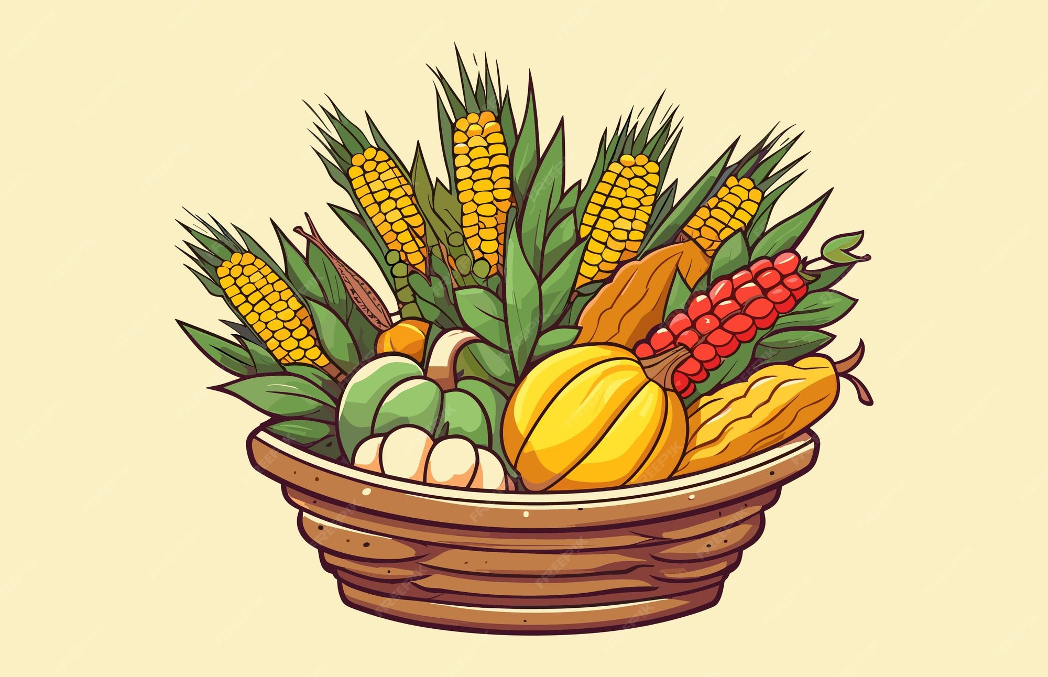
The Teachings
How did the community come together to help each other in the two stories we have just heard?
Can you think of any times when your school community comes together in a similar way?
Notes:
Images show harvest festival, Iftar and Langar- adapt the images to your school. You may have photos showing these events happening within your school. If no examples talk through the ones shown.

Slide 42
Think about the school canteen. Would you rather eat alone or together?
How many people are there to help us with our lunch?
How do we all work together to make it better?
How do we show equality in the canteen?
What is good about eating together?
Do you enjoy eating in the canteen with more people or do you prefer to eat on your own?
What words about sharing food and eating together could we add to our word wall?

Slide 43
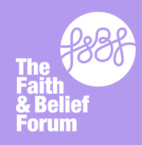
Interfaith Week Poetry Competition 2025
This year we are inviting you to take part in our Interfaith week poetry competition.
We are asking you to write a poem on the theme Community: Together we Serve
We want to see you using the key concepts and perspectives from the IFW session reflected in your work.
Your teacher will judge a Key Stage 1 and Key Stage 2 winner in school; the winner will then be sent to the Interfaith Week team to judge nationally.
There will be lots of exciting prizes and certificates for individuals and the school.
Further information available from your teachers.
Closing date 28th November
www.ifw4schools.co.uk

