Slide 1

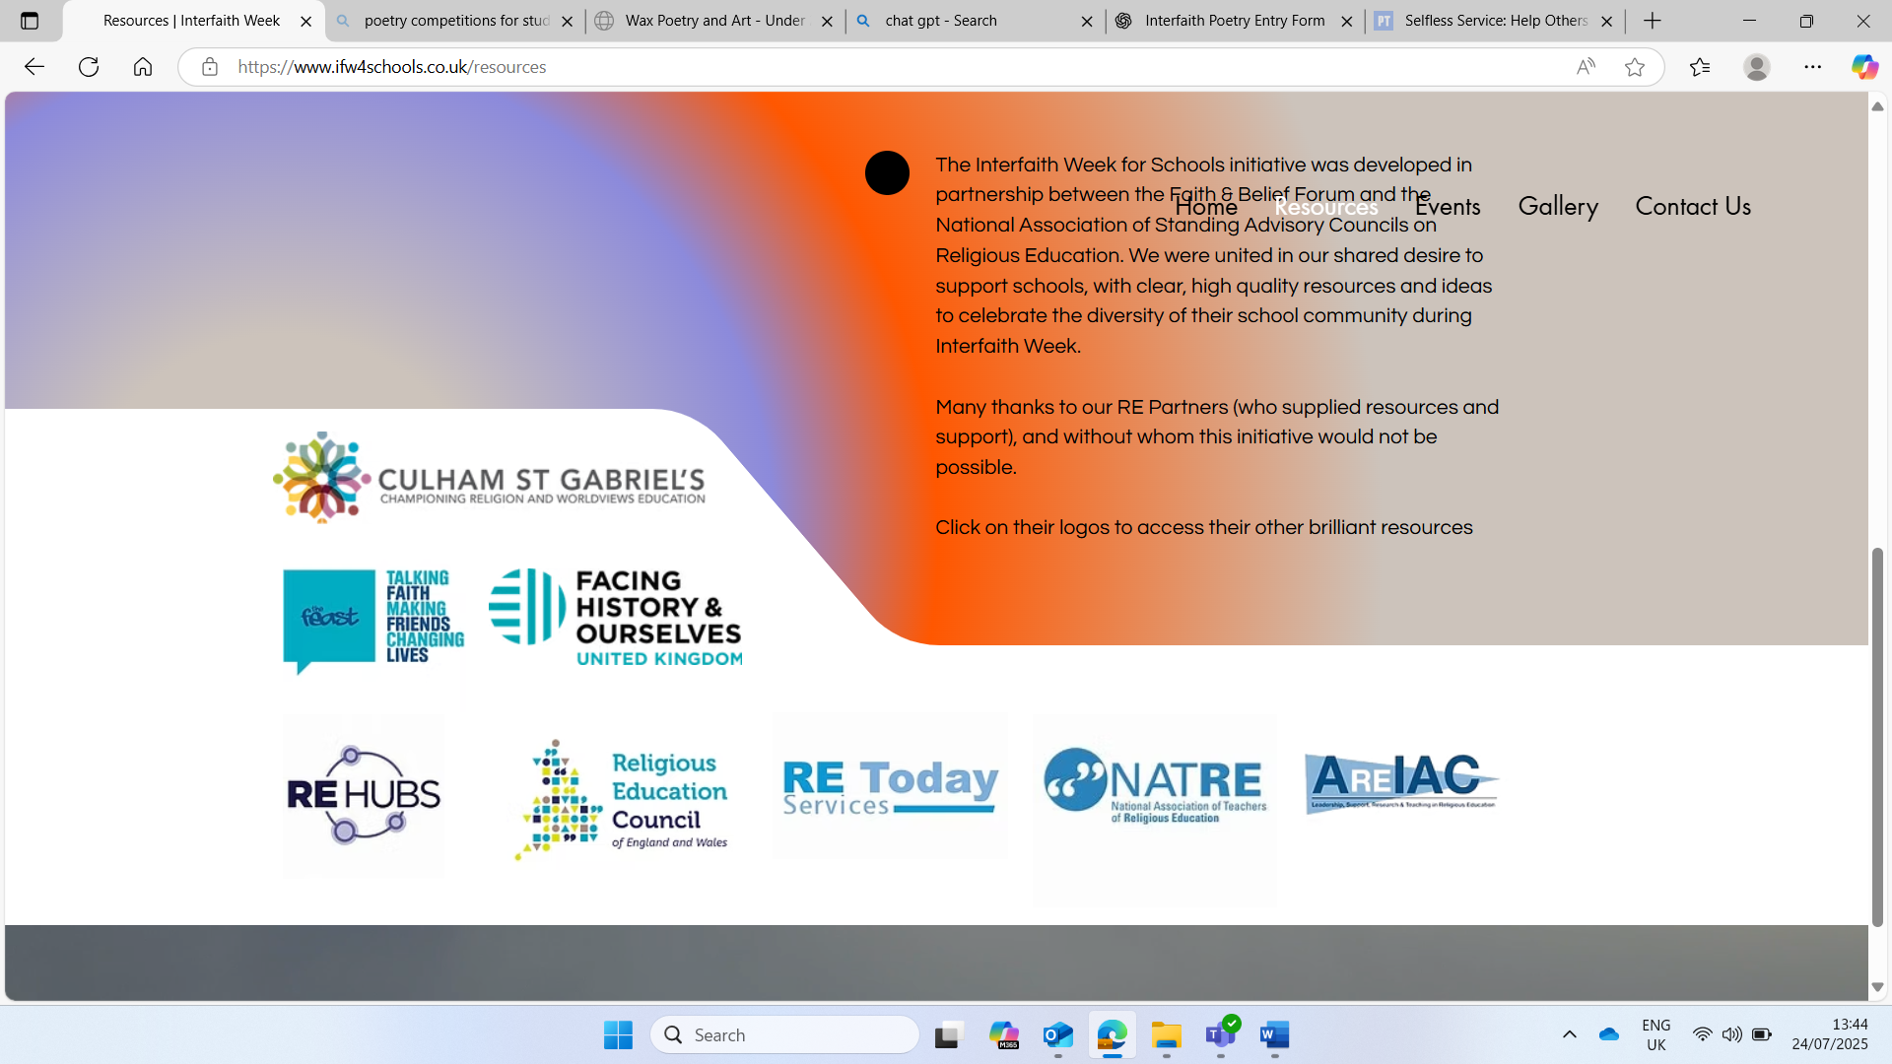

Interfaith Week 2025
Community: Together We Serve
KS4/5: Introduction
Notes:
This week is Interfaith week, a time when we learn about how people of different religions and beliefs can be friends, work together and help others. This year's theme is Community: Together we Serve, this means helping others and making our community a kinder place, together! We will be looking at people from different faiths, and those of no faith to see what they think about our theme. Throughout the week we will be engaging in Interfaith Dialogue. Interfaith means we will be looking at more than one faith and dialogue means sharing ideas. So we will be sharing ideas about community and service from different faith points of view.

Slide 2
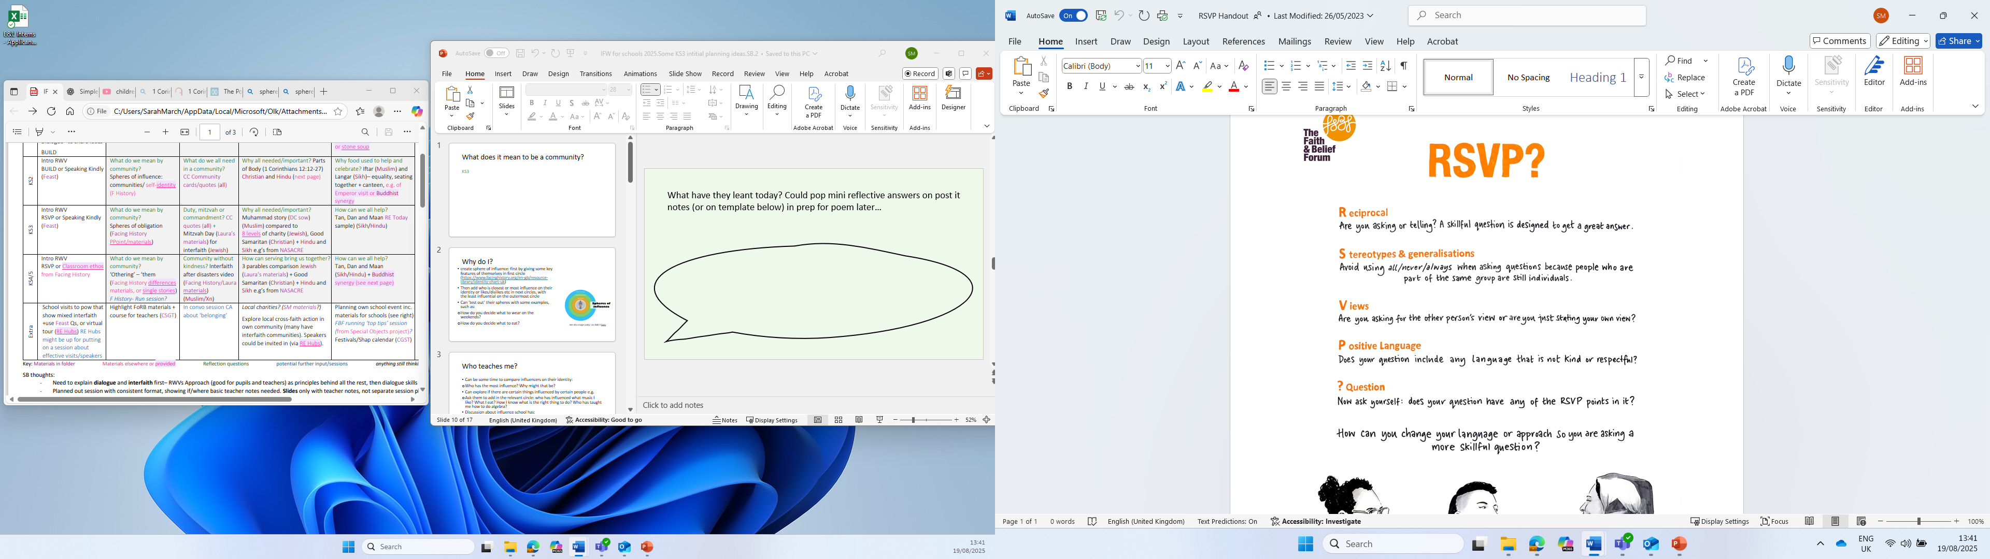
RSVP?
When sharing our own faith and beliefs, it’s important to agree on some ground rules. This helps to ensure that everyone feels comfortable, respected, and able to speak in a brave and safe space.
Look at the RSVP information.
It is important that we all understand and agree to follow these guidelines throughout the session.
Notes:
REF: Faith and Belief forum

Slide 3

1.What does it mean to be a community??
Notes:
Ask the pupils for some initial answers to this question, do they know the word? What does it mean to them?

Slide 4
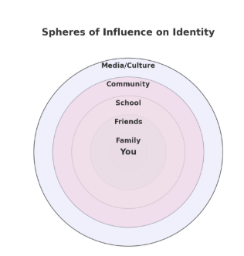
Your sphere of influence
Our identity is shaped by many people and the things around us. These are also known as spheres of influence.
They might include family, friends, school, community, culture, religion or media.
Use the blank diagram to fill in the different spheres of influence in your life with specific examples.
Notes:
Use the example on the slide to help them
Ref: Facing history and ourselves

Slide 5
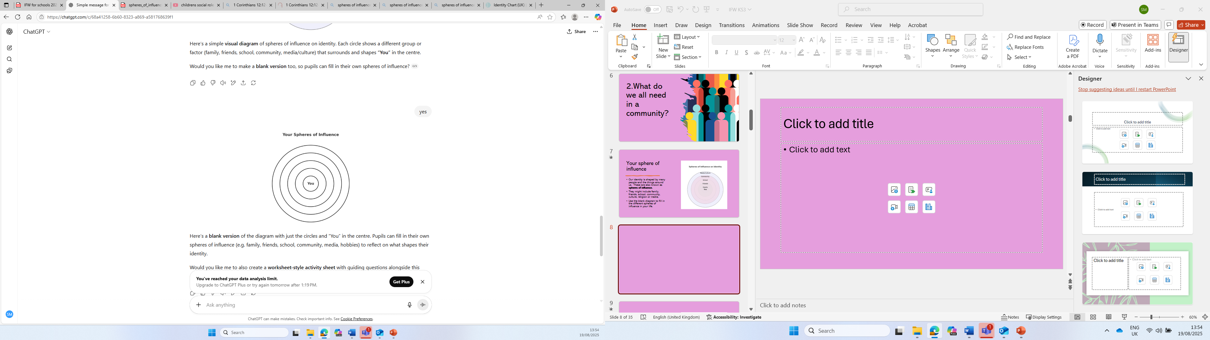
Your sphere of influence
In Circle 1, write your name.
In Circle 2, write the name of people/groups/beings to whom you feel the greatest obligation to or sense of care for – for example, people for whom you’d be willing to take a great risk or put yourself in peril for (you don’t have to write actual names.)
In Circle 3, who are the people/groups/beings on the next level? That is people to whom you have some obligation/responsibility, but not as great as in circle 2.
In Circle 4, who are the people/groups/beings on the next level? People to whom you have some obligation, but not as great as in circle 3.
Notes:
Ref: Facing history and ourselves

Slide 7
Your sphere of influence
Think about the following questions to help you with your spheres.
Who in your family influences the way you think or act?
How do your friends shape your identity?
What role does your school or teachers play in who your becoming?
Does your community, culture or religion influence your values?
How does the media affect the way you see yourself?
Notes:
Use the example on the slide to help them

Slide 8
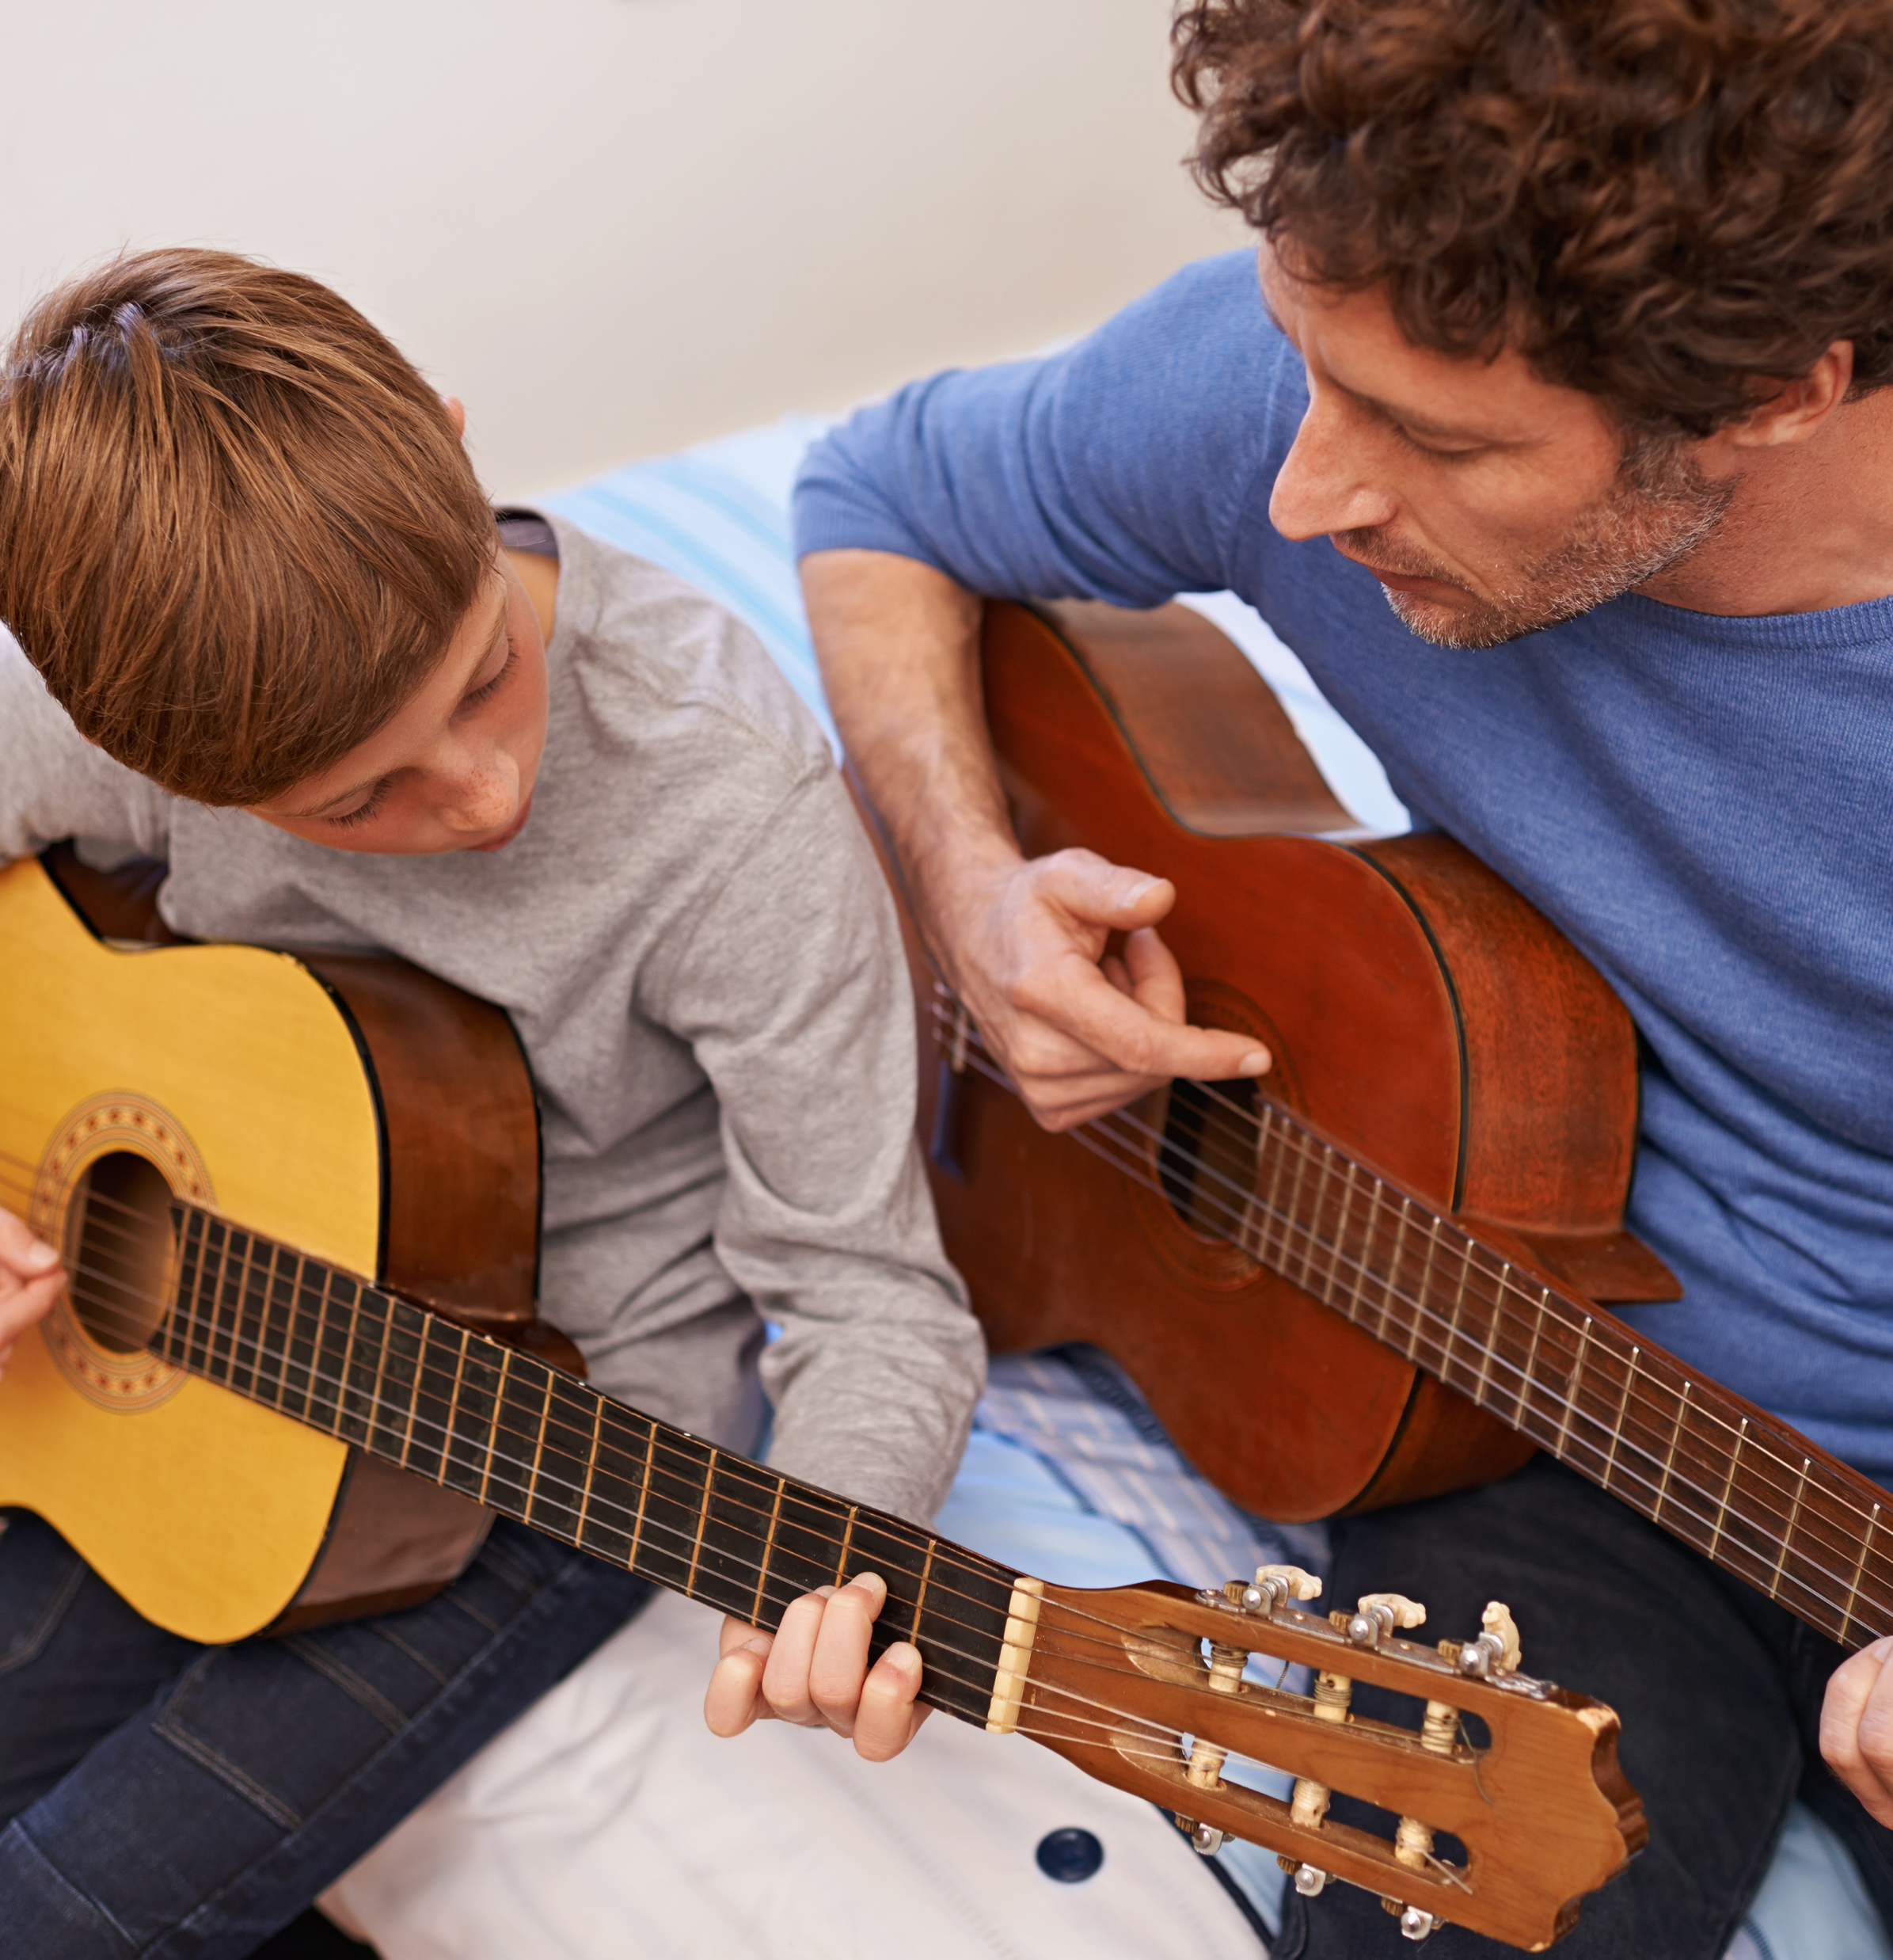

Who influences you?
Who has the most influence on you and why?
Are there certain people who are a stronger influence in some areas than others?
Who has influenced what music you like?
What food you like?
How you know right from wrong?
Who has taught you how to read?
Notes:
Allow students time to discuss their spheres with others and then bring them back together for a group discussion on the questions on the slide.

Slide 9

Who influences you?
School
Are there things you have learnt in school you would not have with any of the other influences in your circle? Why?
Why might it be a good thing to have more people to help and learn from?

Slide 10
What does community mean?
Unity: means ‘one’
COM: means ‘with’
COMMUNITY
Look back at your spheres of influence. How many communities can you see?
What are the positives about being part of a community?
Are there any negatives?
Notes:
Explain the etymology of the word community Com: with and Unity: One

Slide 11
What does being part of a community mean?
What does the term obligation mean?
Can you define it?
Write a one sentence definition, considering the words duty, responsibility, serve and care.
An act or course of action to which a person is morally or legally bound; a duty or commitment
If you were to complete a sphere of obligation would you have the same information. Why might that be?
Notes:
Check their own definition to the dictionary definition

Slide 12
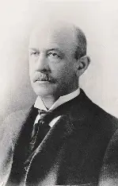
What does being part of a community mean?
Every man and woman in society has one big duty. That is, to take care of his or her own self.
Sociologist William Graham Sumner, 1800s
Do you agree with the quote?
Why might ignoring the other spheres be dangerous when thinking about obligation, duty and responsibility?
Notes:
Discuss the quotes, check understanding and explain any parts that may be unclear. Do you agree with it?

Slide 13
What do we do with a variation? James Berry
What do we do with a difference?
Do we stand and discuss its oddity
or do we ignore it?
Do we shut our eyes to it
or poke it with a stick?
Do we clobber it to death?
Do we move around it in rage
and enlist the rage of others?
Do we will it to go away?
Do we look at it in awe
or purely in wonderment?
Do we work for it to disappear?
Do we pass it stealthily
or change route away from it?
Do we will it to become like ourselves?
What do we do with a difference?
Do we communicate to it,
let application acknowledge it
for barriers to fall down?
Choose one of the lines in the poem and connect it to a time you experienced difference. Is there a word to describe how your school or community has reacted to difference?
What do you think the phrase “let application acknowledge it” means? How might it connect to the idea of barriers?
What is the message of the poem?
Write another stanza of the poem describing how you’d like to see your community respond to differences today
How did those in the outer circles of his sphere respond to him?
Notes:
Read the poem out loud to the students
Ref: What Do We Do with a Difference? | Facing History & Ourselves
Explain that next session we will be aiming to recognize the importance of looking and listening to others about how they serve the community. Refer back to RSVP? To consider why it is so important that we respond to comments in a positive way.

Slide 14

2.What do we all need in a community?
Notes:
Initial thoughts from the pupils. Recap that we will be looking and listening to others about how they serve and help their community.

Slide 15

What do we all need in a community?
Look at the quotes on the following slide.
Complete the table you have been given.
Notes:
Discuss the quotes, check understanding and explain any parts that may be unclear.

Slide 16
Those who see all creatures in themselves and themselves in all creatures will find true unity
Caring for our fellow human beings is our highest calling
Whatever you say should be just, don’t be biased
We don’t believe in God, but we do believe in good
Be truthful and honest. Give people 2nd chances
As each Christian has a physical body through Jesus they form one spiritual body where everyone belongs to each other
In dealing with people, treat them with good and kind manners
Don’t show partiality to the poor or favouritism to the great, but judge all fairly
Always aim at purifying your thoughts and all will be well
Love God and love other people as you love yourself
A friend loves at all times, and a brother is born from a time of adversity
Always speak the truth. God and truth are two and one
Do not harbour evil intentions in your mind towards others
Generosity in everything
Notes:
Ref: REmatters

Slide 17
Quote | Example of this quote in action | Which is the most important for your class and why? | Which is the most important for the country and why? | What faith or belief?
Always speak the truth. God and truth are two and one
Whatever you say should be just, don’t be biased
Don’t show partiality to the poor or favouritism to the great, but judge all fairly
Do not harbour evil intentions in your mind towards others
We don’t believe in God, but we do believe in good
Always aim at purifying your thoughts and all will be well
Generosity in everything
Notes:
Print this slide and slide 15 for the students to fill in

Slide 18
Quote | Example of this quote in action | Which is the most important for your class and why? | Which is the most important for the country and why? | What faith or belief?
Be truthful and honest. Give people 2nd chances
Love God and love other people as you love yourself
Those who see all creatures in themselves and themselves in all creatures will find true unity
As each Christian has a physical body through Jesus they form one spiritual body where everyone belongs to each other
A friend loves at all times, and a brother is born from a time of adversity
Caring for our fellow human beings is our highest calling
In dealing with people, treat them with good and kind manners

Slide 19








Those who see all creatures in themselves and themselves in all creatures will find true unity
Caring for our fellow human beings is our highest calling
Whatever you say should be just, don’t be biased
We don’t believe in God, but we do believe in good
Be truthful and honest. Give people 2nd chances
As each Christian has a physical body through Jesus they form one spiritual body where everyone belongs to each other
In dealing with people, treat them with good and kind manners
Don’t show partiality to the poor or favouritism to the great, but judge all fairly
Always aim at purifying your thoughts and all will be well
Love God and love other people as you love yourself
A friend loves at all times, and a brother is born from a time of adversity
Always speak the truth. God and truth are two and one
Do not harbour evil intentions in your mind towards others
Generosity in everything
Notes:
Check the faith is matched to the quote

Slide 20
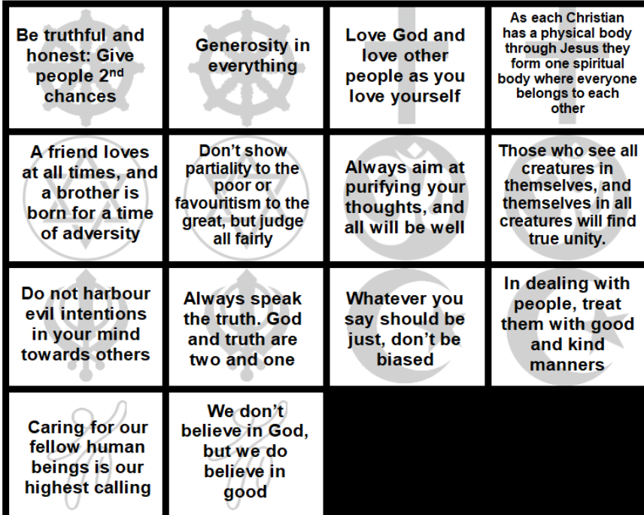
Would it be a community without kindness?
Pick out the key words from these quotes such as love, kindness, wisdom and add to the last column on your table.
Which are the top three words in your opinion and why?

Slide 21



Why a commandment for kindness?
Some examples of interfaith work in the UK are:
Scriptural reasoning: When members of different religions come together to examine common themes or people in their religious traditions.
Shared spaces: Some churches work with other religions to share spaces or to give disused buildings to another religion to use.
Councils of faiths: When local committees of different religions come together to talk and campaign on issues of shared interest.
Disaster Response: Different religions often come together to respond to humanitarian issues and provide support/funds for those in need.
Shared Celebrations: When people of one religion invite others to important celebrations to understand and share in the important parts of their religion.
Which of the quotes from the previous activity match the examples of the interfaith work mentioned here?
Notes:
Ref: Assembly: November 2025 - Interfaith Week.pptx - Google Slides

Slide 22
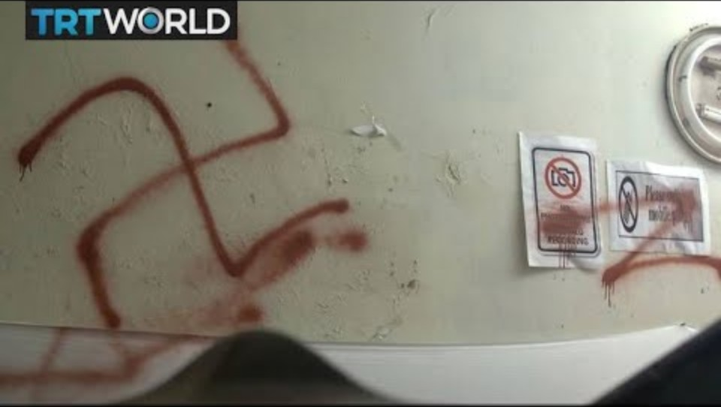
Why a commandment for kindness?
1.How did the attack impact the Muslim community?
2.What is the school principal Mufti Muhammad Abdulmuheet’s response towards the attackers?
3.How do other faith leaders respond to the attack?
  a.What is powerful about this response?
  b.How do you think it made those attacked feel?
4.What does this example show about the power of interfaith collaboration?
Which of the quotes from the previous activity match the examples of the interfaith work mentioned here?
Think back to the poem ‘What do we do with a variation?’ How is the response in the clip different to the response in the poem?
Why does kindness need to be shown to all others in the wider community, not just those who are the ‘same’as us?
Notes:
Ref: Assembly: November 2025 - Interfaith Week.pptx - Google Slides
Discuss or write down the answers to the questions.

Slide 23
Notes:
What have the students learnt in this session? Write on a post it note or the template and save

Slide 24
3. How can we serve our community?
Notes:
Ask the pupils for some initial answers to this question

Slide 25

Who might we serve?
We are now going to look at some examples of kindness and service from Sikhi and the Hindu faith.
For each example answer the following questions:
How do each of these faiths demonstrate service to others?
Which circle of obligation would these examples fit into?
Does it mean more to show kindness and service to someone who doesn’t have the same beliefs as you? Or someone who is on your outer circle? Why?

Slide 26
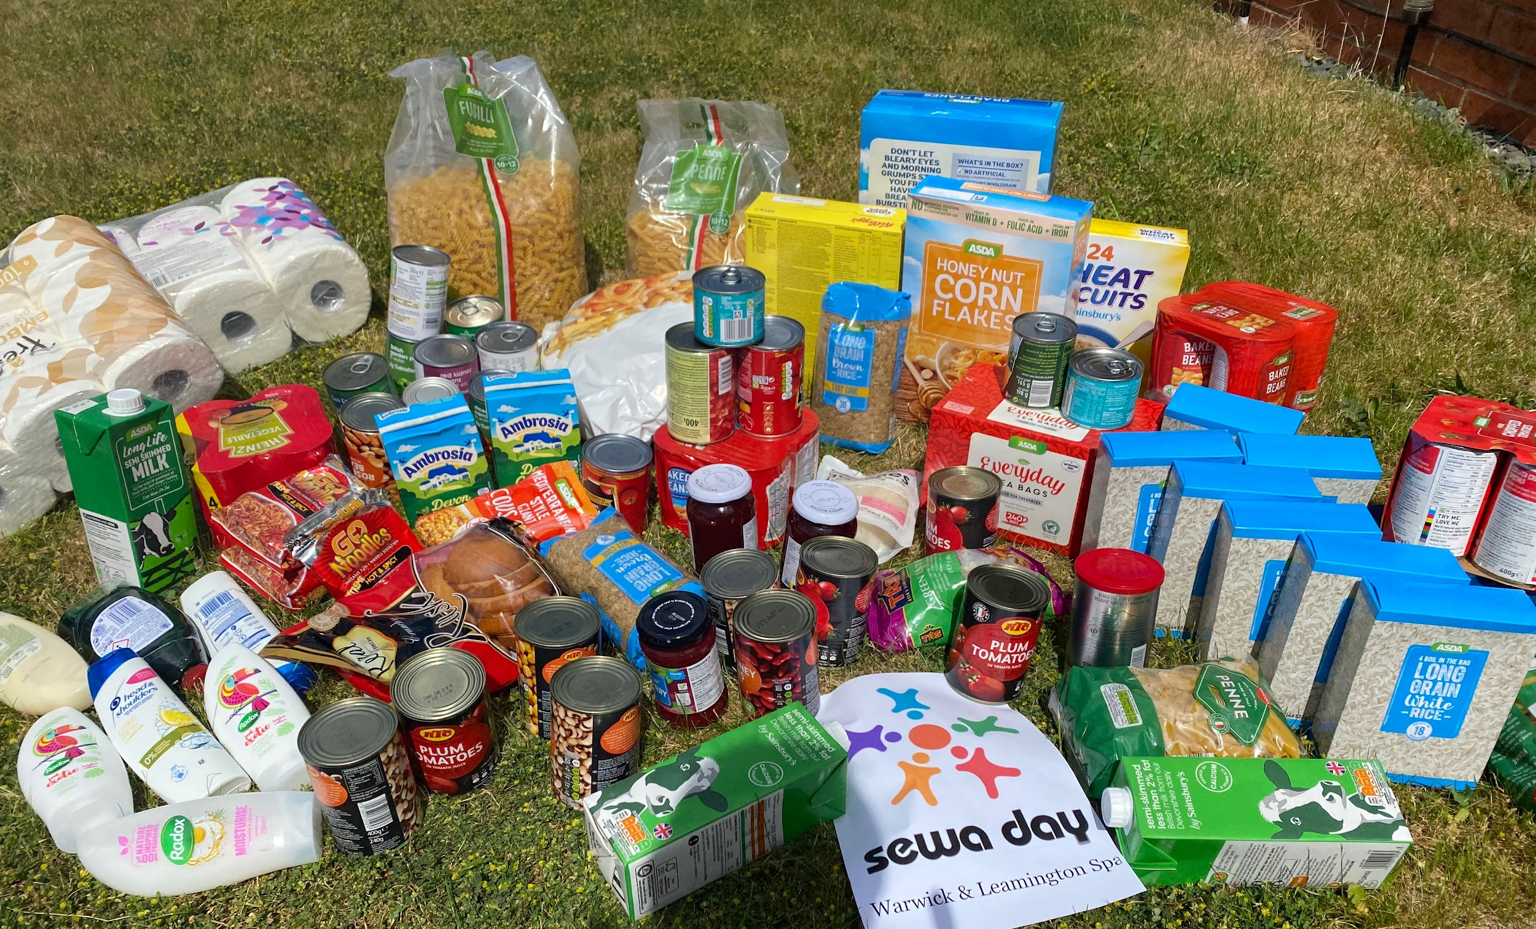
Hindu Faith
Hindus During Covid
Hindus helped restore a balance in the society and country they were living in by doing Sewa/service.
They replenished food banks, supplied PPE and cooked and delivered hot meals to elderly and disabled.
Hindus recognise the whole world as a one big family. VASUDHAIVA KUTUMBAKAM
Like in a family they accept all the members irrespective of their opinions and differences. The same way Hindus accept whole of Human race as one family irrespective of their beliefs.
Hindus apply this not only to human race but extend it to all living things too.
Notes:
How do each of these faiths demonstrate service to others?
Does it mean more to show kindness and service to someone who doesn’t have the same beliefs as you? Why?
Ref: NASACRA

Slide 27
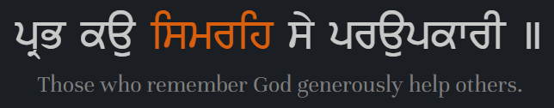
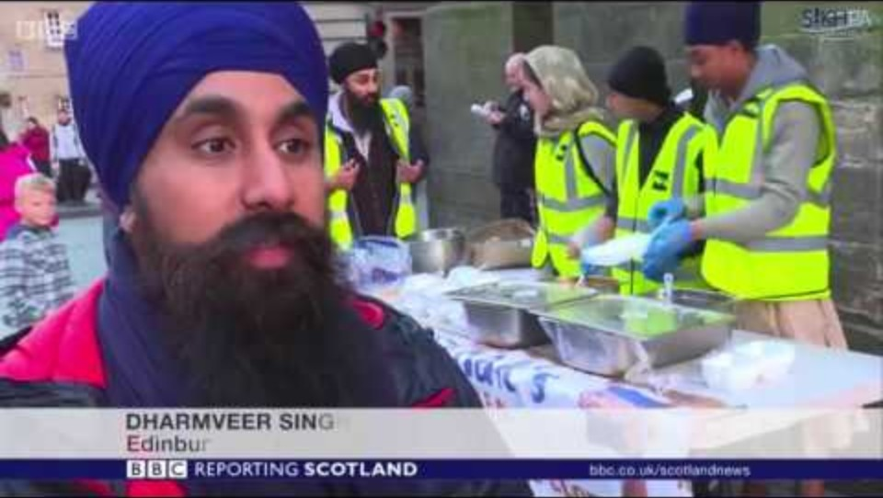
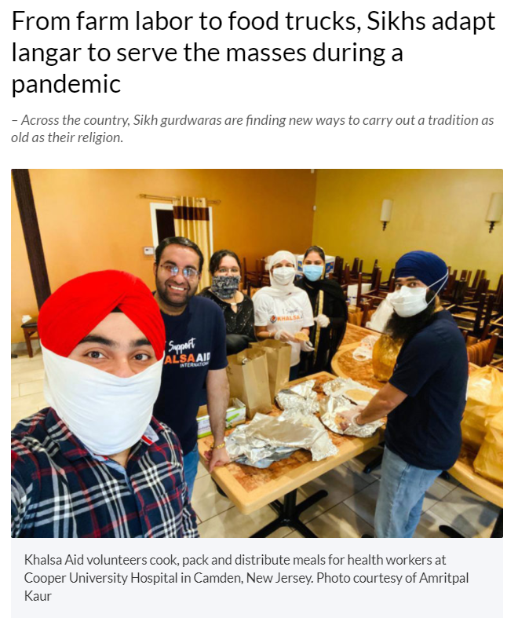
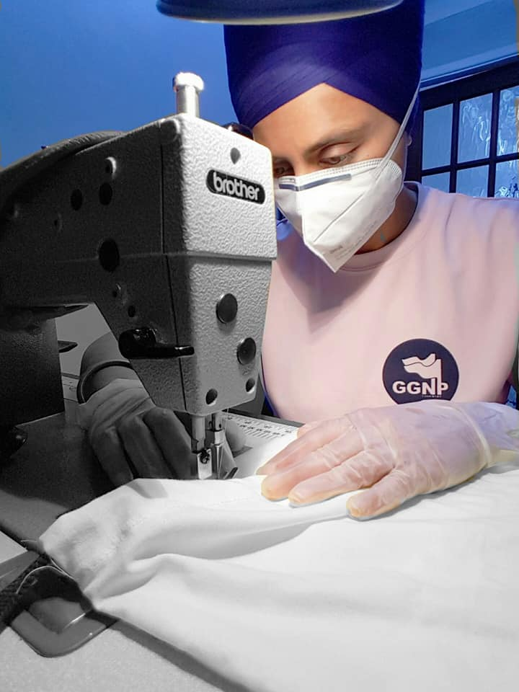
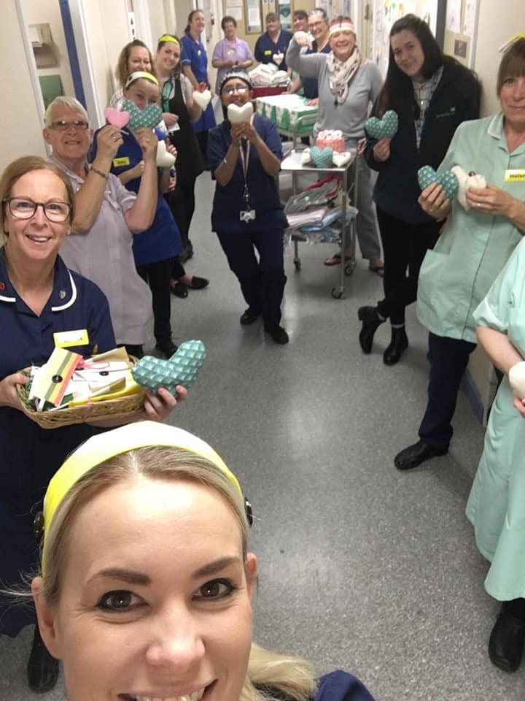
Sikh Faith
Notes:
How do each of these faiths demonstrate service to others?
Does it mean more to show kindness and service to someone who doesn’t have the same beliefs as you? Why?
REF: NASACRA BBC

Slide 28


Does some service mean more?
Which spheres of community/obligation are being reflected?
What service is being given?
How is this more than just donating?
Is this type of service like obligation?
Three Parables for Integration
Rabbi Jonathan Sacks tells three parables about 100 strangers looking for somewhere to stay.
In the first parable, they are wandering around the countryside and arrive at a big country house where they are welcomed to live with the owner as guests. This is society as a country house.
In the second parable, they are wandering around a city and find a hotel. They are able to pay to stay and have more freedom and equality than in the first parable as the hotel only has guests (there is no power imbalance). This is society as a hotel.
In the third parable, the strangers arrive at a town and are welcomed by everyone and are helped to build their own homes on an empty patch of land. This is society as a home we build together.
In relation to this third model, Sacks states:
The newcomers still occasionally seem strange. They speak and act and dress differently than the locals. But those long sessions of working together have had their effect. The locals know the newcomers are serious, committed, dedicated. They have their own ways, but they have also learned the ways of the people of the town, and they have worked out [...] a rough and ready friendship. [...] Making something together breaks down walls of suspicion and misunderstanding. [. . .] That is society as the home we build together.
Notes:
Ref: Facing history & ourselves
Read through with the students, discuss and check understanding

Slide 29
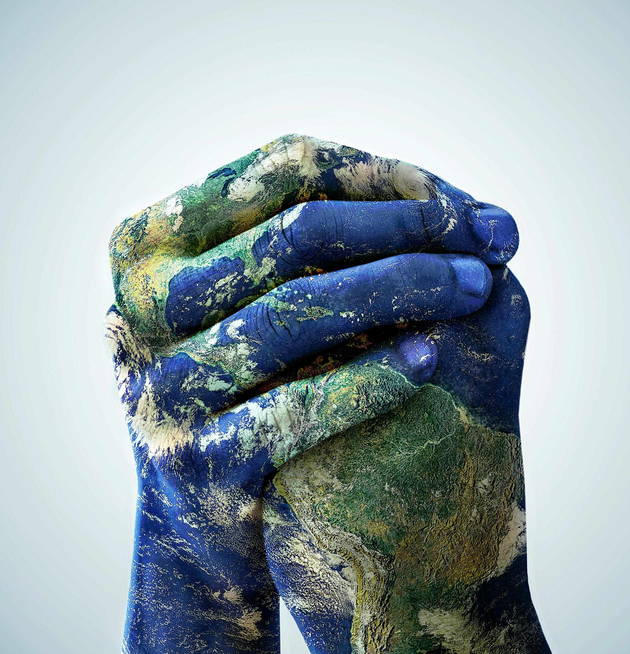
How can serving other bring us together?
Think back to the examples of service from the Hindu and Sikh communities we looked at previously.
Where in the spheres would these examples fit? Would another sphere need to be added?
Think again about why it might be important to serve others in the wider community, not just those who are the ‘same’ as us?
How can this negate the examples of ‘differences’ mentioned in the poem?

Slide 30
How can serving others help bring us together?
Notes:
Add answers from the student onto white board

Slide 31
4. What is so good about sharing?
Notes:
Ask the pupils for some initial answers to this question

Slide 32
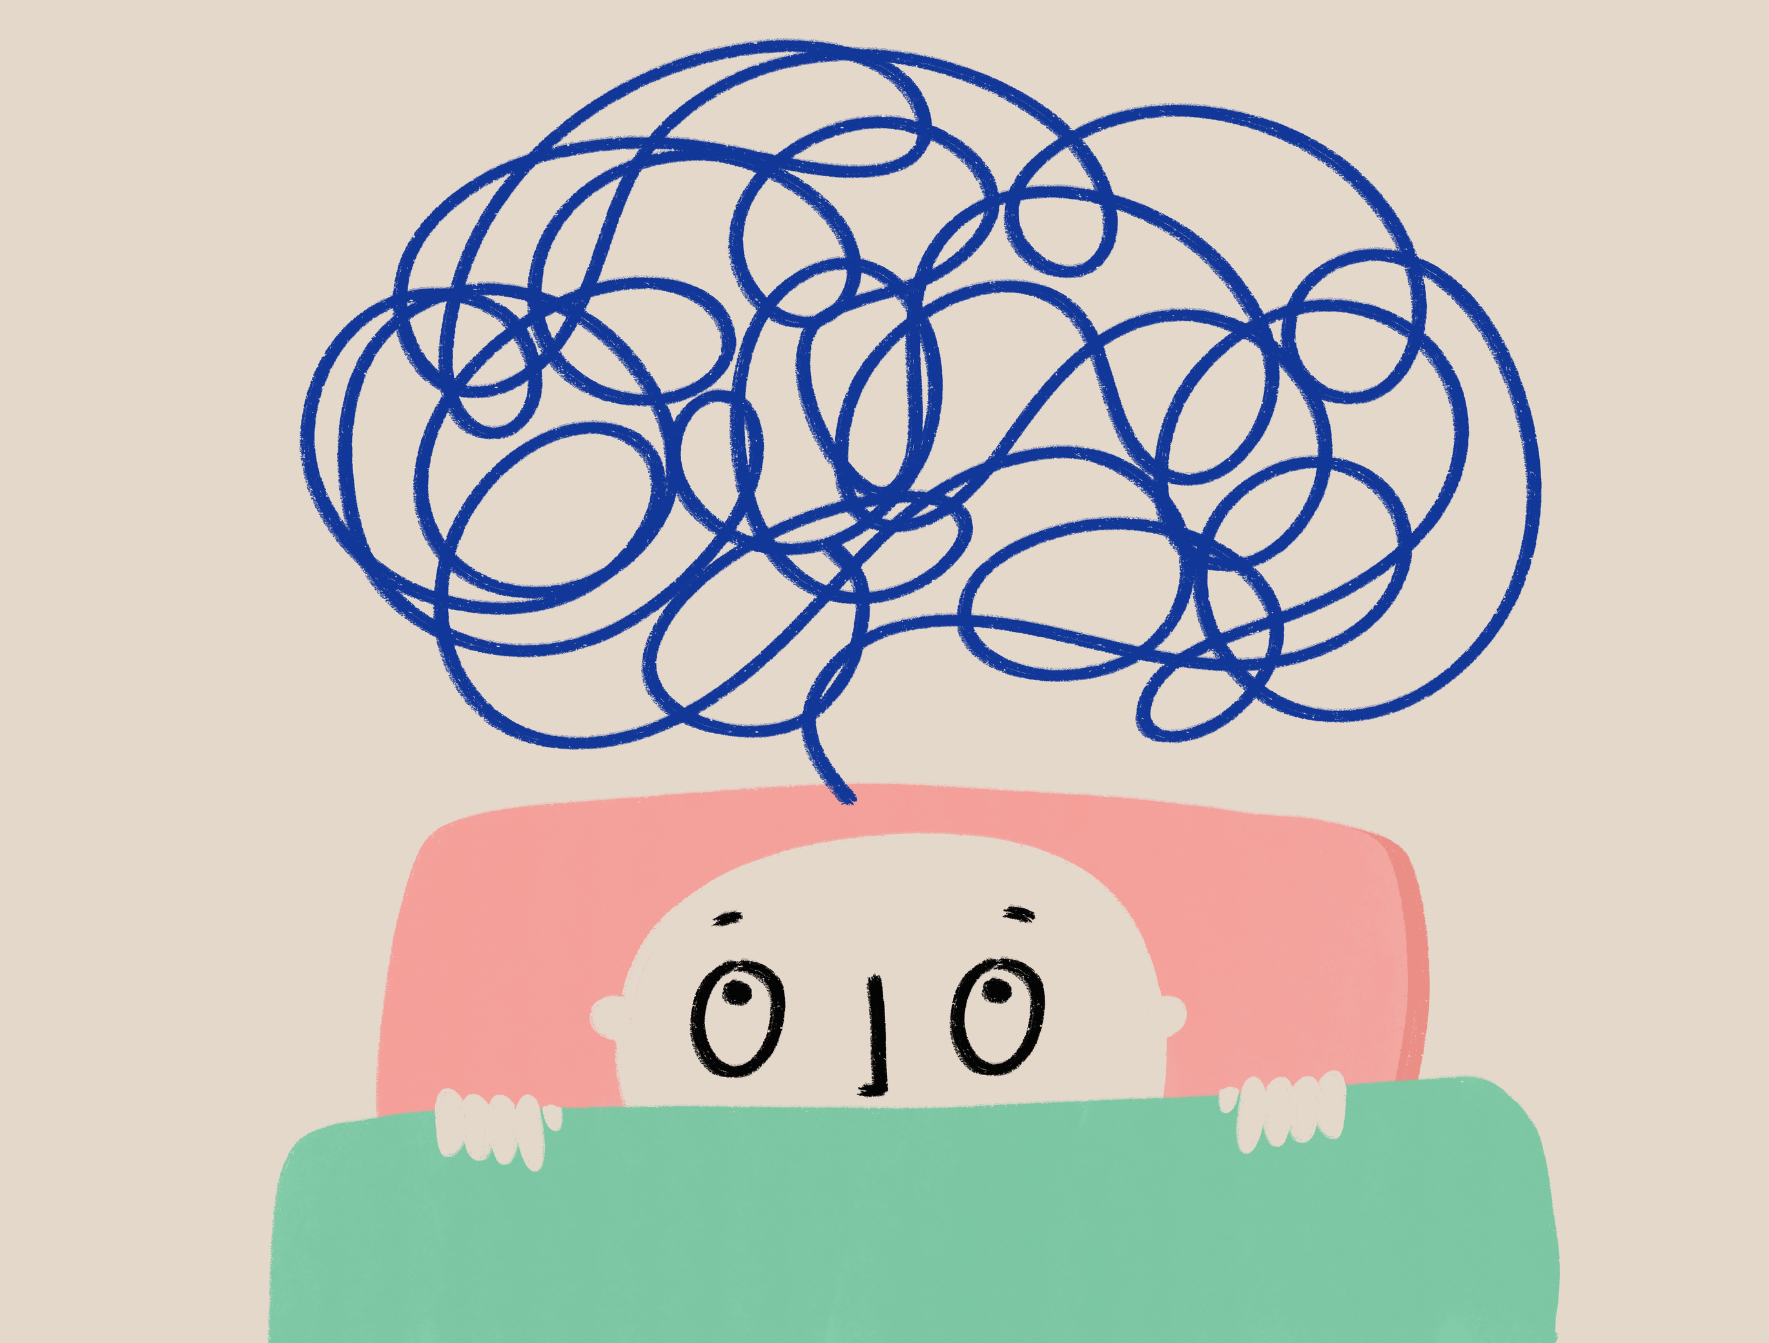
What is so good about sharing?
What is Langar? List all the ways people can give
If we just live together but don’t help each other are we still a community?
Who or what were your strongest influences on your sphere of influence?
What have you learnt today?
Why is it good to take a turn to serve others? How does this show equality in a community?

Slide 33
Sikh: Sewa
Within the Sikh faith they believe in 3 types of service/sewa.
We are now going to explore Sewa in more depth.
Questions to consider:
How did the Gurus/Sikhs support the community in the examples we have seen?
Can you match these examples to the 3 types of service on the following slide?

Slide 34
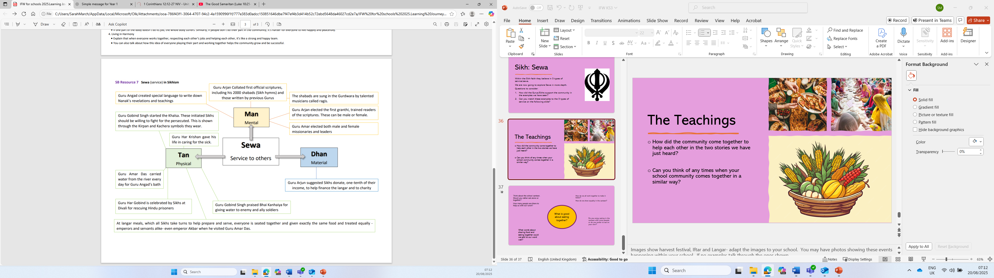
Notes:
Ref: SB resource

Slide 35

The Power of Synergy
Centuries ago, within China, there was a Buddhist monastery. This monastery housed 99 monks, who were led by a Head Monk. These monks led a life of seclusion, chastity and penance. They sustained themselves by seeking food as alms from people in the neighbouring villages. Other than food, another basic necessity is drinking water. There was a fresh water pond at a distance from the monastery. Those were days, when there were no water pipes or borewells. Each day, a set of monks spent a few hours collecting water from the pond in earthen pots and transporting it to the monastery. There was a man-made tank, not too large, within the premises in which this water was stored for the 100 monks to drink from through the day.
What does synergy mean?
Why is this showing how everyone contributing/serving in a community helps?
Notes:
Read through the story with the pupils
Ref: The Power Of Synergy - Eclatmax | Professional Development Solutions

Slide 36
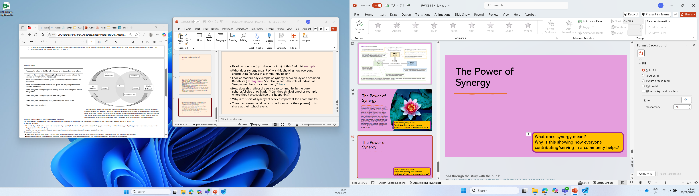
The diagram shows a modern day example of synergy between lay and ordained Buddhists
Why is this sort of synergy of service important for a community?
Notes:
Ref: SB
Responses to be recorded to refer back to

Slide 37
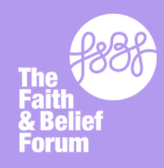
Interfaith Week Poetry Competition 2025
This year we are inviting you to take part in our Interfaith week poetry competition.
We are asking you to write a poem, no more than 30 lines in any style on the theme Community: Together we Serve
We want to see you using the key concepts and perspectives from the IFW session reflected in your work.
Your teacher will judge a Key Stage 3 and Key Stage 4 winner in school; the winner will then be sent to the Interfaith Week team to judge nationally.
There will be lots of exciting prizes and certificates for individuals and the school.
Further information available from your teachers.
Closing date 28th November
www.ifw4schools.co.uk

