Slide 1

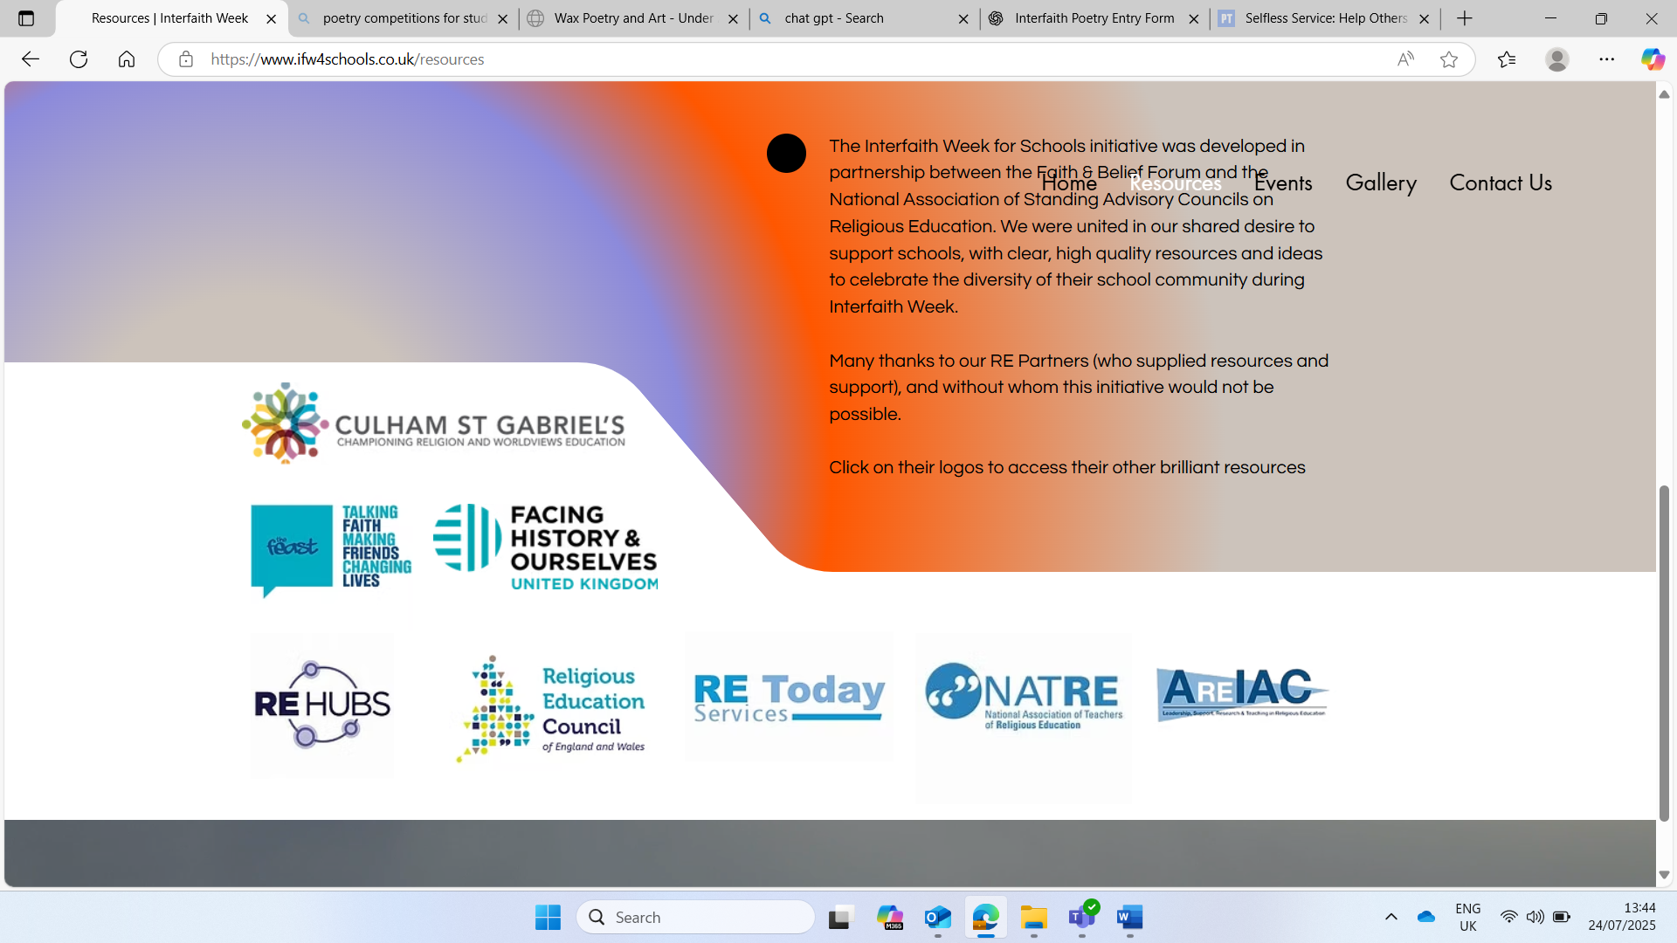

Interfaith Week 2025
Community: Together We Serve
EY/KS1
Introduction
Notes:
This week is Interfaith week, a time when we learn about how people of different religions and beliefs can be friends, work together and help others. This year's theme is Community: Together we Serve, this means helping others and making our community a kinder place, together! We will be looking at people from different faiths, and those of no faith to see what they think about our theme. Throughout the week we will be engaging in Interfaith Dialogue. Interfaith means we will be looking at more than one faith and dialogue means sharing ideas. So we will be sharing ideas about community and service from different faith points of view.

Slide 2
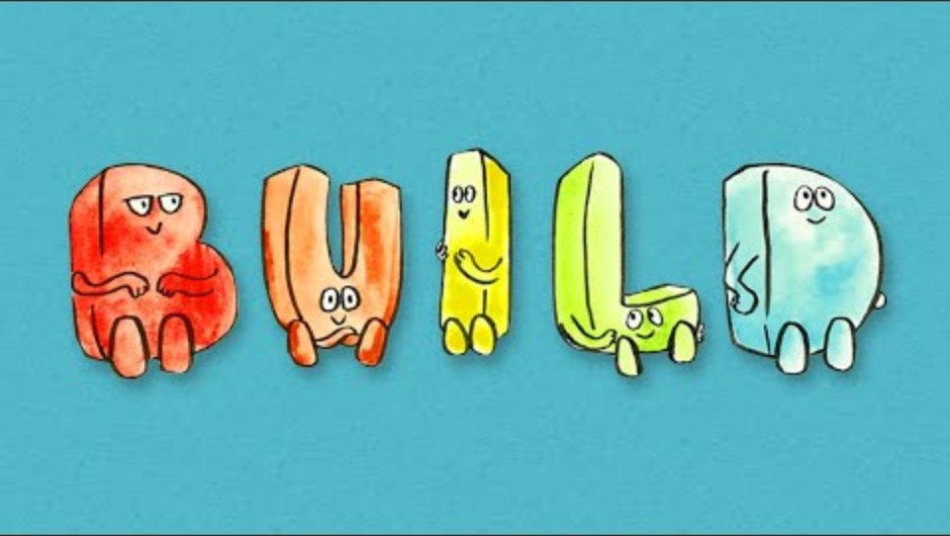
BUILD
When sharing our own faiths and beliefs, it’s important to agree on some ground rules. This helps make sure that everyone feels comfortable, respected, and able to speak in a brave and safe space. Watch the following clip to see how we can create this kind of space in our school.
Notes:
Ref: Faith and Belief Forum

Slide 3

1. What does community mean?
Notes:
Ask the pupils for some initial answers to this question, do they know the word? What does it mean to them?

Slide 4

Hands up if you….
Are in X school
Dislike Chocolate
Like playing football
Are in X class
Like eating bacon
Have ever been to the beach
Like playing computer games
Notes:
Adapt X to relevant information

Slide 5
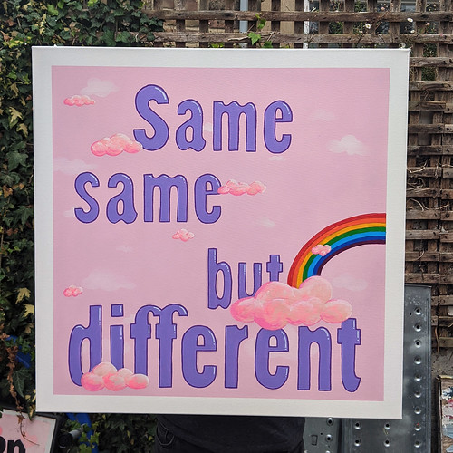
Does it matter?
Does it matter if didn’t all say yes to all questions?
What did we all say ‘yes’ to?
What do we all have in common?
Would other people in our school all have these in common?
Would people in X area have all these in common?
This Photo by Unknown Author is licensed under CC BY-NC
Notes:
Adapt the X to make relevant to your school.
Give the class one post it note each and ask them to write down what do they all have in common. Add the information to a class word wall someone in the room. Discuss the words they added. Emphasise the point that although we are all in the same school and live in the same area we have many differences. We don’t have to all be the same to get along. Ask them to consider what the biggest difference they have with their best friend is, does it affect or change your friendship with them?

Slide 6
What does community mean?
Unity: means ‘one’
COM: means ‘with’
COMMUNITY
What do you think this means?
How are we all one community?
How does it feel to be a part in our community?
What might be good about being part of a community?
Notes:
Explain the etymology of the word community Com: with and Unity: One
Ask the pupils to write down on a post it note what is good about being part of a community and add it to the word wall you have started to create.

Slide 7

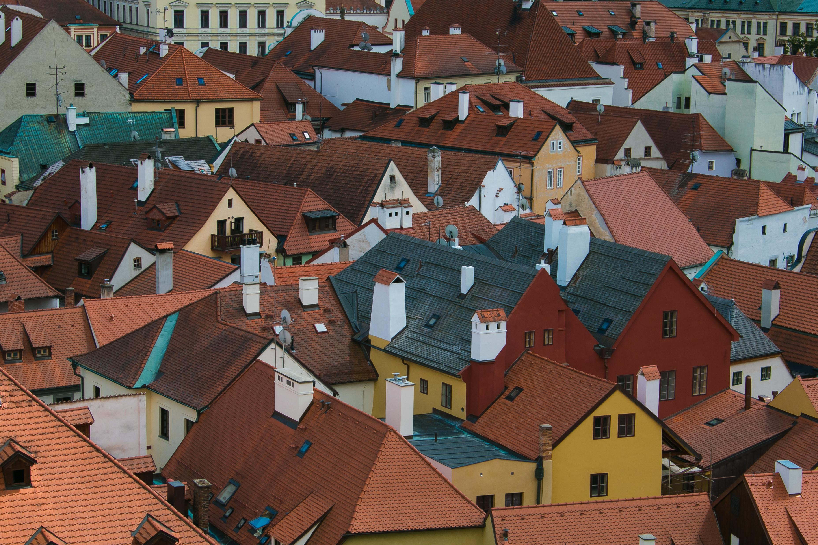

Why might it be good to think together as a community?
Notes:
Ask the pupils the question and get some answers using the images to help generate some thoughts.
Some suggestions for answers: Sharing different Points of view: Everyone brings unique experiences, knowledge, and ideas. When people think together, the community can see problems and solutions from many angles.
Stronger Solutions: Working as a group often leads to more creative and practical answers than what one person might come up with alone.
Builds Trust: When people are listened to and included, they feel valued and connected, which strengthens the community.
Learning from Each Other: Helps people understand new viewpoints, challenge assumptions, and grow their knowledge.
Fairness and Inclusion: Decisions made together are more likely to reflect the needs of everyone, not just a few.
Responsibility: Thinking as a community gives people a sense of responsibility, which encourages action and cooperation.
Explain that in the next session we will be looking and listening to others about how they serve their communities, so its important to remember the BUILD principles.

Slide 8

2. What do we all need in a community?
Notes:
Initial thoughts from the pupils

Slide 9
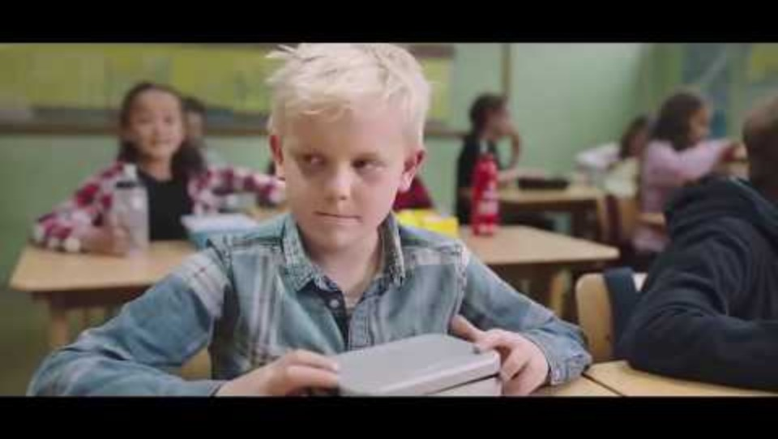
What does helping the community look like?
Notes:
Recap: they will be looking and listening to others about how they serve and help their community
Watch the video
Ref: https://www.youtube.com/watch?time_continue=1&v=ruW9GzcuFG4&embeds_referring_euri=https%3A%2F%2Fhubblecontent.osi.office.net%2F&source_ve_path=Mjg2NjY

Slide 10

What does helping the community look like?
How do you think the boy felt at the start of the video?
How does he feel at the end?
How do you think the children felt who helped him?
Why did they do it?
Add your answers to the Word Wall from last lesson

Slide 11
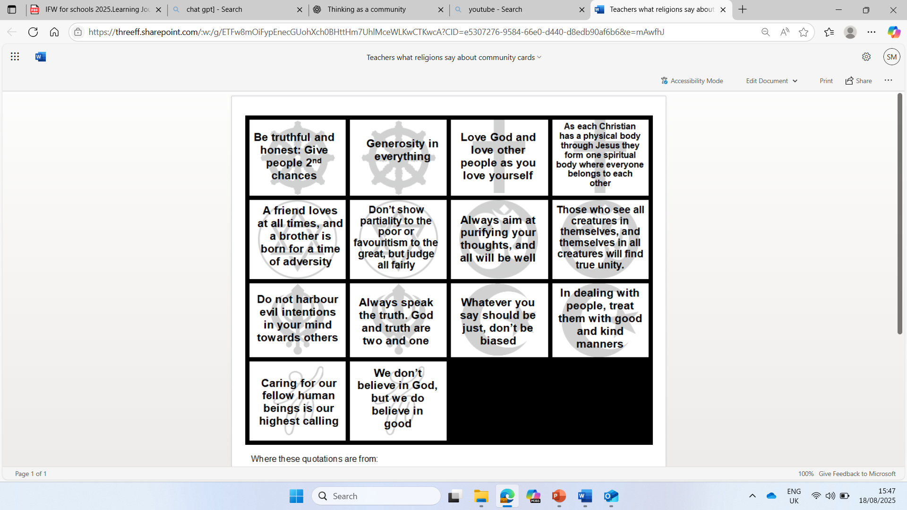
Would it be a community without kindness?
What do you think each of these world views believe about community and kindness from the quotes?
Notes:
Top left-Islam, Top right-Humanism, Bottom left – Buddhism, Bottom right – Christianity
Ref: REMatters

Slide 12
Would it be a community without kindness?
Kind manners
Generosity
Which of these words taken from the quotes on the previous slide do you think is the most important?
Why?
Love
Goodness

Slide 13
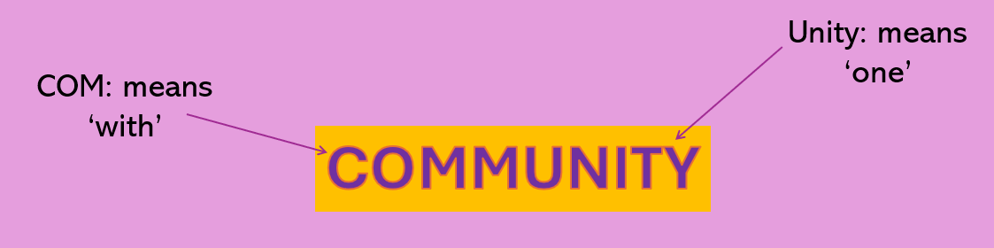
Community
Can you remember what community means?
What have you learnt today?

Slide 14
3. How can we serve our community?
Notes:
Ask the pupils for some initial answers to this question

Slide 15
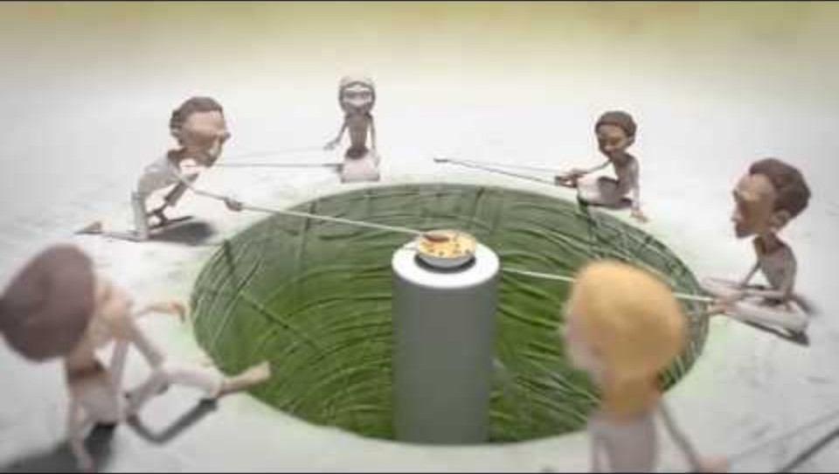
The Long Spoons
Notes:
Ref: One Human Family, Food for All

Slide 16
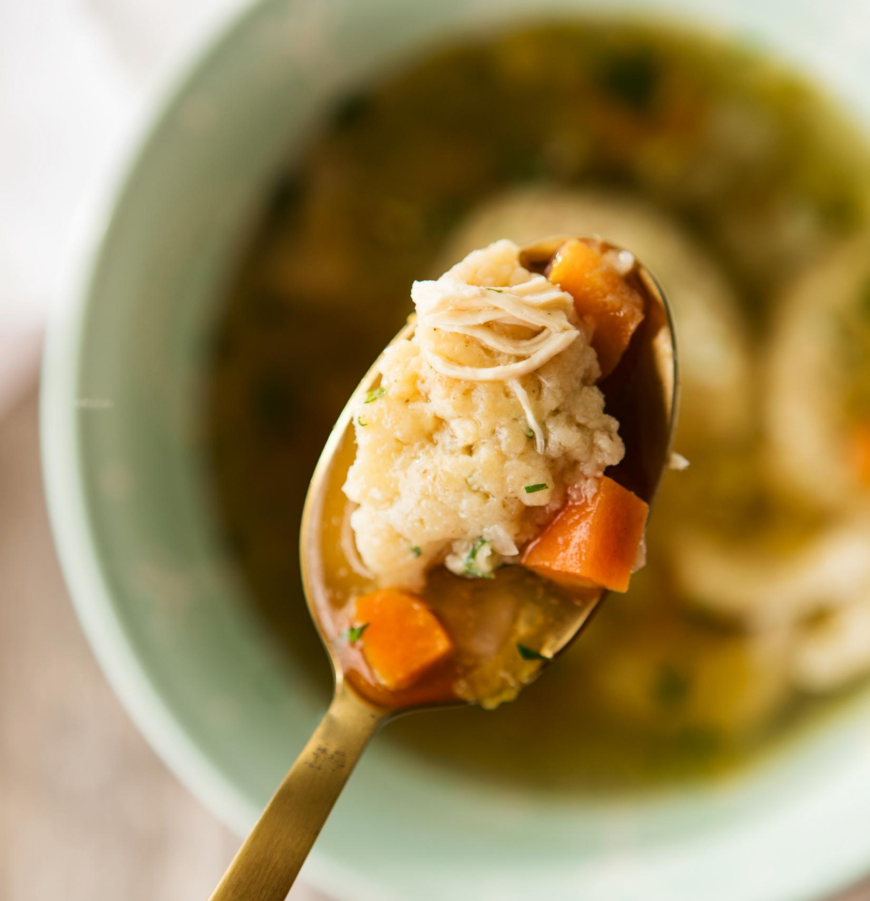
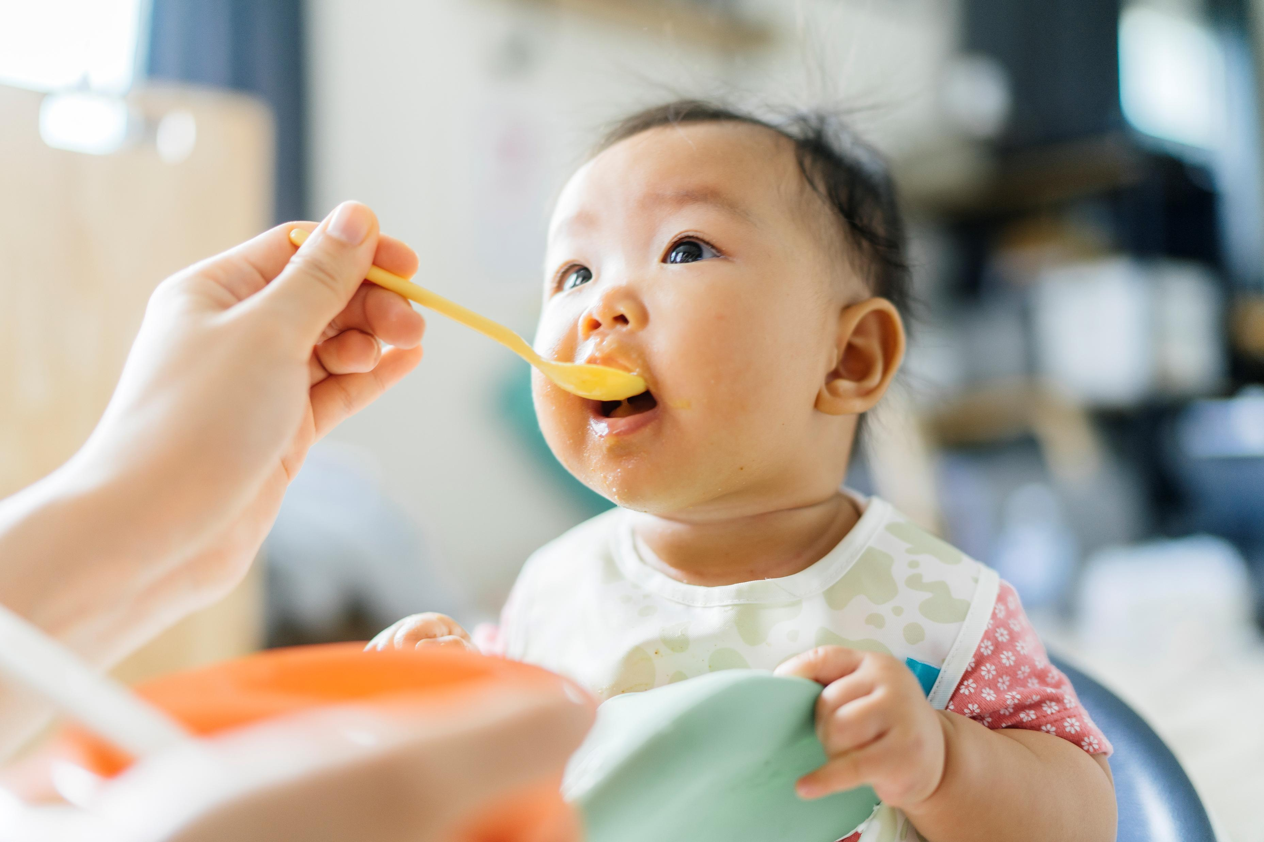
Who should we help?
At the start of the clip the community doesn’t help or serve each other. What happens because of this?
What happens at the end of the clip? How does it reflect your word wall/ideas about kindness?
Think about the word service. The people in the story served each other food, but which of the other words (from your word-wall) did this show?
Did you notice that everyone served each other – how did this show equality?
Notes:
Meaning behind the long spoons: moral of sharing, encourages the nurturing of others as a means of nurturing ourselves. It's the ethic of reciprocity — aka the Golden Rule. In the exact same setting, one group perishes and one group thrives… all based on how they treat each other.

Slide 17

What do we mean by service?
Read or watch the story of Muhammad (PBUH) and the old woman.
What acts of service or kindness did he show?
Did it mean more that it was to someone who didn’t show kindness to him at first?
Does this make a difference to the value of service/kindness that Muhammad showed?
Notes:
Ref: DC

Slide 18
Story of Prophet Muhammad (PBUH) and the Old Woman
In Makkah, the people loved and respected Muhammad (pbuh) and treated him kindly. When Allah gave him revelation and made him a prophet, the people turned against him and would try to harm him. This was because Muhammad told them to worship only Allah and they wanted to worship their stone idols. There was an old woman who would collect thorns and twigs. She would wait until Muhammad (pbuh) was coming and she then threw them in the way hoping that Muhammad (pbuh) would step on them and get hurt. She would collect these thorns everyday and wait for Muhammad (pbuh) to arrive. One day, the prophet (pbuh) was passing by and saw that the old woman had not thrown down the thorns on the road. He was worried for the old lady and asked some people where she was. They told him that the old woman was very ill and too sick to leave her bed. The Prophet (pbuh) was very concerned for the old lady and went to visit her. When he went to her house, he spoke to her in a respectful and kind manner. He spoke to her politely and said some kind words before he left her house. The woman was very surprised to meet such a respectful man. She felt ashamed that she had been so cruel to him over all this time. She decided that Muhammad (pbuh) was not a bad person like people had told her but was a kind and honest gentleman. From that day on she never tried to hurt the prophet (pbuh) in any way.

Slide 19
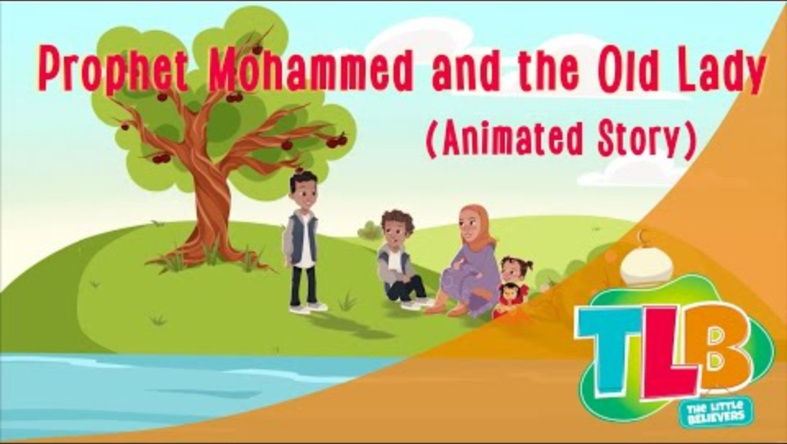
Notes:
The Prophet was kind to everyone. Even when an old lady was unkind to him, he did not get angry. He helped her instead. This teaches us that kindness is stronger than anger.
REF: https://www.youtube.com/watch?time_continue=1&v=QhYY9_m5uk0&embeds_referring_euri=https%3A%2F%2Fhubblecontent.osi.office.net%2F&source_ve_path=Mjg2NjY

Slide 20
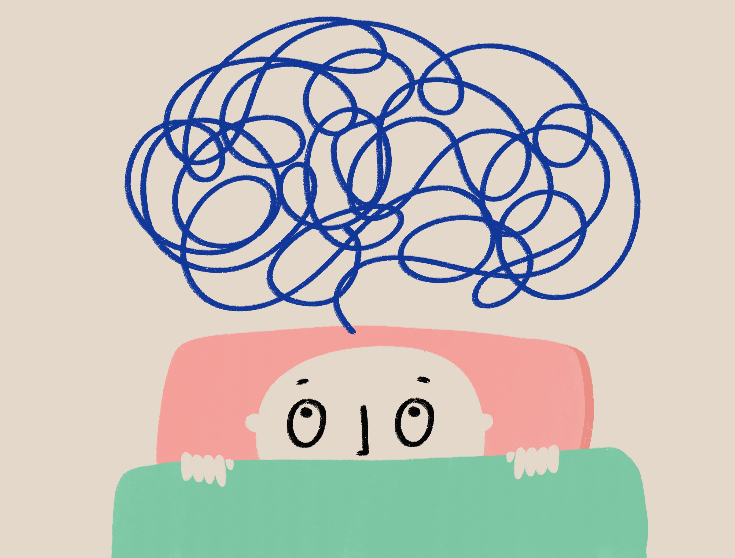
How can serving others bring us together?
Who can remember what community means?
If we just live together but don’t help each other are we still a community?
What have you learnt today?

Slide 21

How can serving others bring us together?
Reflect on the 3 key words we have looked at – service, kindness and equality. How do they fit with the idea of community?
Can you now write a sentence using one of these words?
Notes:
You can just ask the pupils to put their hands up to make the word into a sentence that you then write on the word wall

Slide 22
4. What is so good about sharing?
Notes:
Ask the pupils for some initial answers to this question

Slide 23
Sharing recap
Think back to the story of the long spoons and the clip we watched on the boy with no lunch in his lunch box.
Which words from your word wall could be seen in the clips?
How did the community help the boy with no lunch?
Up to now, we have looked at how we can help the community.
How did the clip show us what was good about being part of a community?

Slide 24
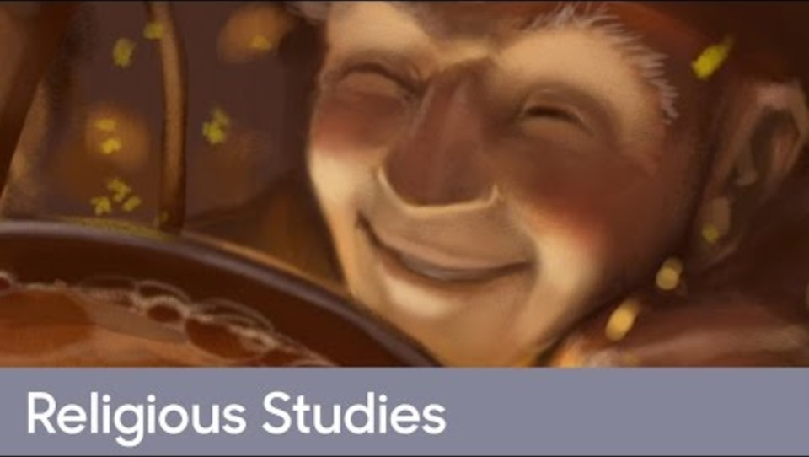
Stone Soup
Notes:
If you would rather read the story here is the link: Ref: Stone soup - BBC Teach

Slide 25
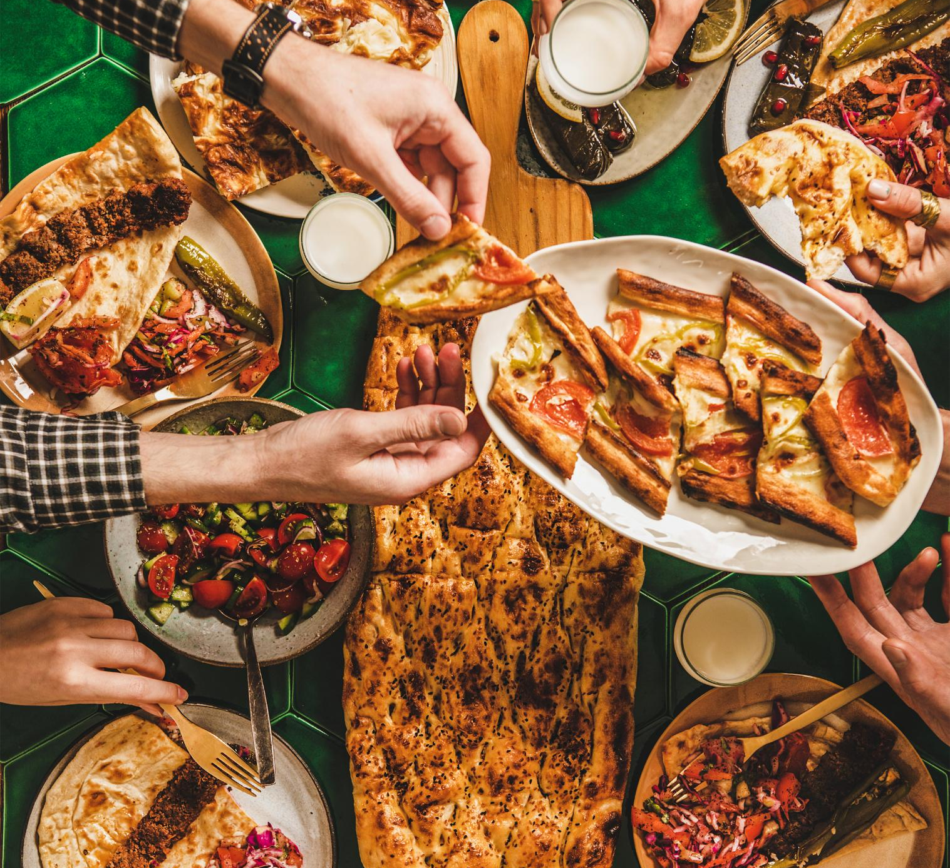
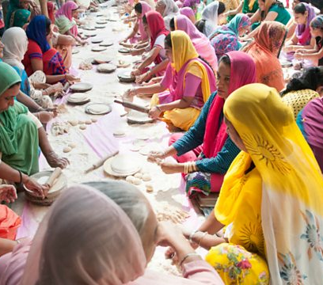
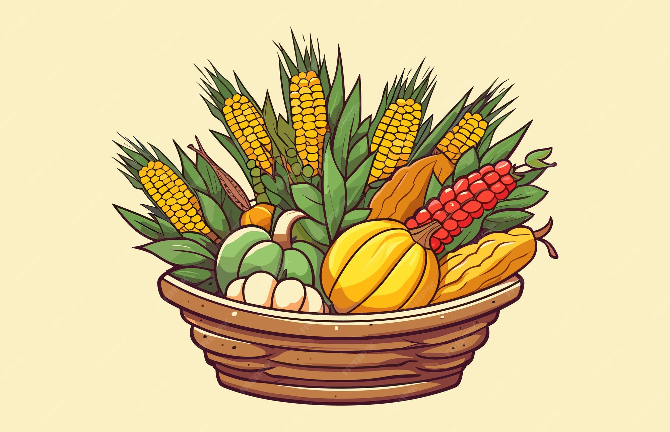
Stone Soup
How did the community come together to help each other in the story?
Why did the old man describe the stone as the ‘vital ingredient’?
What did the community learn from the old man?
Can you think of any times when your school community comes together in a similar way?
Notes:
Images show harvest festival, Iftar and Langar- adapt the images to your school. You may have photos showing these events happening within your school. If no examples talk through the ones shown.

Slide 26
Think about a nice celebration meal you have had ……
What words describe it?
If your school was to celebrate a community meal, why would you want people from the community to join you?
What is good about eating together?
Were there more people there than normal?
Does this make it more special? Why?
Words associated with food or parties

Slide 27
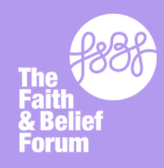
Interfaith Week Poetry Competition 2025
This year we are inviting you to take part in our Interfaith week poetry competition.
We are asking you to write a poem on the theme Community: Together we Serve
We want to see you using the key concepts and perspectives from the IFW session reflected in your work.
Your teacher will judge a Key Stage 1 and Key Stage 2 winner in school; the winner will then be sent to the Interfaith Week team to judge nationally.
There will be lots of exciting prizes and certificates for individuals and the school.
Further information available from your teachers.
Closing date 28th November
www.ifw4schools.co.uk

